Slide 1
Brand Strategy
Saratoga Peanut Butter

Slide 2
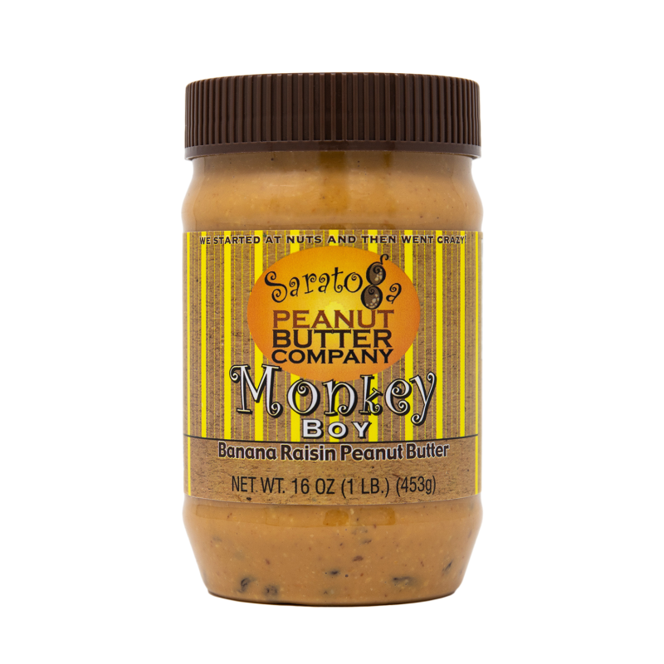
Agenda
01
Discovery
02
Strategy
03
Creative
04
Conclusion

Slide 3

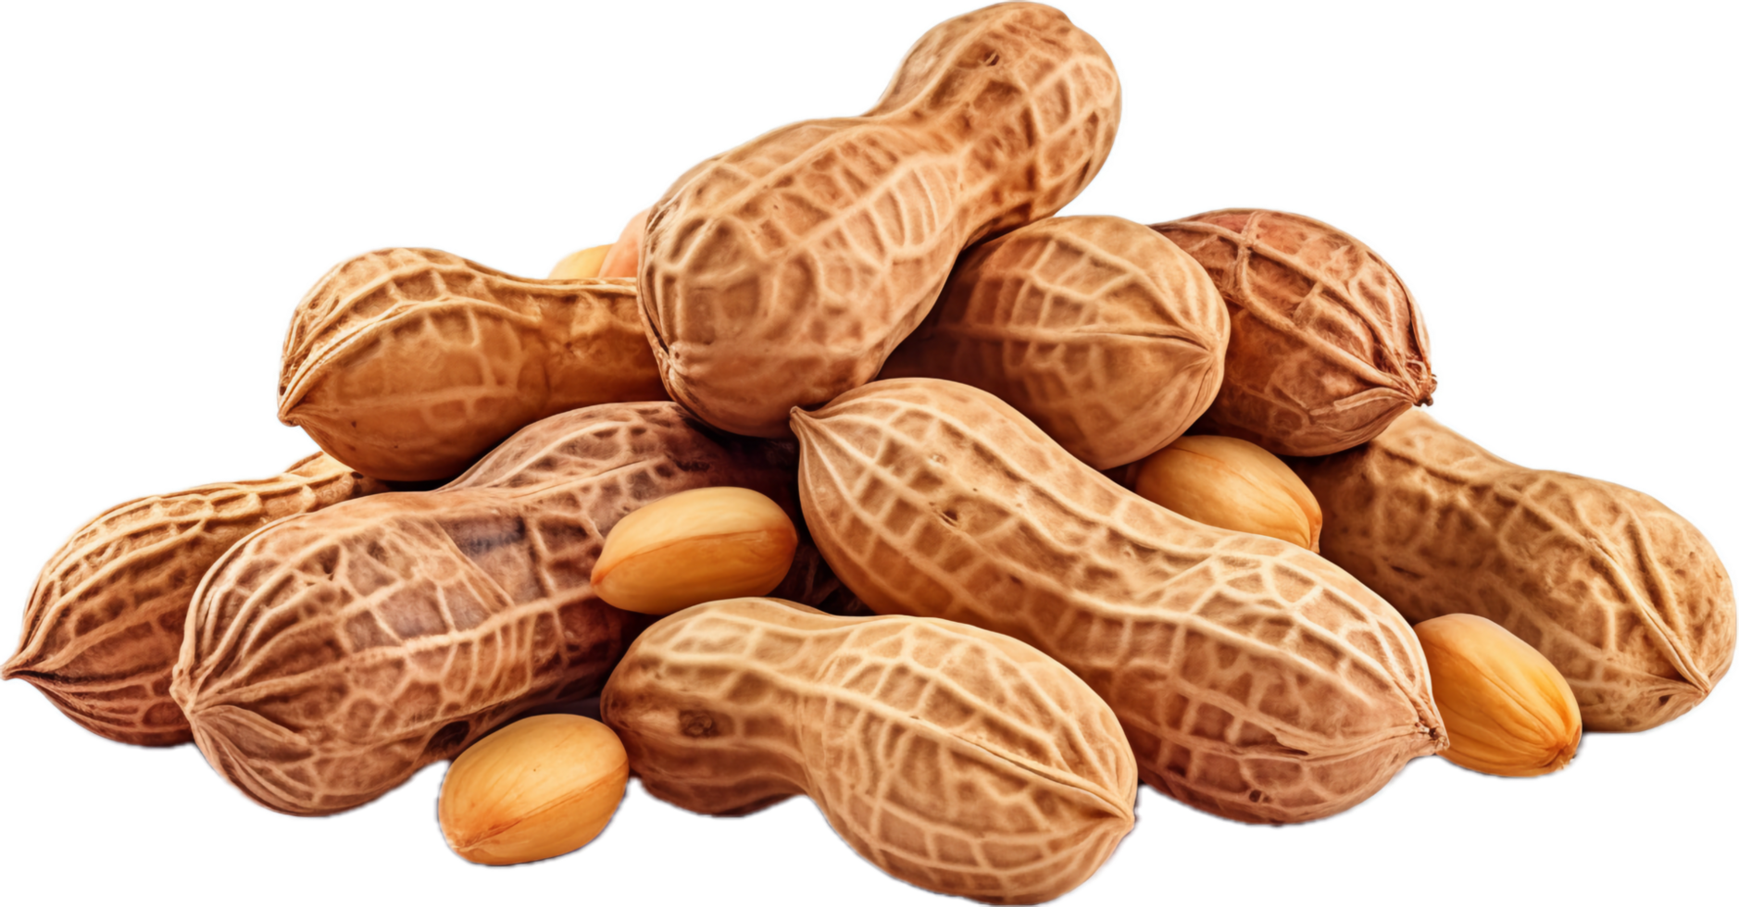
Discovery

Slide 4
Industry Analysis
Peanut Butter market value in 2023: USD 5.9 Billion
Projected revenue for 2033: USD 10.7 Billion
Growth factors: Food on the go trends, rising disposable income, increasing demand for healthier and plant based snacks
Source: Market.us
2024
Notes:
date for source

Slide 5
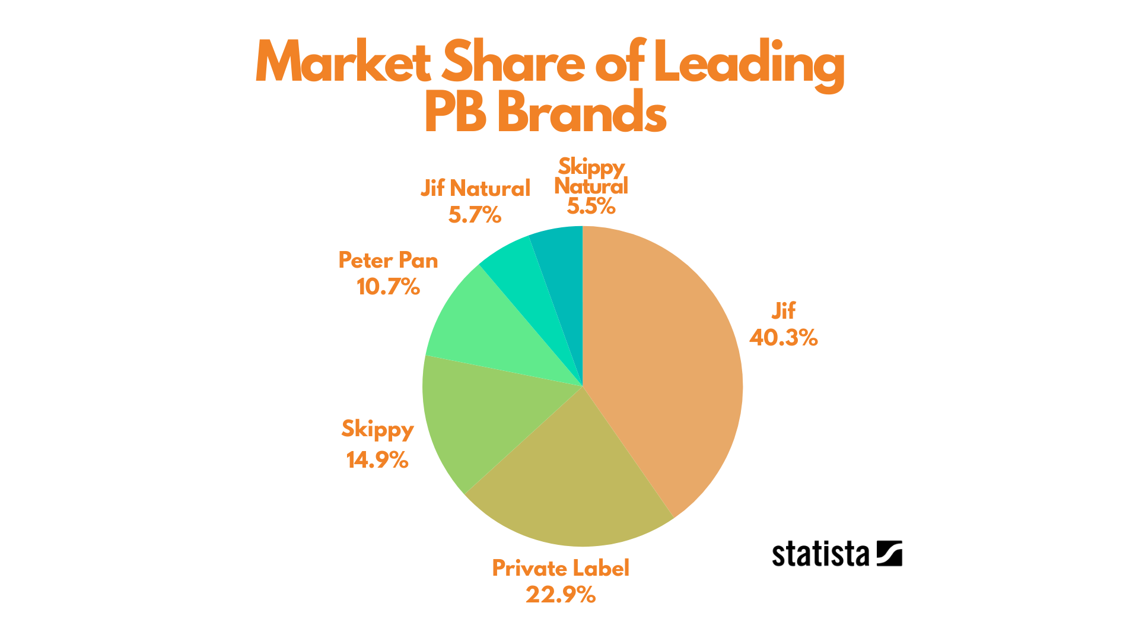
Key Players
Source: Statista

Slide 6
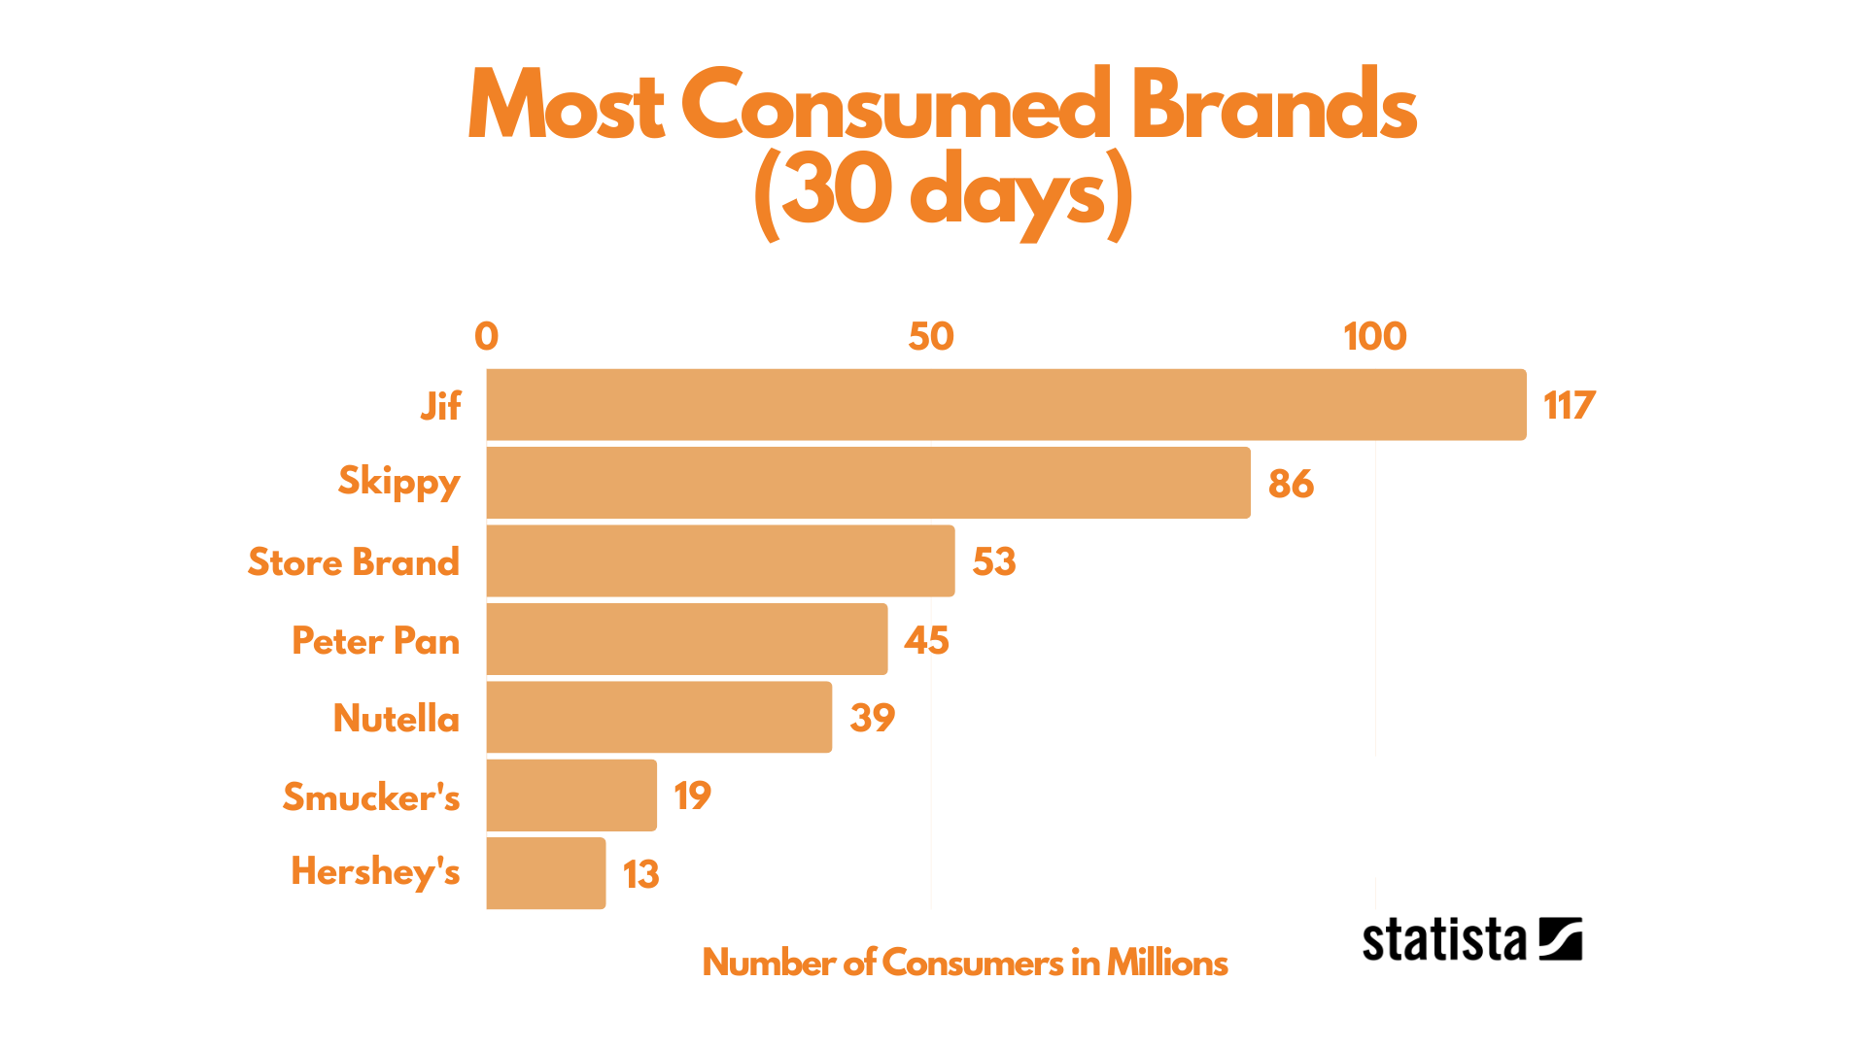
Key Players
Source: Statista

Slide 7
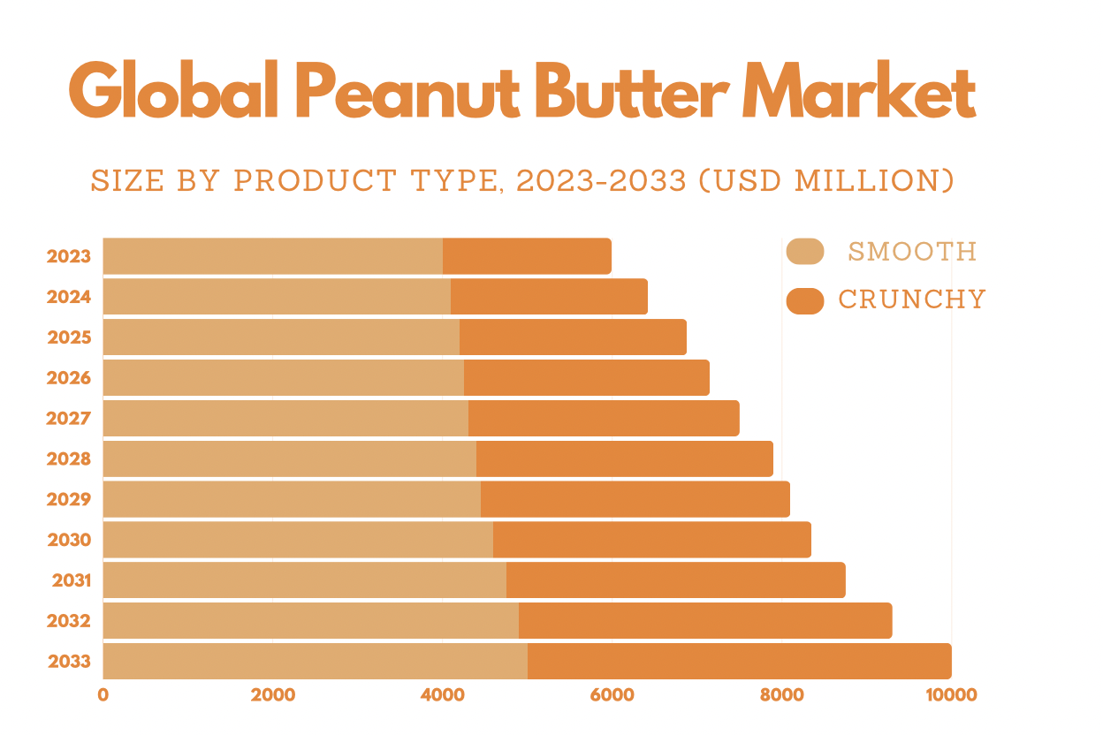
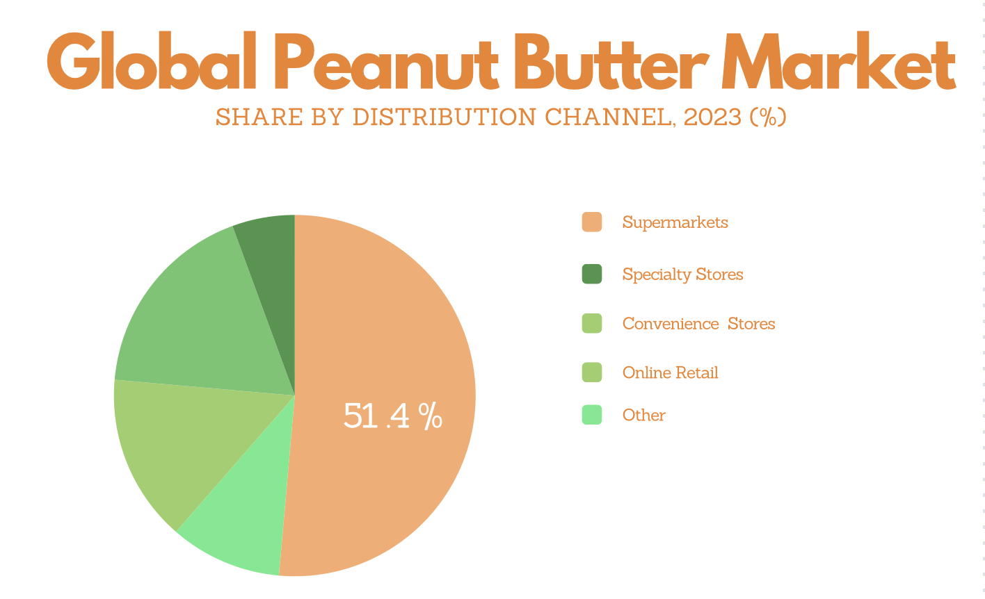
Global Market
Smooth Peanut Butter holds 58.8% of the market share
Crunchy peanut butter holds 67.3%
Supermarkets hold most of the market share at 51%
Source: Market.us
Notes:
dates

Slide 8
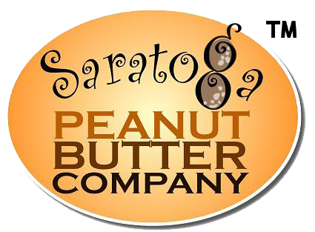
Company Insights
•Humble beginnings - started in 2005 in duplex home
•Women owned
•Sold to mom & pop shops
•Expanded to regional shows, farmers markets, mainstream grocery store chain (Hannaford)
•Began to push online sales in 2020 due to Covid

Slide 9
Company Insights
Flavor Blends
Fun, unique, versatile, stand-alone snack
Health-Focused
Non-GMO, no palm oil, no added sugar, all natural
Small Business
Small batches, fresh, caring, neighborly

Slide 10
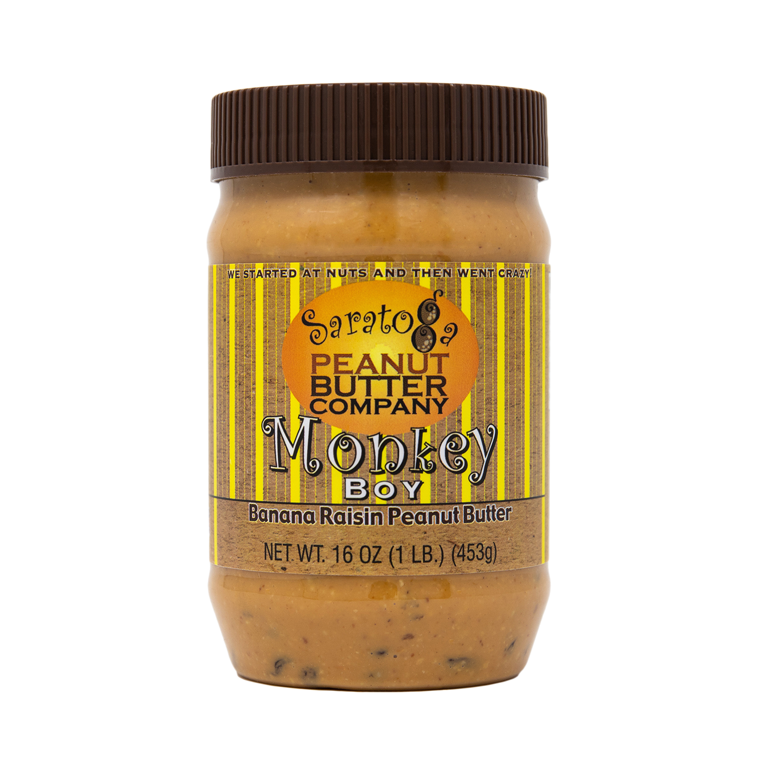
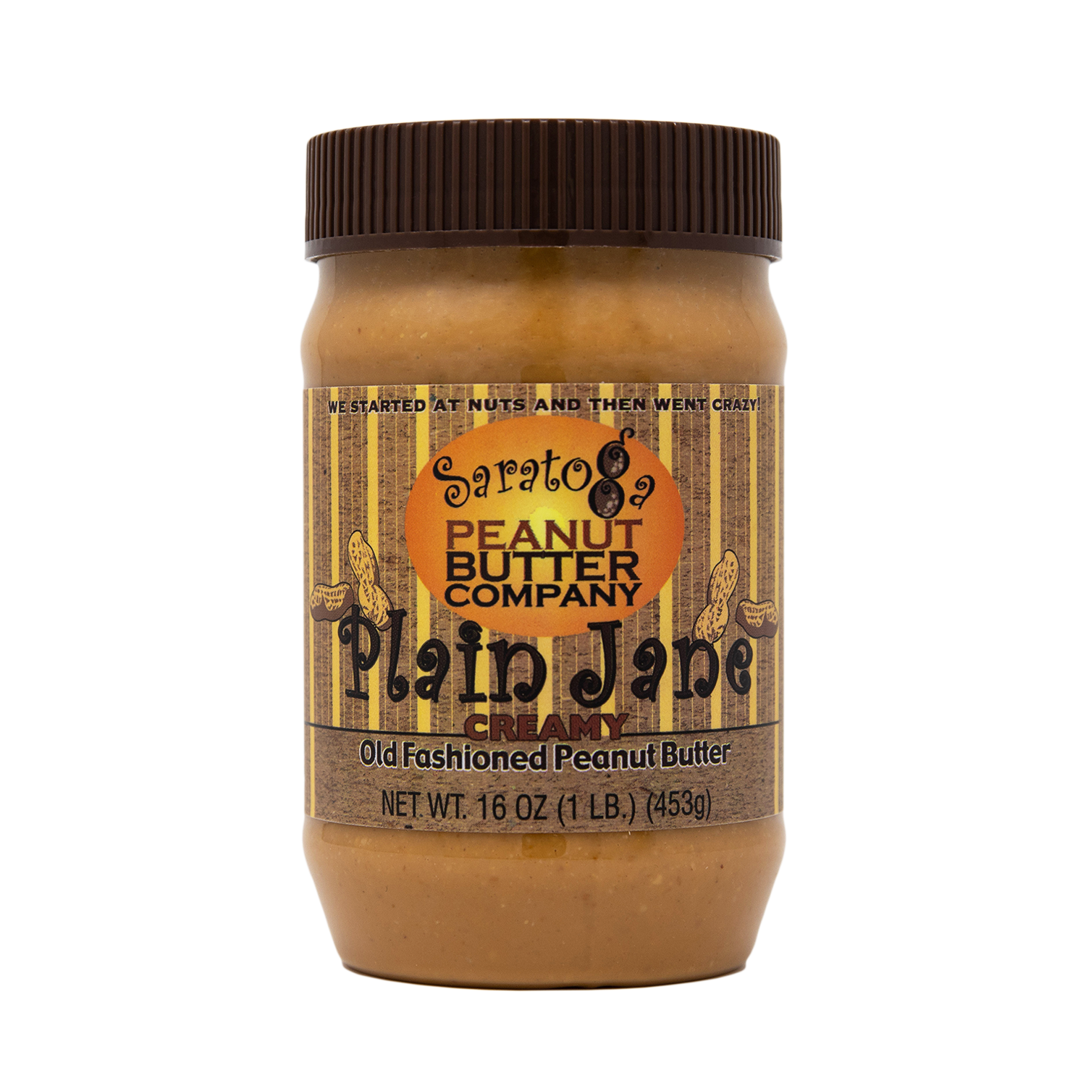
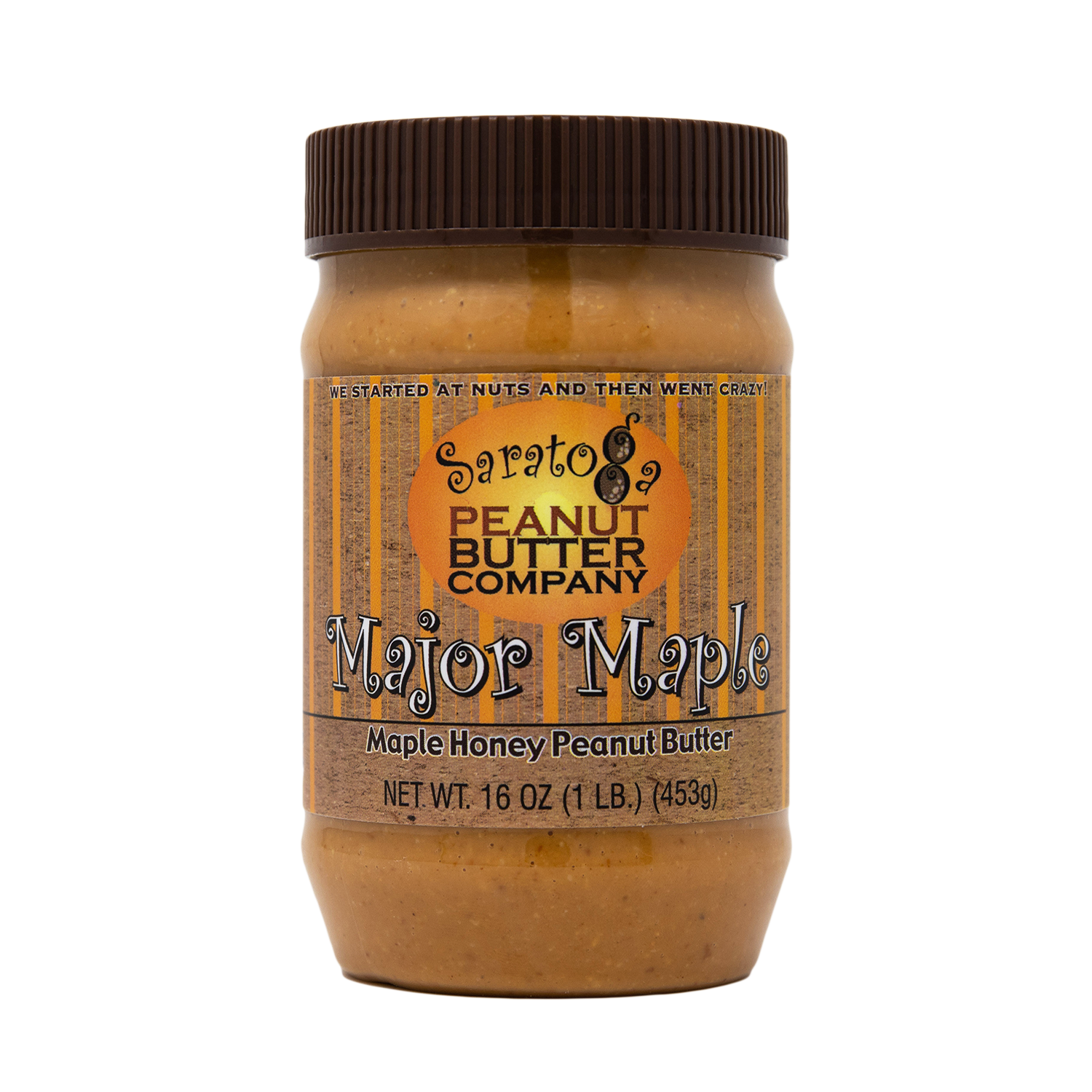
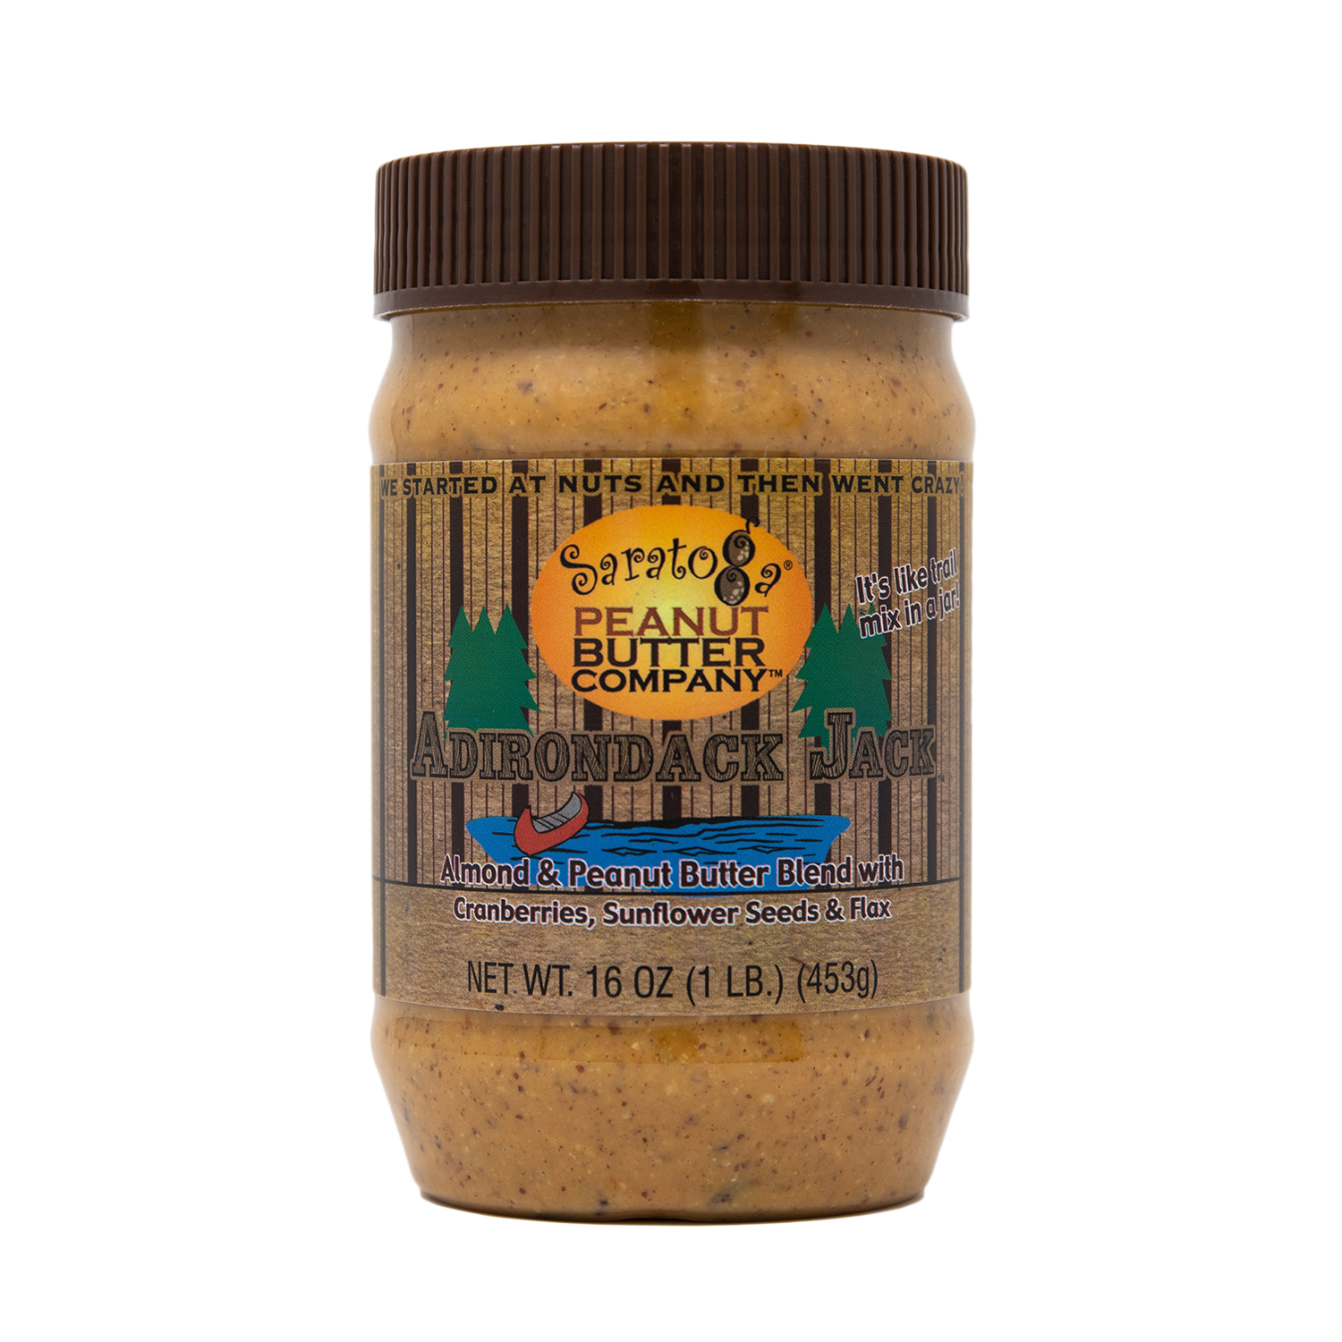
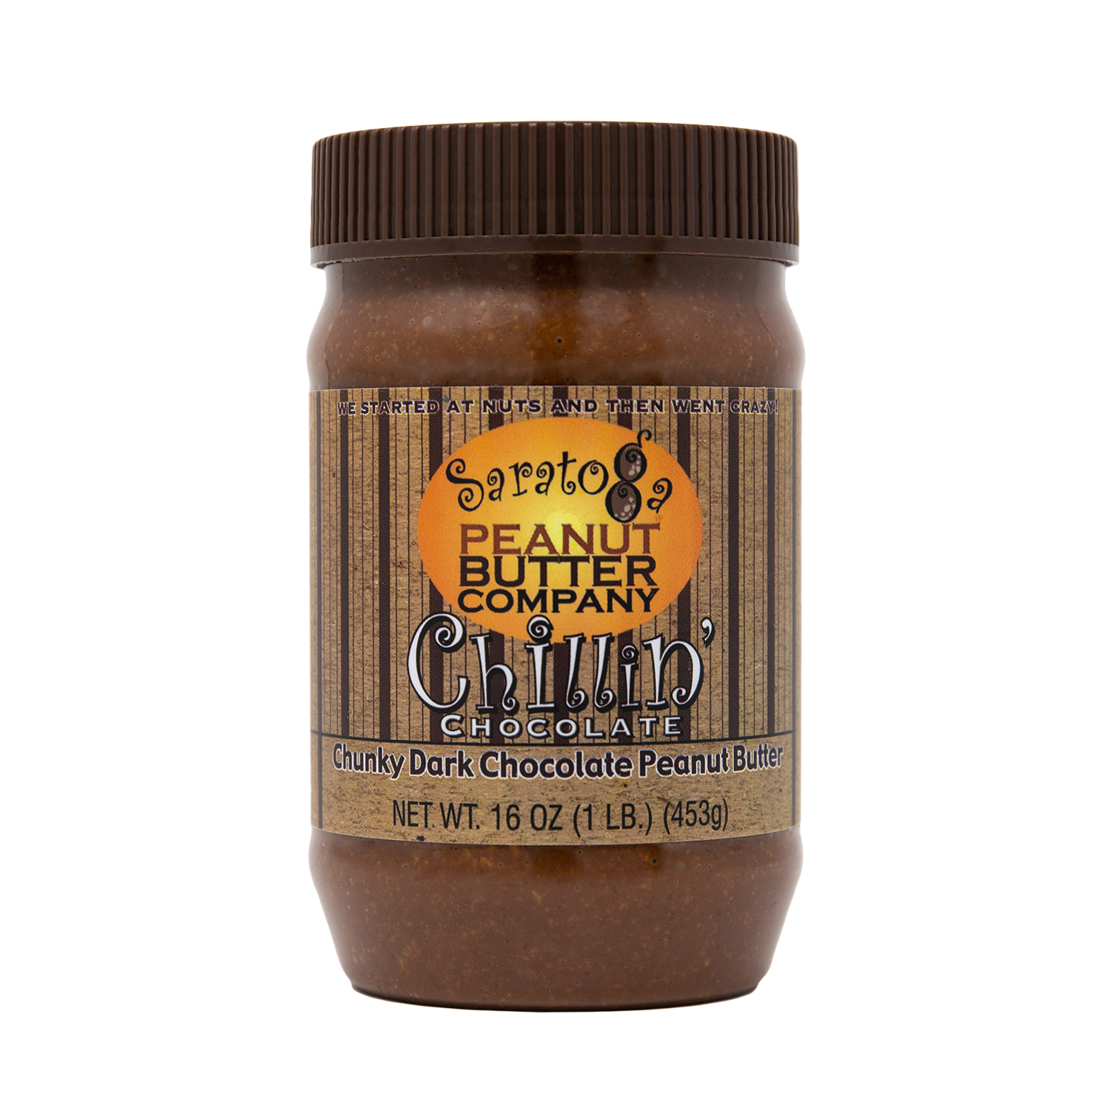
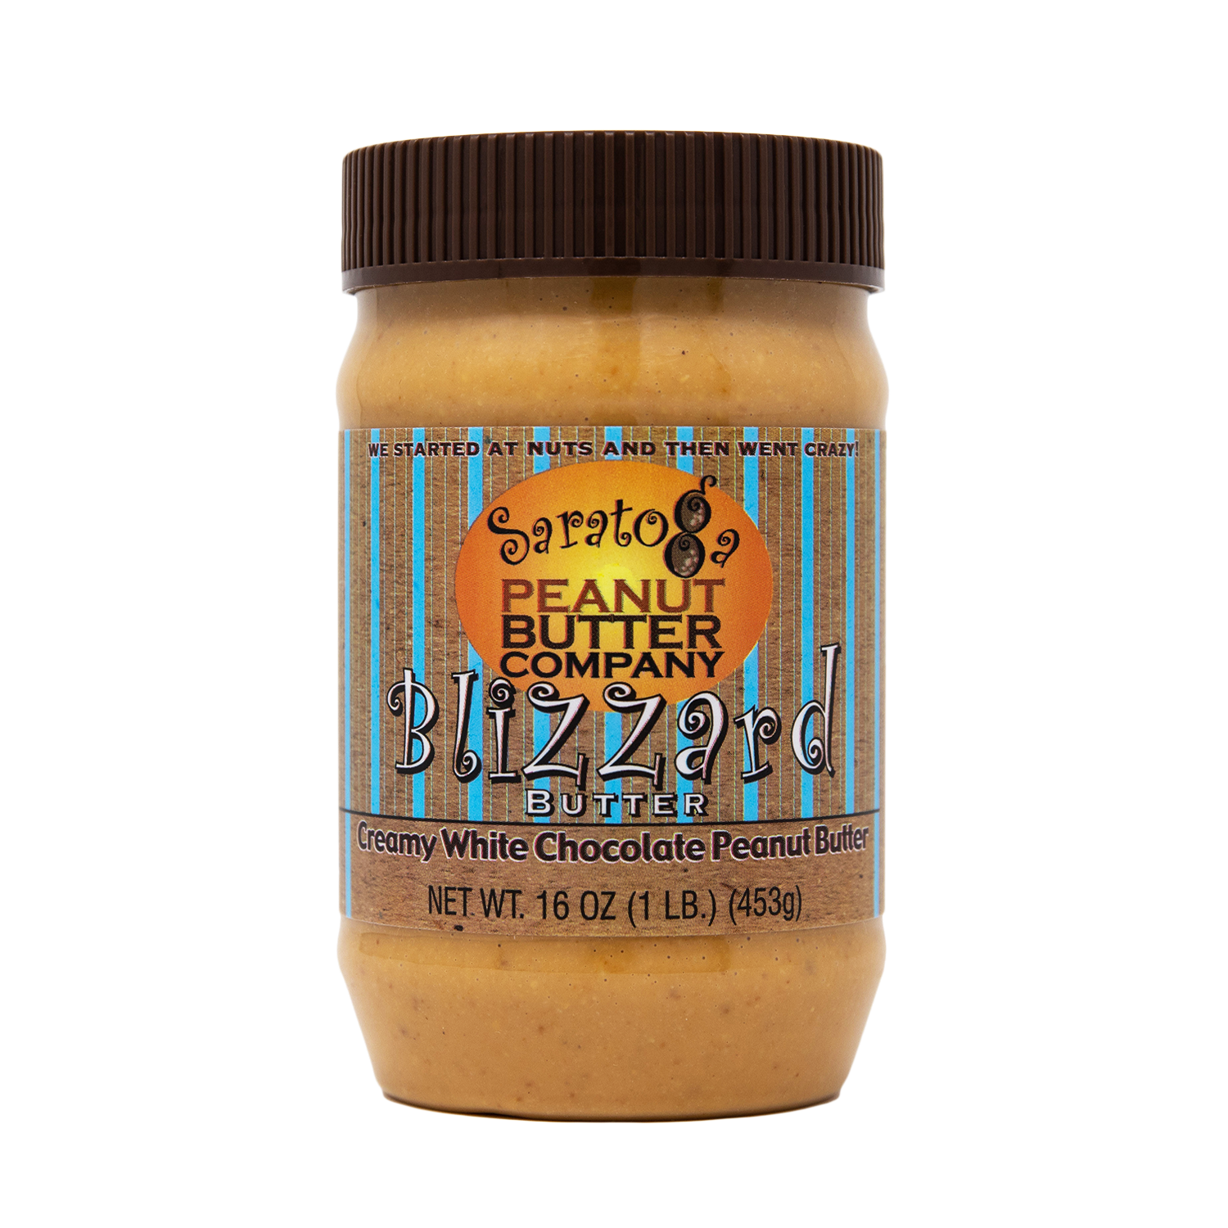
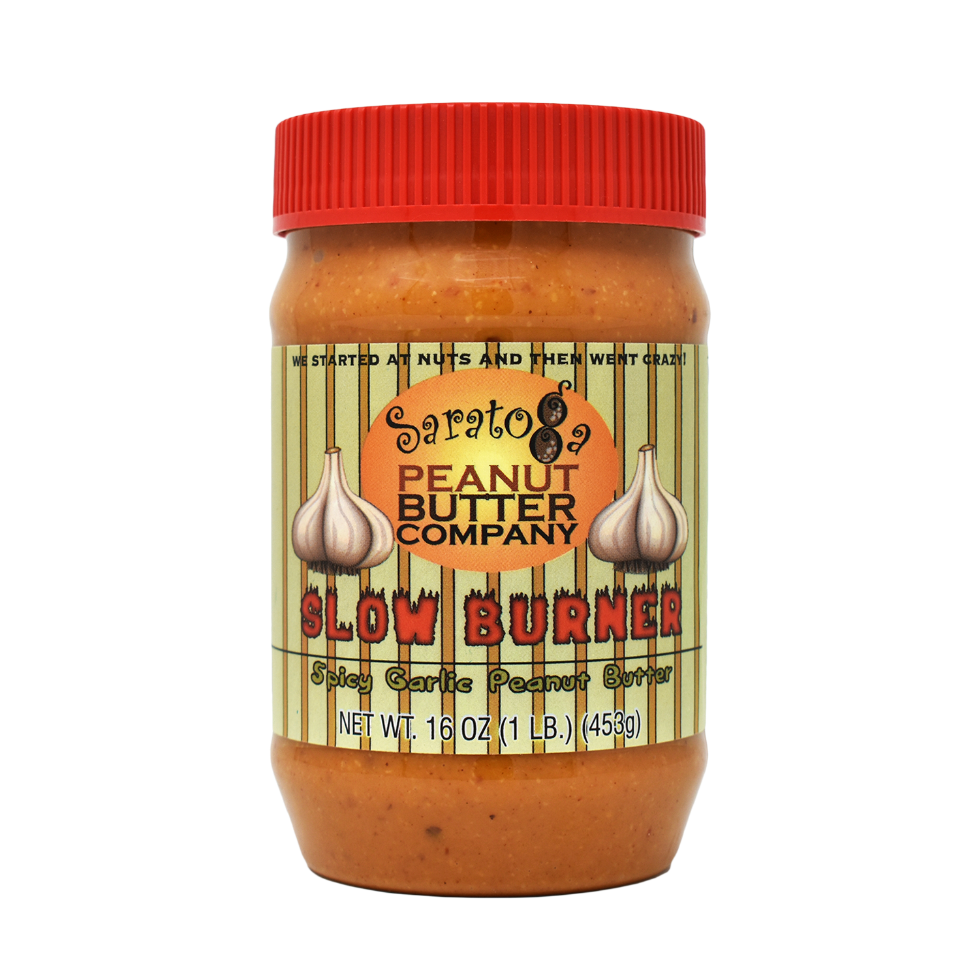
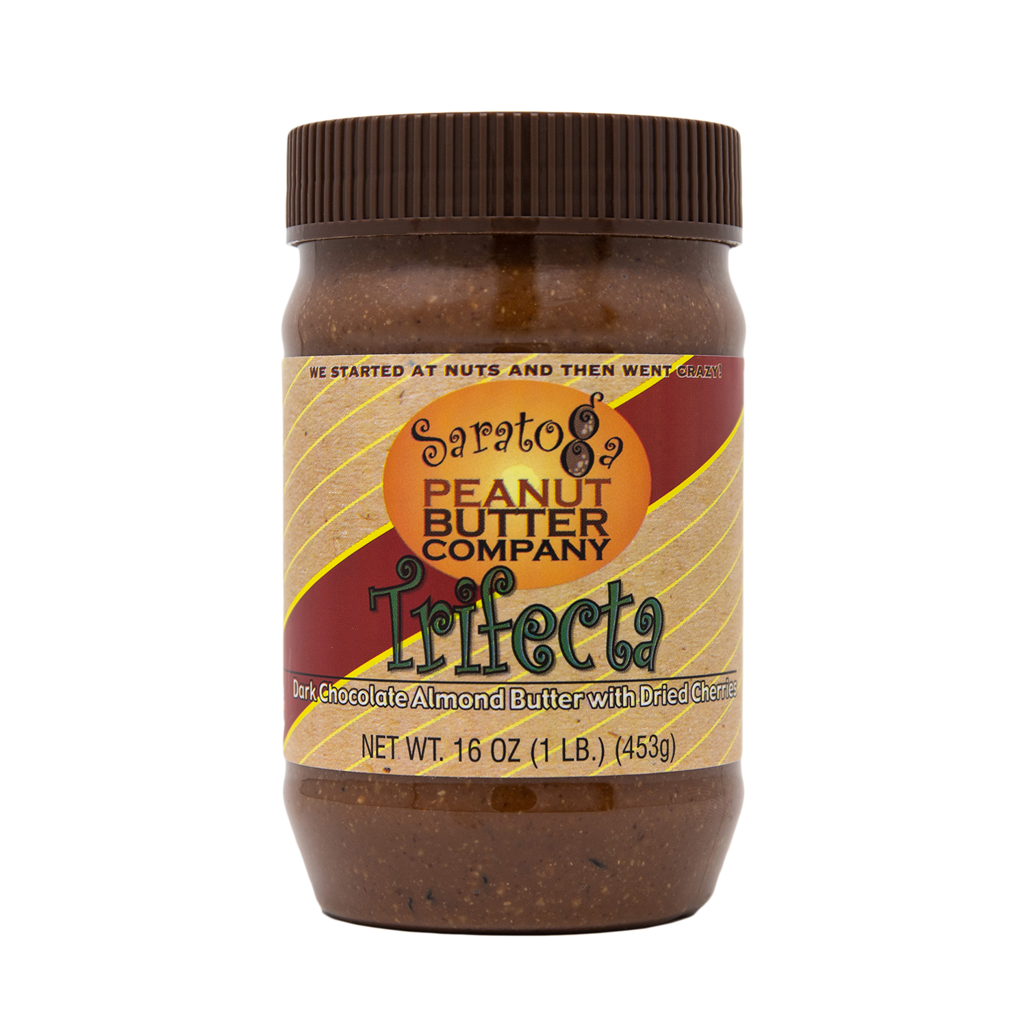
Core Product Offerings

Slide 11
Broad Cultural Context
Peanut Butter is a staple food in America, found in 90% of American households due to its convenience and nutritional value.
Peanut Butter is the most sold nut butter in the U.S with $2.2 Billion in sales, followed by almond butter at $156 million.
Large nut butter brands are losing market share due to consumers seeking organic and speciality products.
Source: Hormel Foods
Notes:
Sources

Slide 12
Consumer Preferences
People care about ingredients, but do not trust the food system
of adults say ingredients influence what they buy
say they are paying more attention to ingredients lists now than 5 years ago
said they try to choose foods made with clean ingredients
63%
62%
64%
Source: Food Information Council
Source: Food Institute
Gen Z and Millennials are
24%
2X
of adults trust information about food production and growth
more likely to care about food sourcing than boomers
Notes:
Sources for specific data

Slide 13
What are People Saying?
Why do you Buy Peanut Butter?
“It’s a convenient snack that tastes good”
“I like to cook with peanut butter”
“I just like the taste”

Slide 14

Strategy

Slide 15
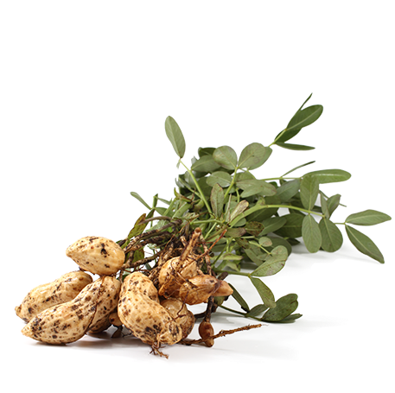
The Challenge
How do we position Saratoga Peanut Butter in order to create a strong brand identity that differentiates them in a very saturated market?

Slide 16
Target Audience - Peanut Butter
Millennials and younger
Buy based on:
convenience
comfort/nostalgia
protein source
87% Millennials and Gen-Z discover new products on mobile sites/social media
(National Peanut Board); (Attentive)

Slide 17
Target Audience - Saratoga PB
Health-conscious, nutrition-focused
Middle – Upper class (salary $60,000+) ​
Millennials; Women; people with families
85% likely to choose healthy option​
Users of Facebook, Instagram, word of mouth​
Small-business shoppers (farmers markets, local M&P shops, small online)​
(Nutritionexfoods); (pubmed)

Slide 18


Problem
Most PB and Spreads
Saratoga Peanut Butter
Additives
Fake ingredients
Artificial flavors
All-natural
Quality ingredients
Crafted with care
Small batches
Notes:
The challenge

Slide 19
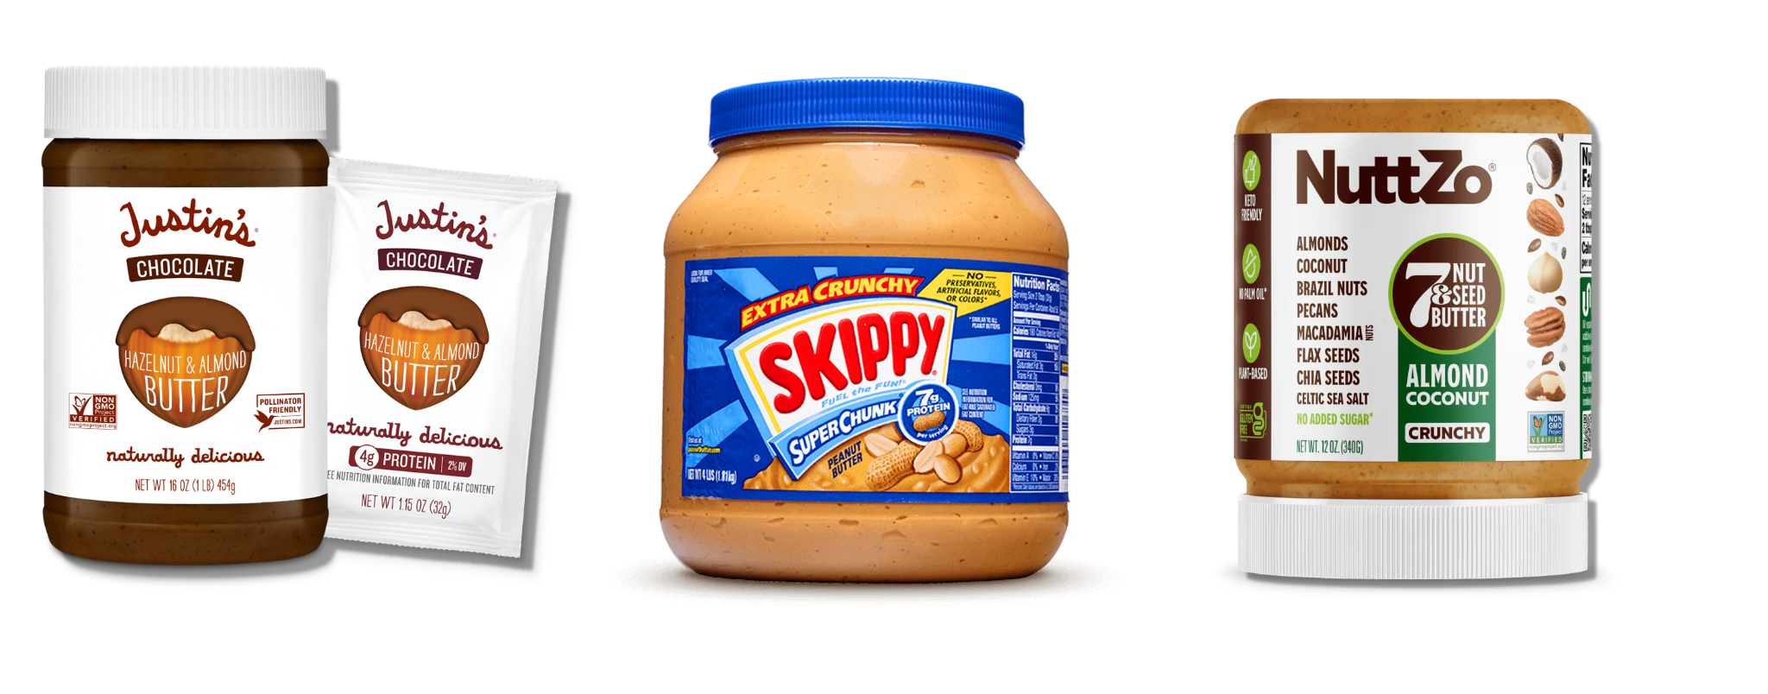
Key Competitors

Slide 20
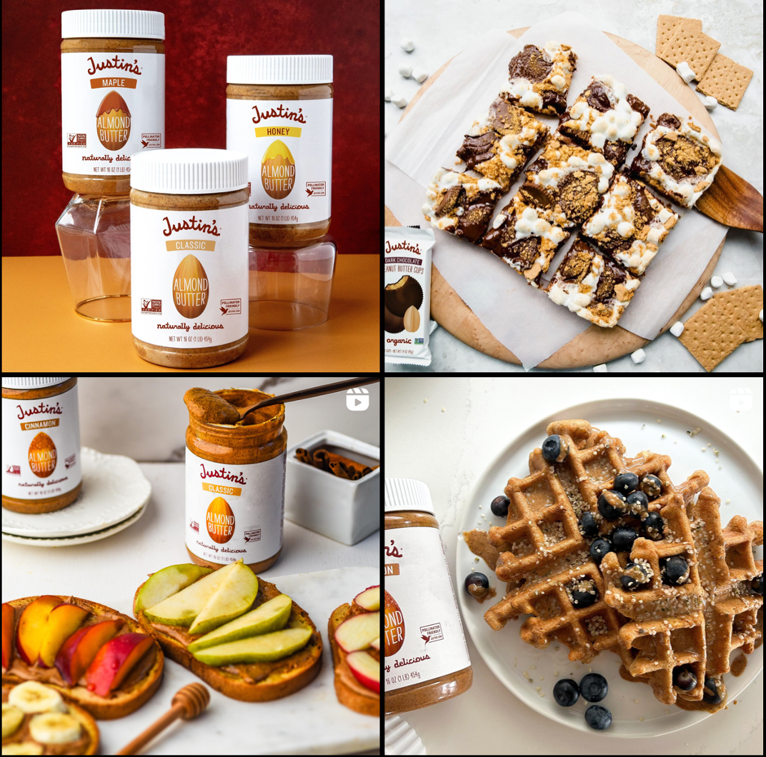
Justin’s
“Naturally delicious”
Marketed as down to earth
“Heroic Nut” central on packaging
The Nut is the focus
Brand Archetype: The Innocent
Simple
Honest
Pure

Slide 21
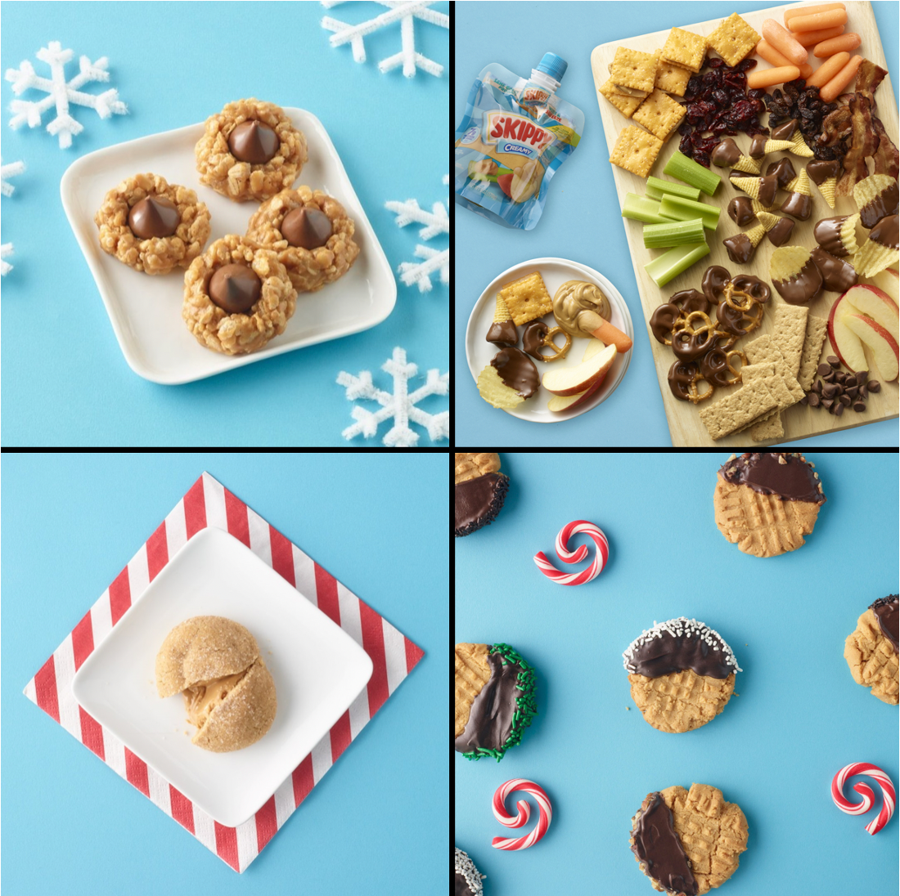
Skippy
“Go to your SKIPPY place”
Embraces the fun of peanut butter with happy vibes
Resonates with kids and families
Partner of USA Gymnastics
Inspirational, fueling
Brand archetype: Jester
Fun-loving
Happy
Entertaining

Slide 22
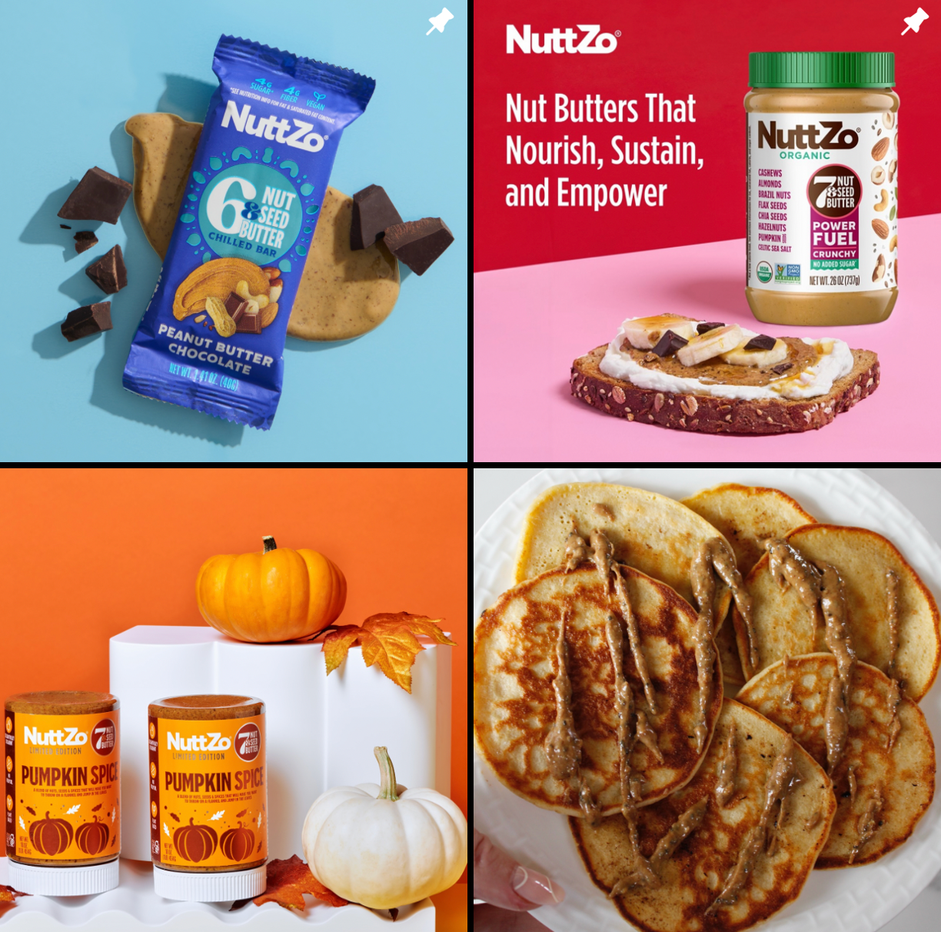
NuttZo
“Lets live bold and make a difference”
The upgraded nut butter
Nourishing and sustaining
Inspires positive change through health
Archetype: Magician
Transformative
Reinformed
Visionary

Slide 23

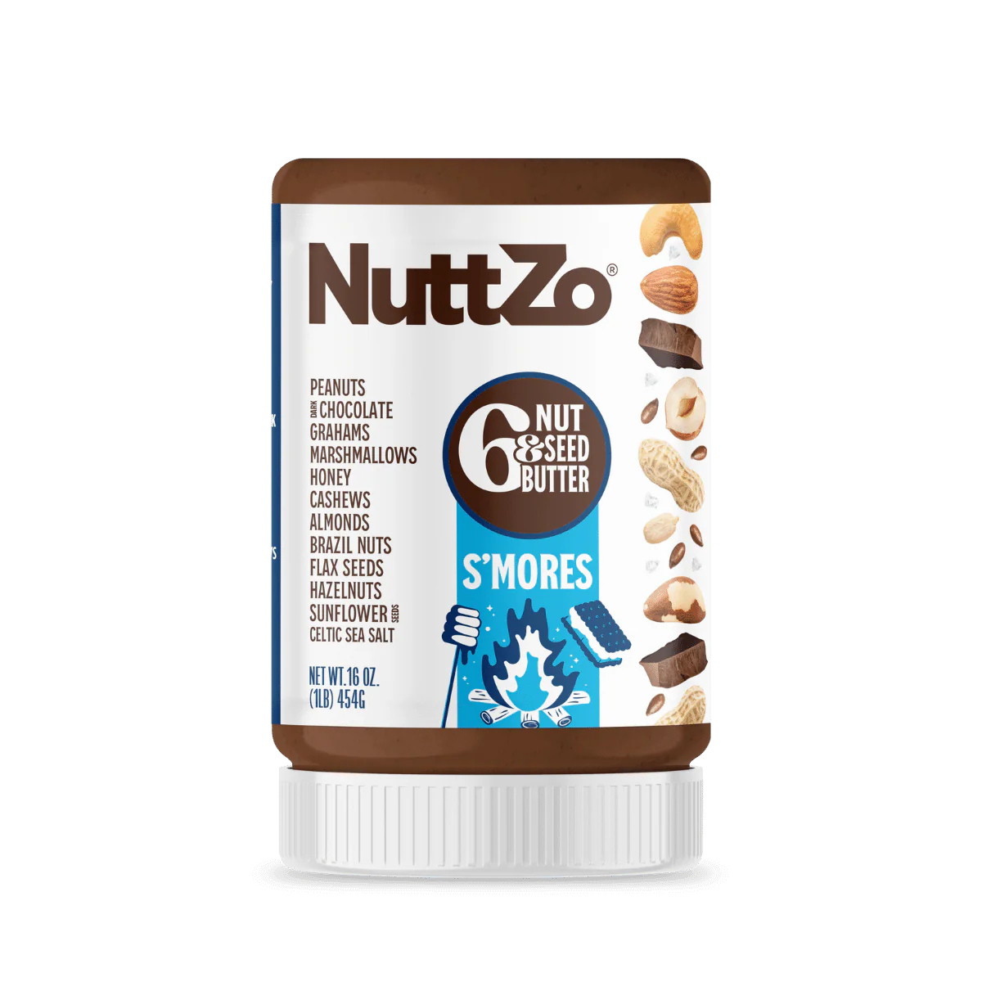
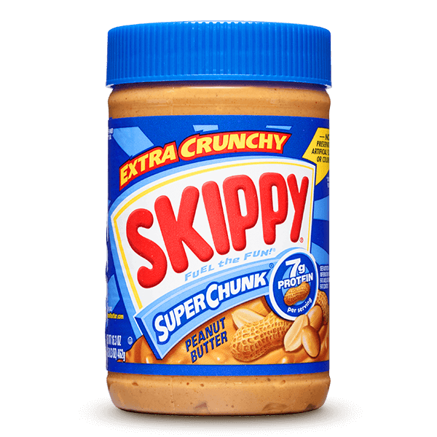
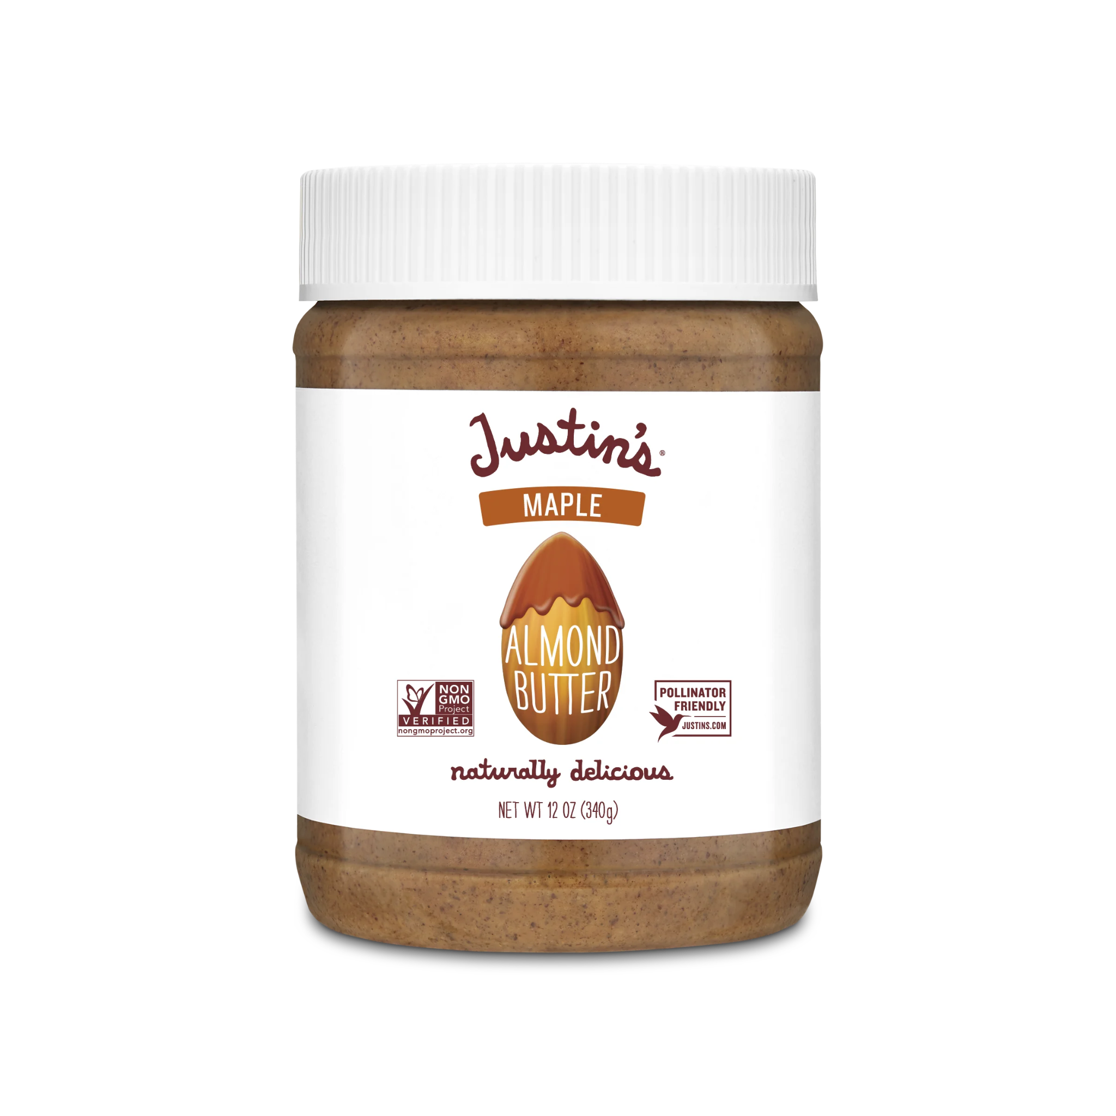
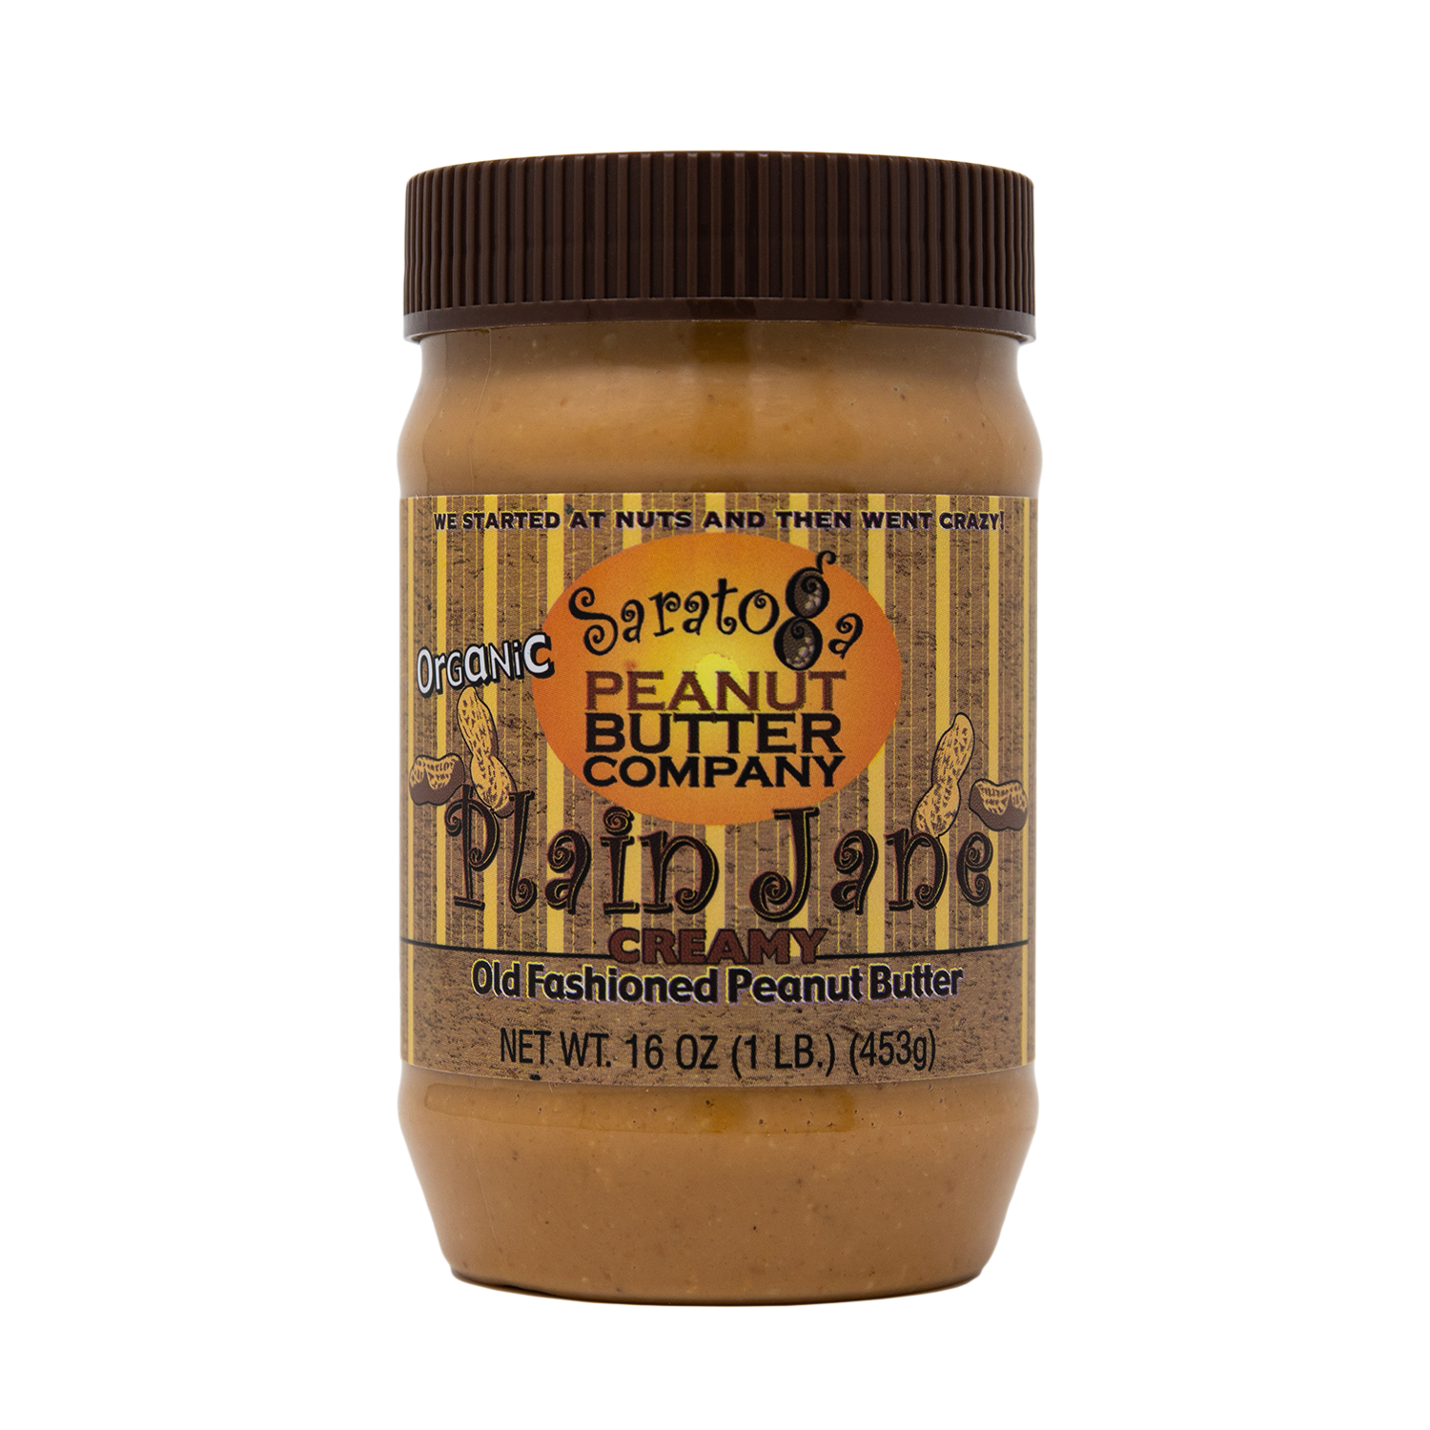
Competitive Positioning
Recap
Jester
Magician
Enjoyment, fun
Family friendly
Happy
Positive change
Transformative
Nutrition focused
Innocent
Caregiver
Simple
Honest ingredients
Upgraded classic
Made by hand
Service to others
Nurturing

Slide 24
Recommended Positioning Strategies

Slide 25

Positioning 1
“Homemade”
Notes:
Homemade? Wholesome

Slide 26
Key Message
Caregiver
Saratoga Peanut Butter is made with care and intention, every spoonful prompts you to appreciate the hand that filled the jar.

Slide 27



How is Saratoga Peanut Butter’s positioning different from key competitors?
Builds trust with consumers
Promises the quality and care of a homemade meal
Reminds consumers of the benefits and goodness inside each jar of Peanut Butter
Rationale:
Feel Good
Why will this work?
Consumers want to eat things with ingredients that will make them feel good
Consumers will feel taken care of knowing where and who their food is coming from
Notes:
Slow food-Change Consumers buy for benefits re-phrase towards the benefits that SPB offers

Slide 28

Tagline:
Each spoonful, made for you

Slide 29

Creative

Slide 30
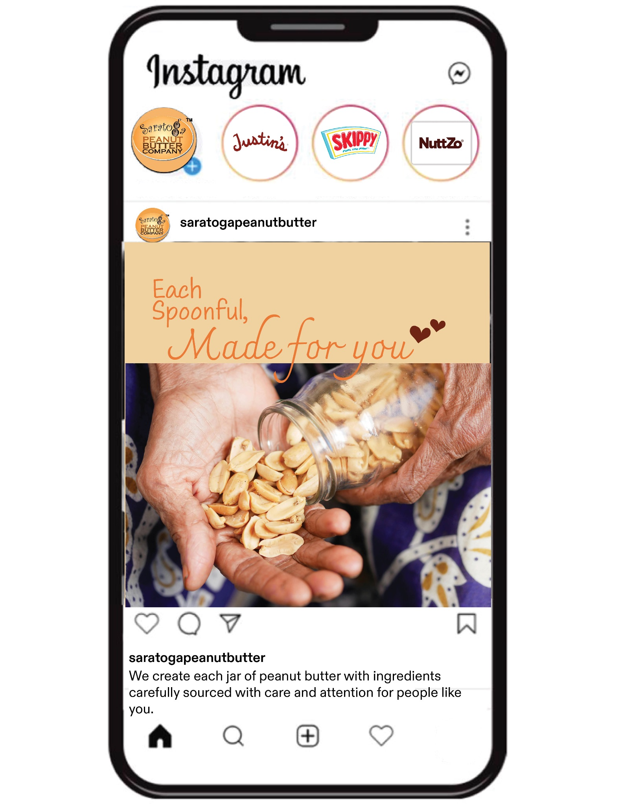
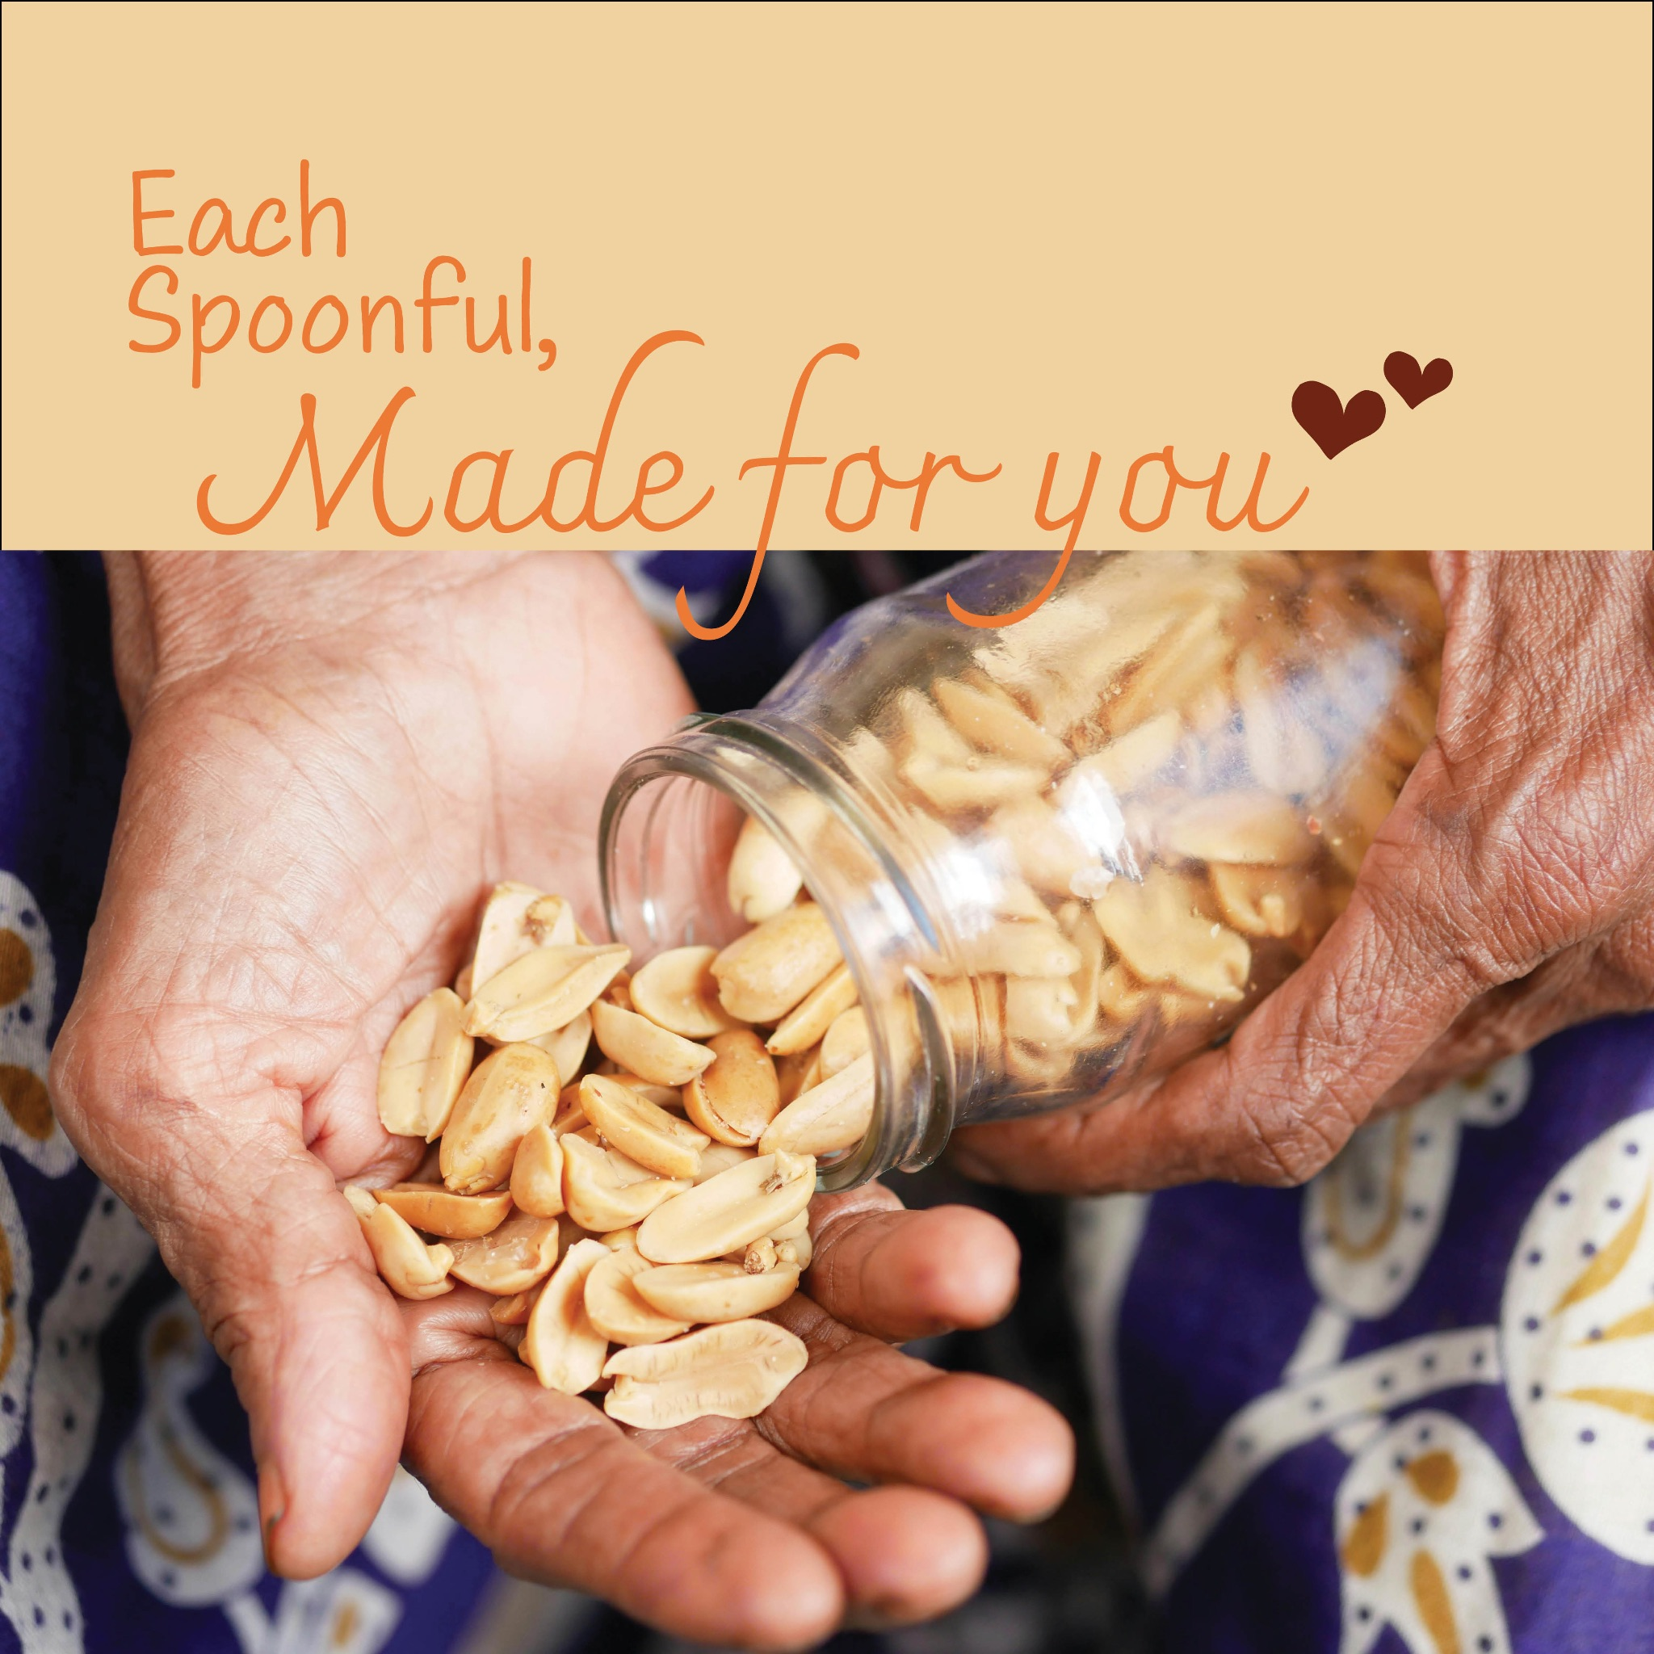
Instagram Post:
We create each jar of peanut butter with ingredients carefully sourced with care and attention for people like you.
Notes:
Ask people in the target audience

Slide 31
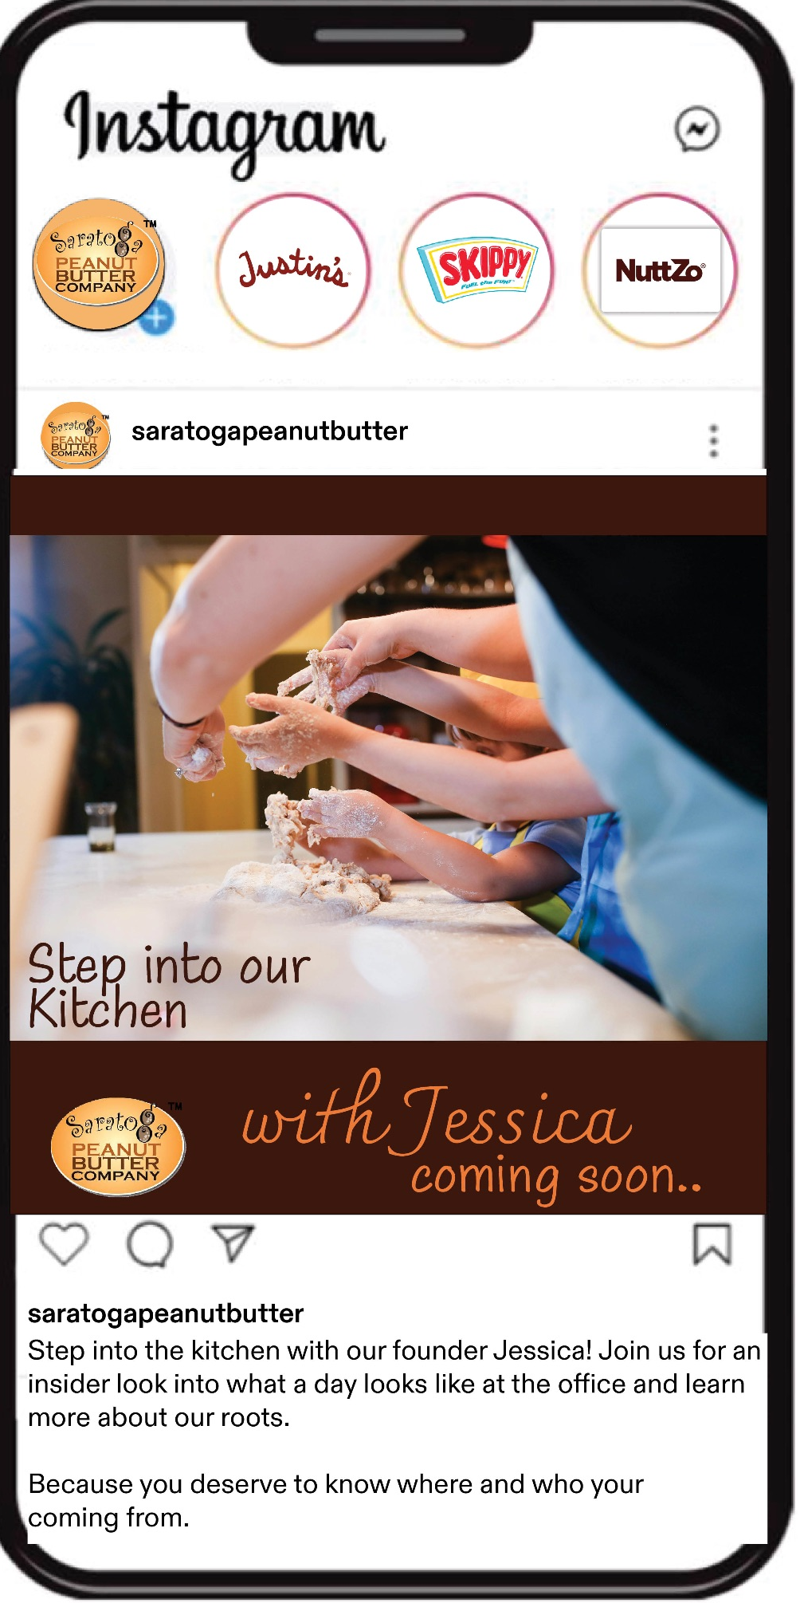
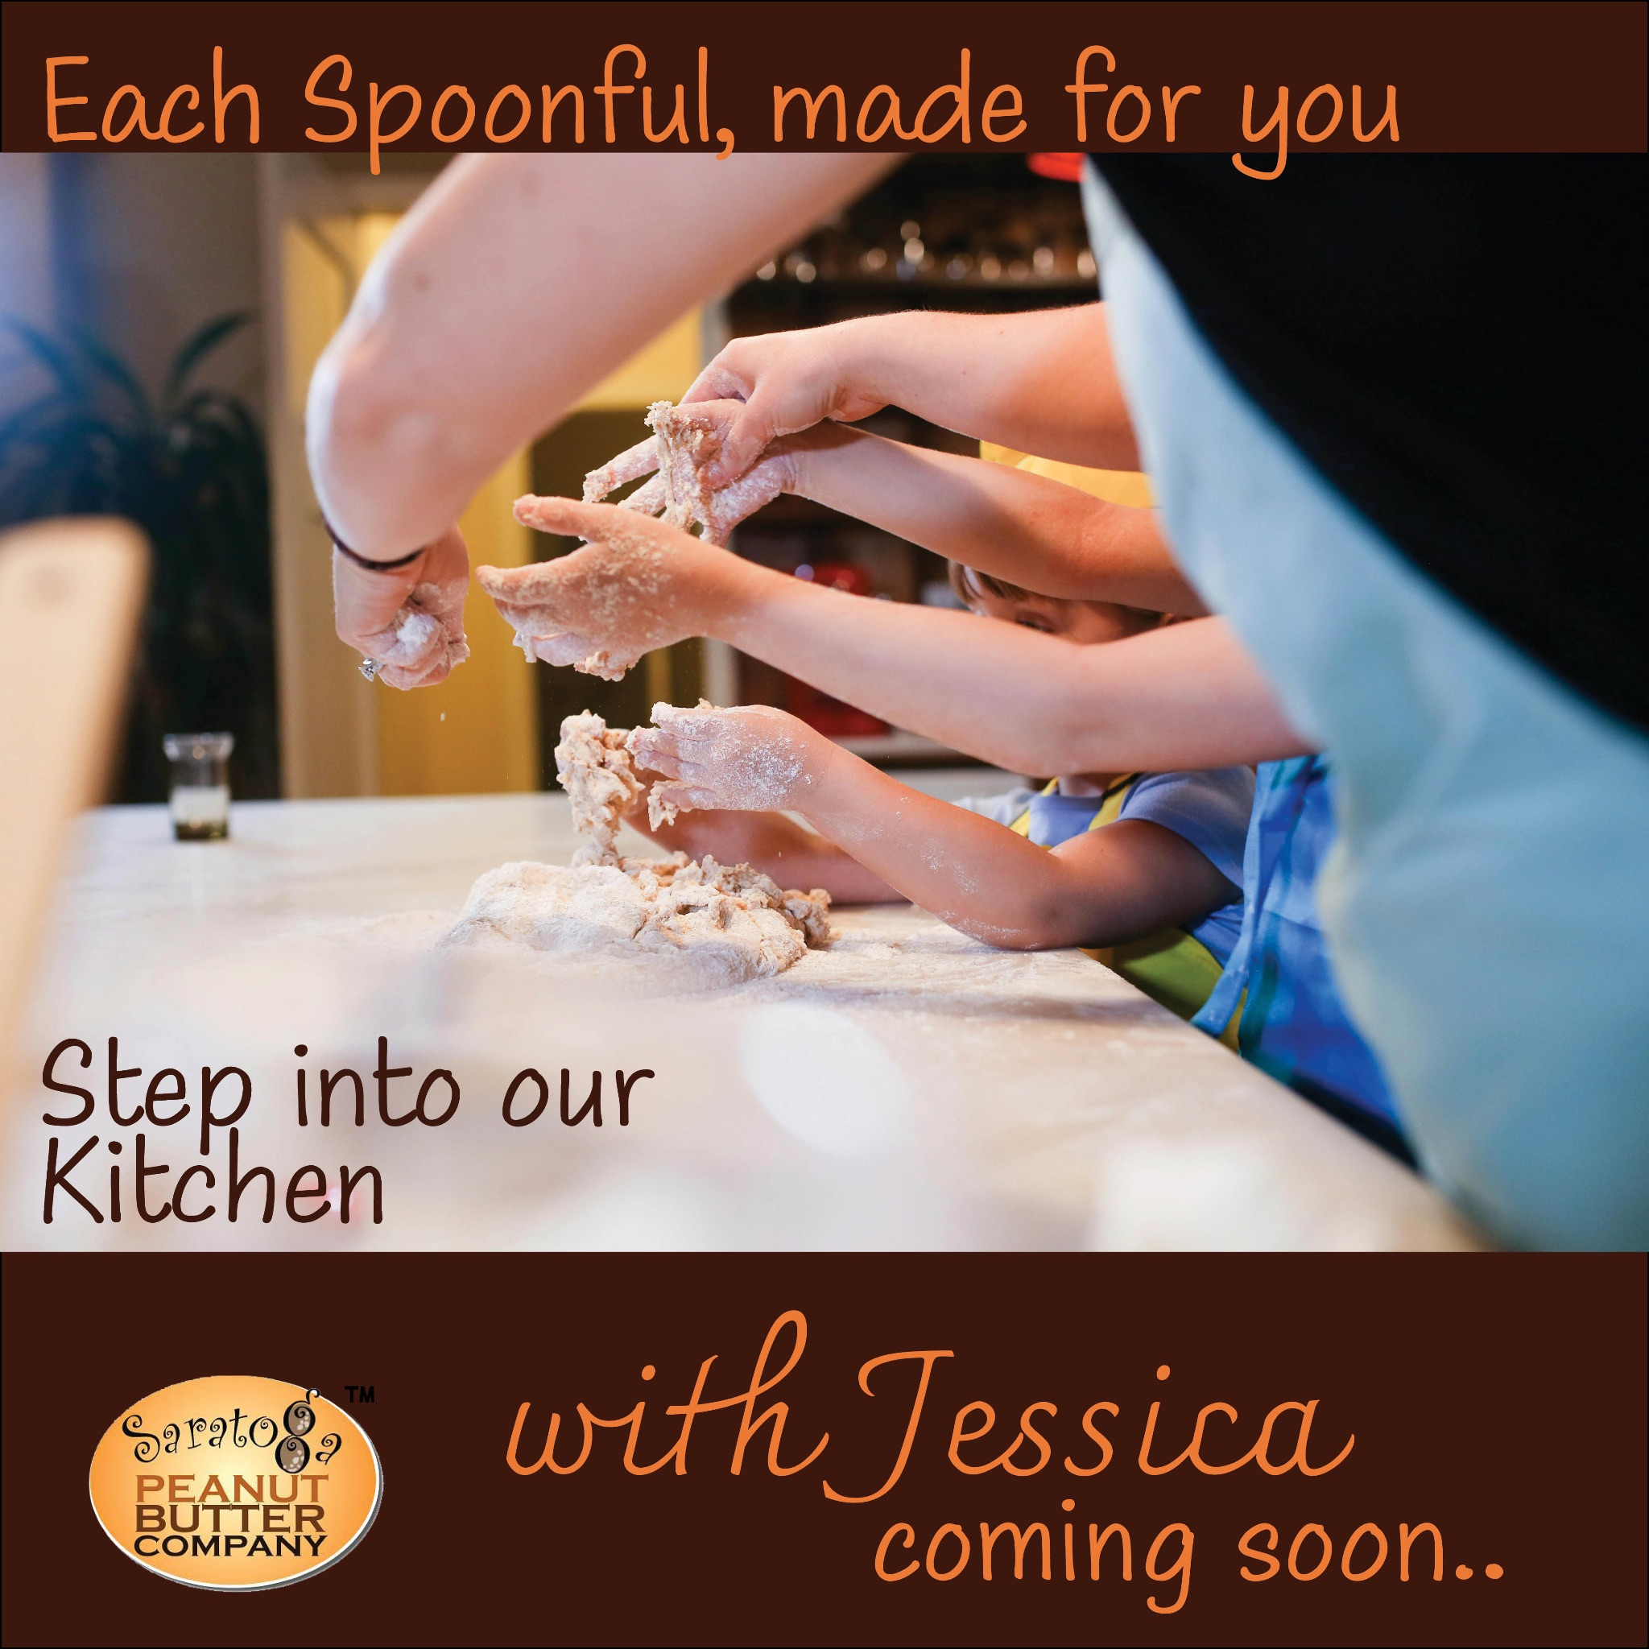
Instagram Post:
Step into the kitchen with our founder Jessica! Join us for an insider look into what a day looks like at the office and learn more about our roots.
Because you deserve to know where and who your food is coming from.
Notes:
Ask people in the target audience

Slide 32
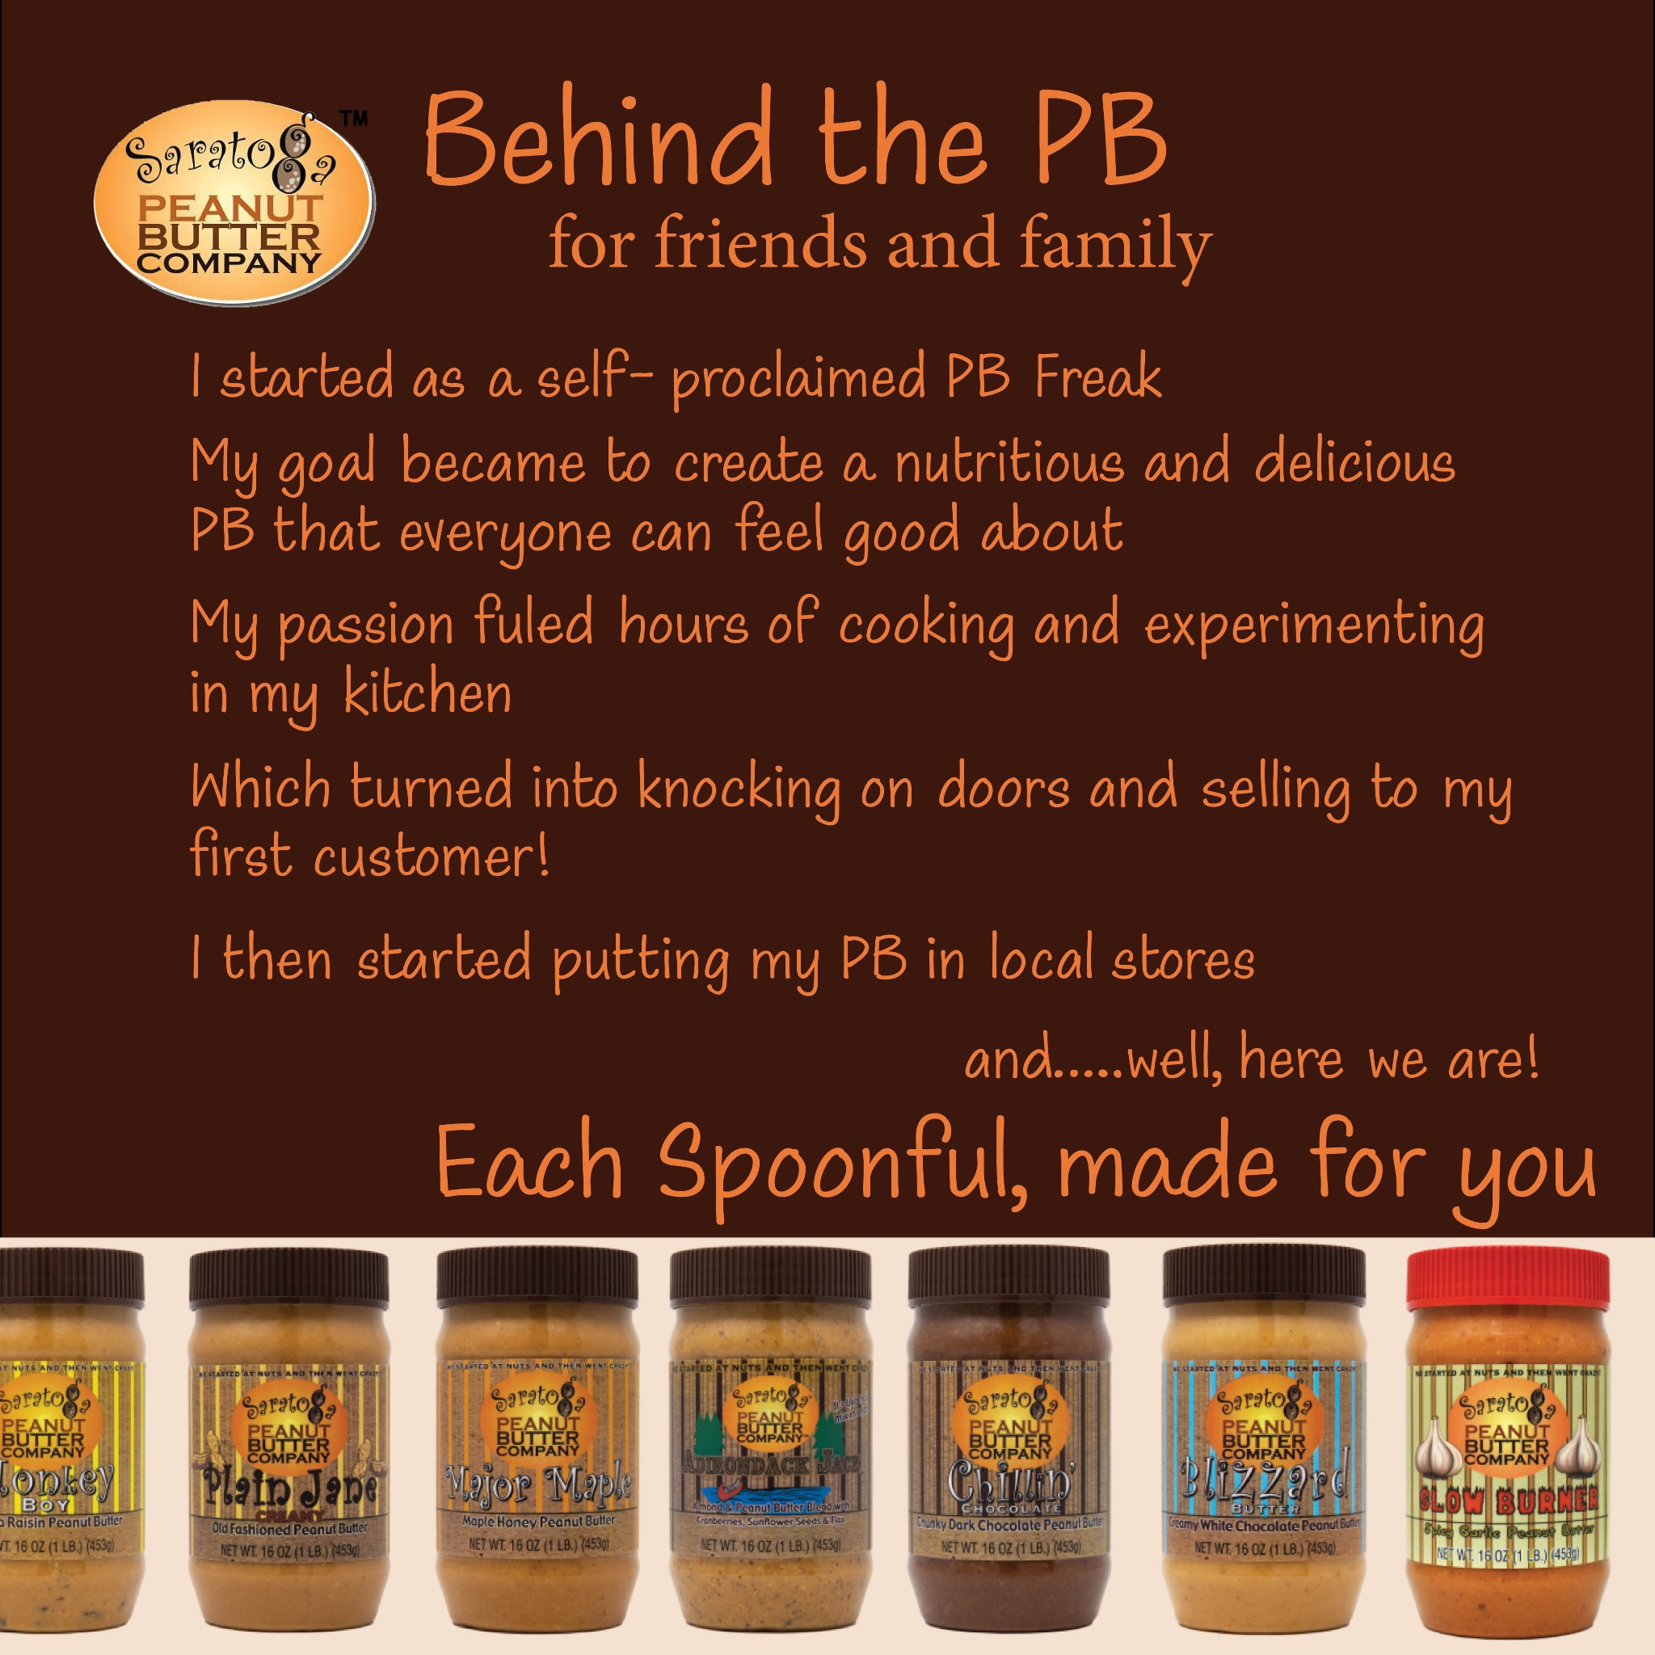
Instagram Post:
Our passion for creating delicious peanut butters that make you feel good is the core of our story. This goal fuels our brand and makes every step of the journey worthwhile!
Our passion for creating delicious peanut butters that make you feel good is the core of our story. This goal fuels our brand and makes every step of the journey worthwhile!
Notes:
Ask people in the target audience

Slide 33
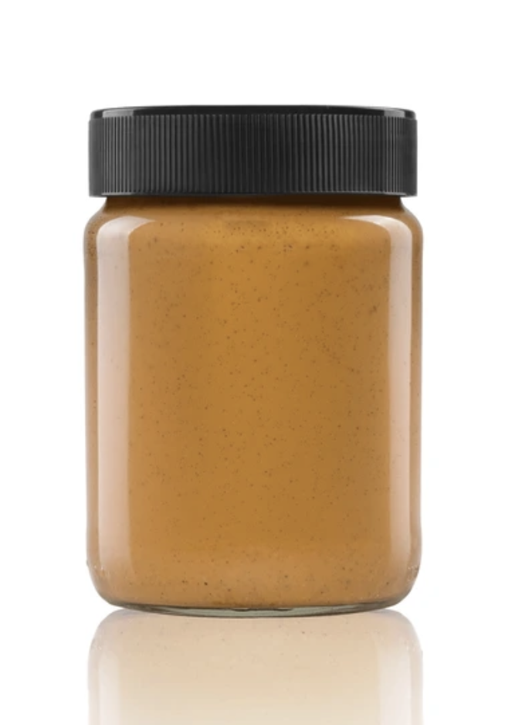
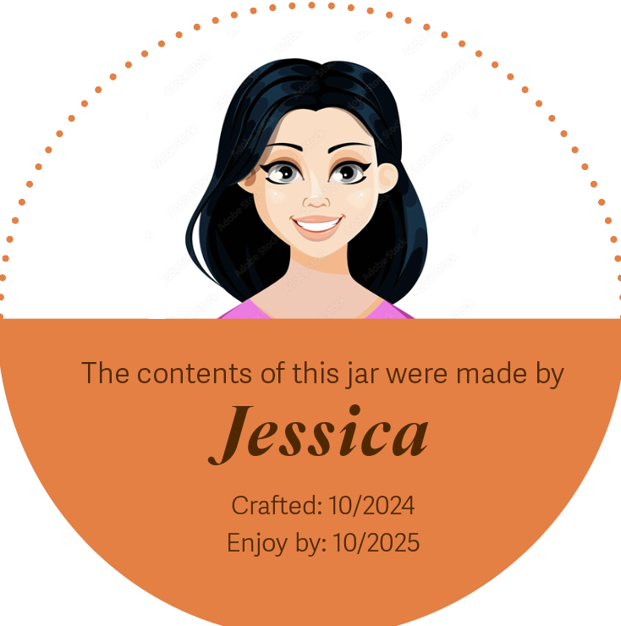
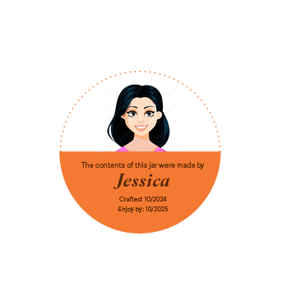
Maker sticker:
Notes:
All creatives should be consistent in the message Get rid of

Slide 34
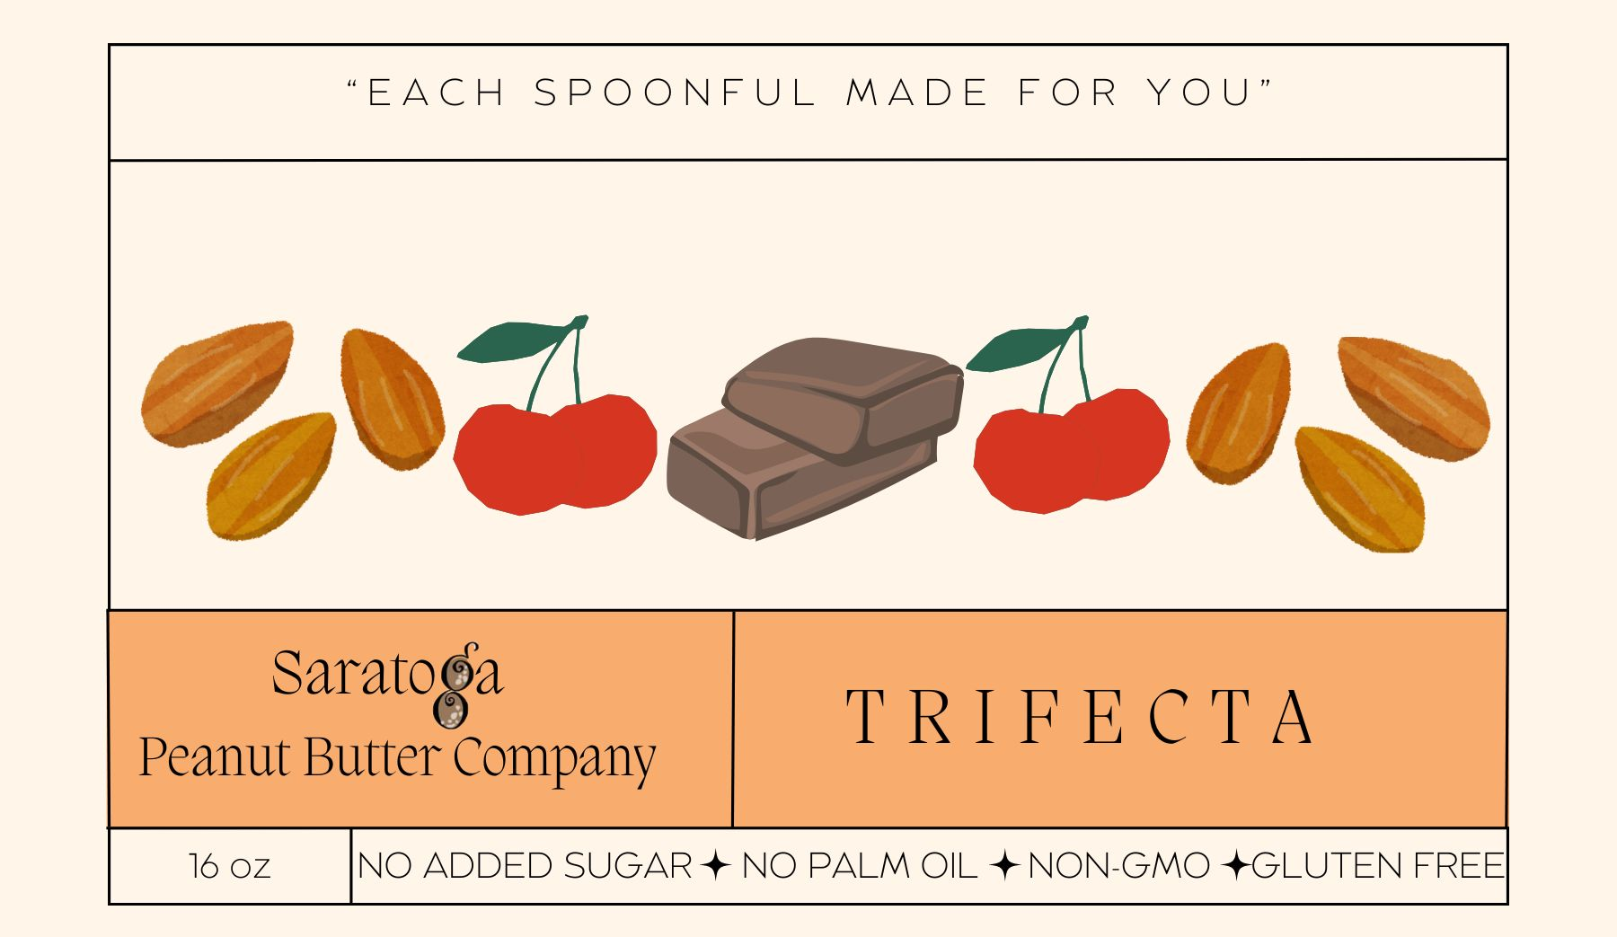
Label Design:
Notes:
Get rid of

Slide 35

Positioning 2
Health

Slide 36
Magician
Saratoga Peanut Butter allows you to indulge while still prioritizing your health and wellness.

Slide 37





Too many foods include:
fake flavors
unhealthy ingredients
SPB allows people to eat without consequence
eliminate additives, palm oil, etc.
maintain taste
provide nutrition
Rationale:
Let’s offer
people something
GOOD

Slide 38
No need to feel naughty
-
Go Nuts!

Slide 39
Creative

Slide 40
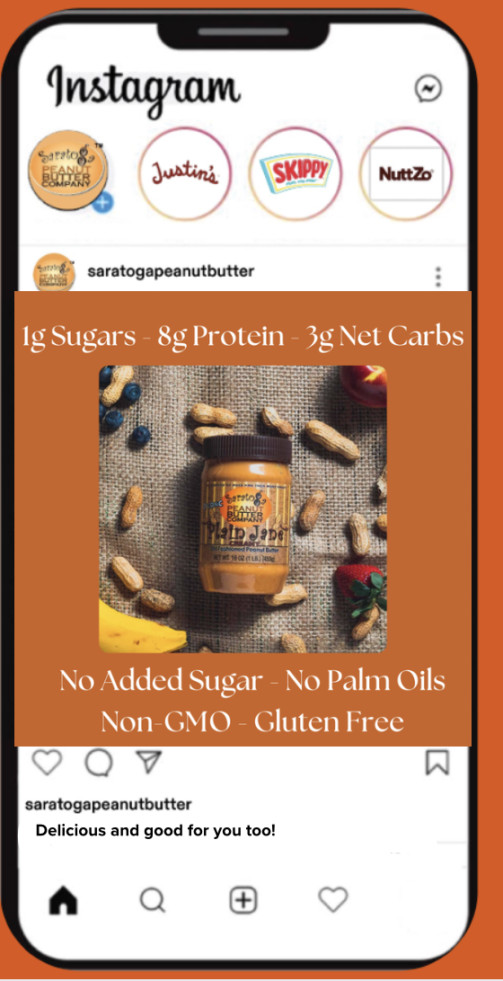
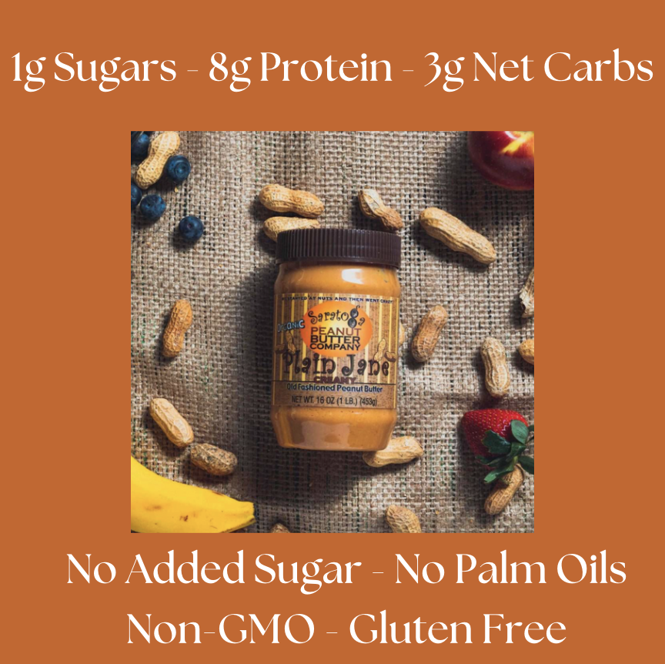
Instagram Post:
Notes:
Ask people in the target audience

Slide 41
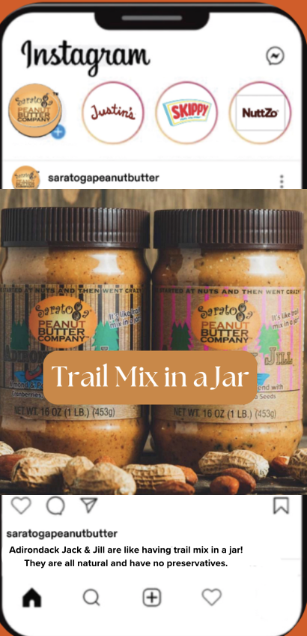
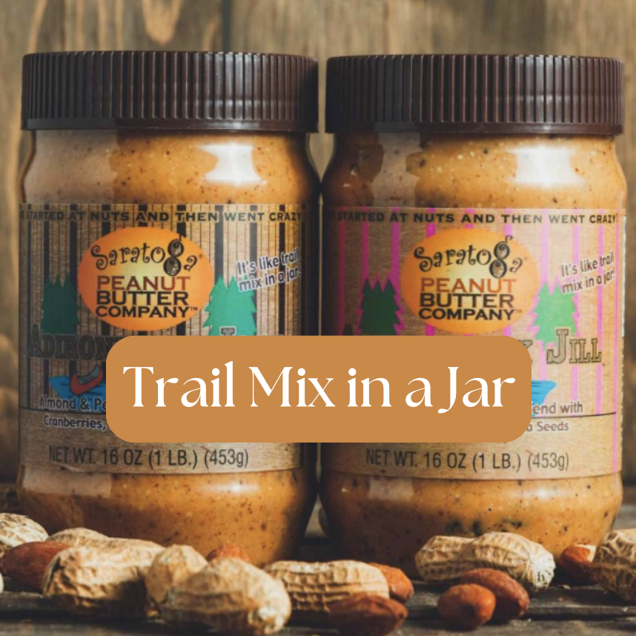
Instagram Post:
Notes:
Ask people in the target audience

Slide 42
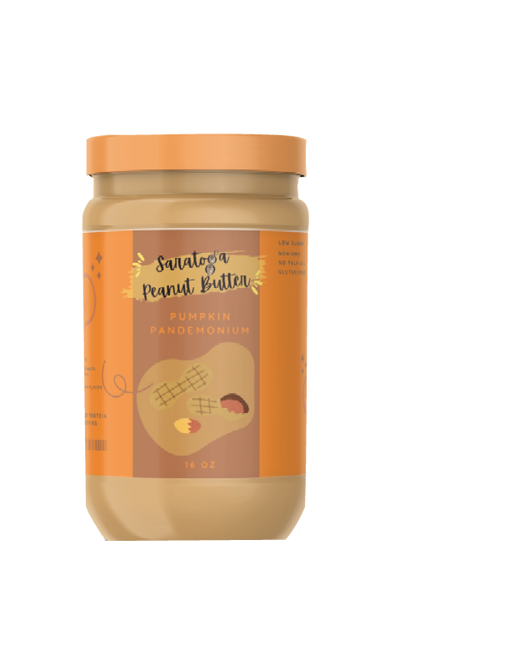
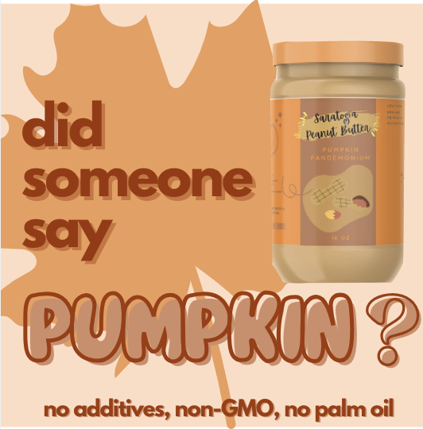
Instagram Post:
Look who’s back! A crowd favorite, Pumpkin Pandemonium, is back on September 10th.
Preorder now!

Slide 43
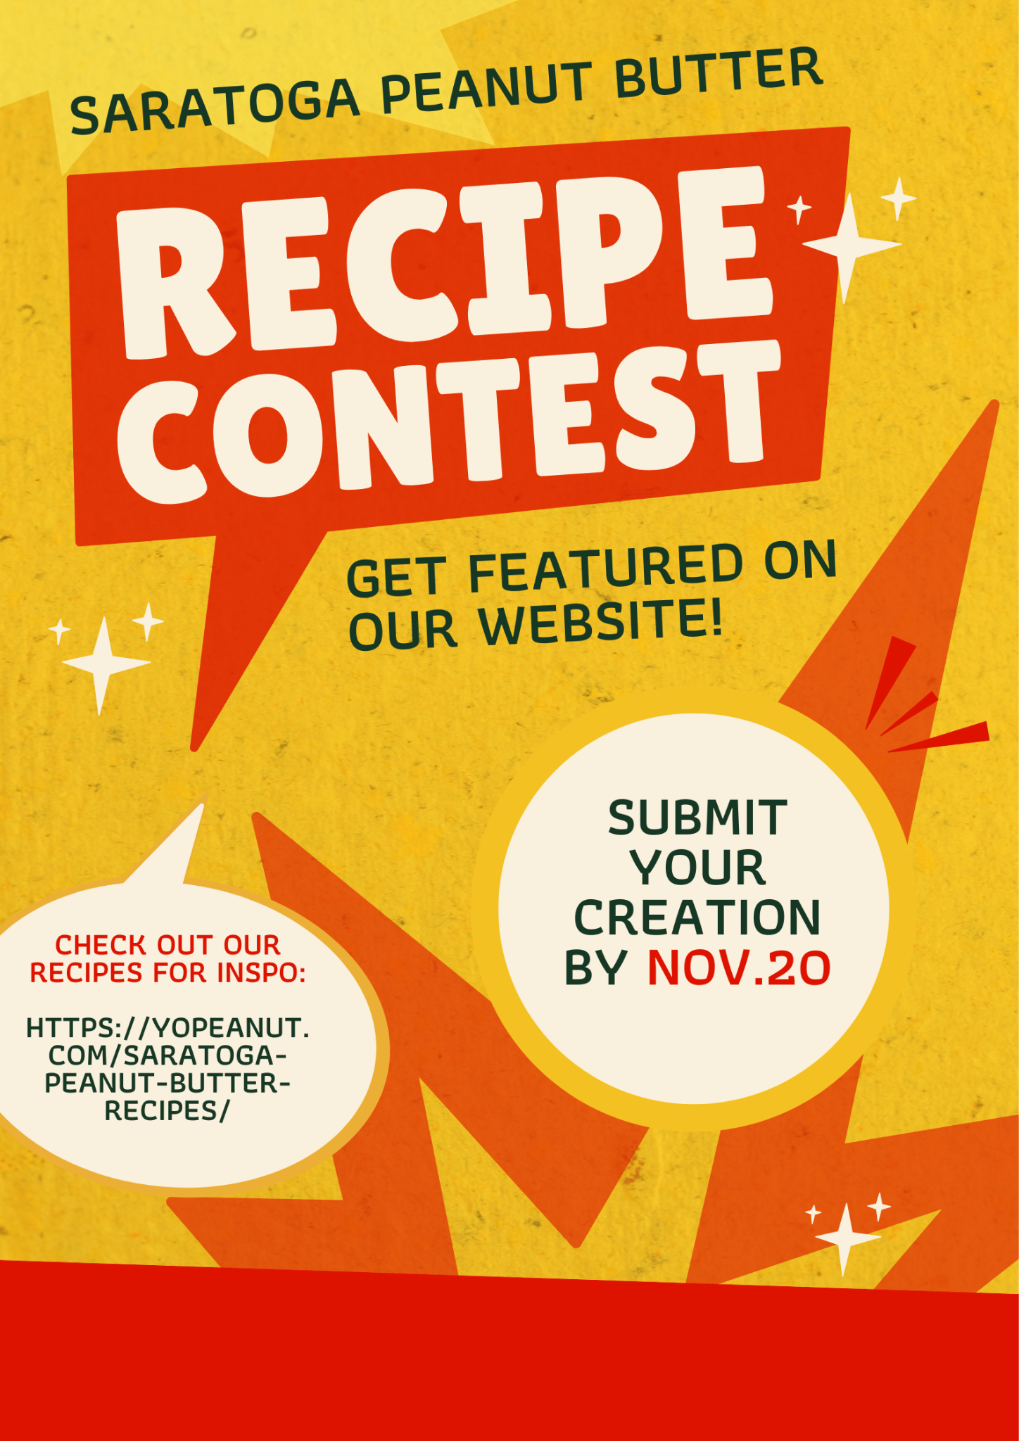
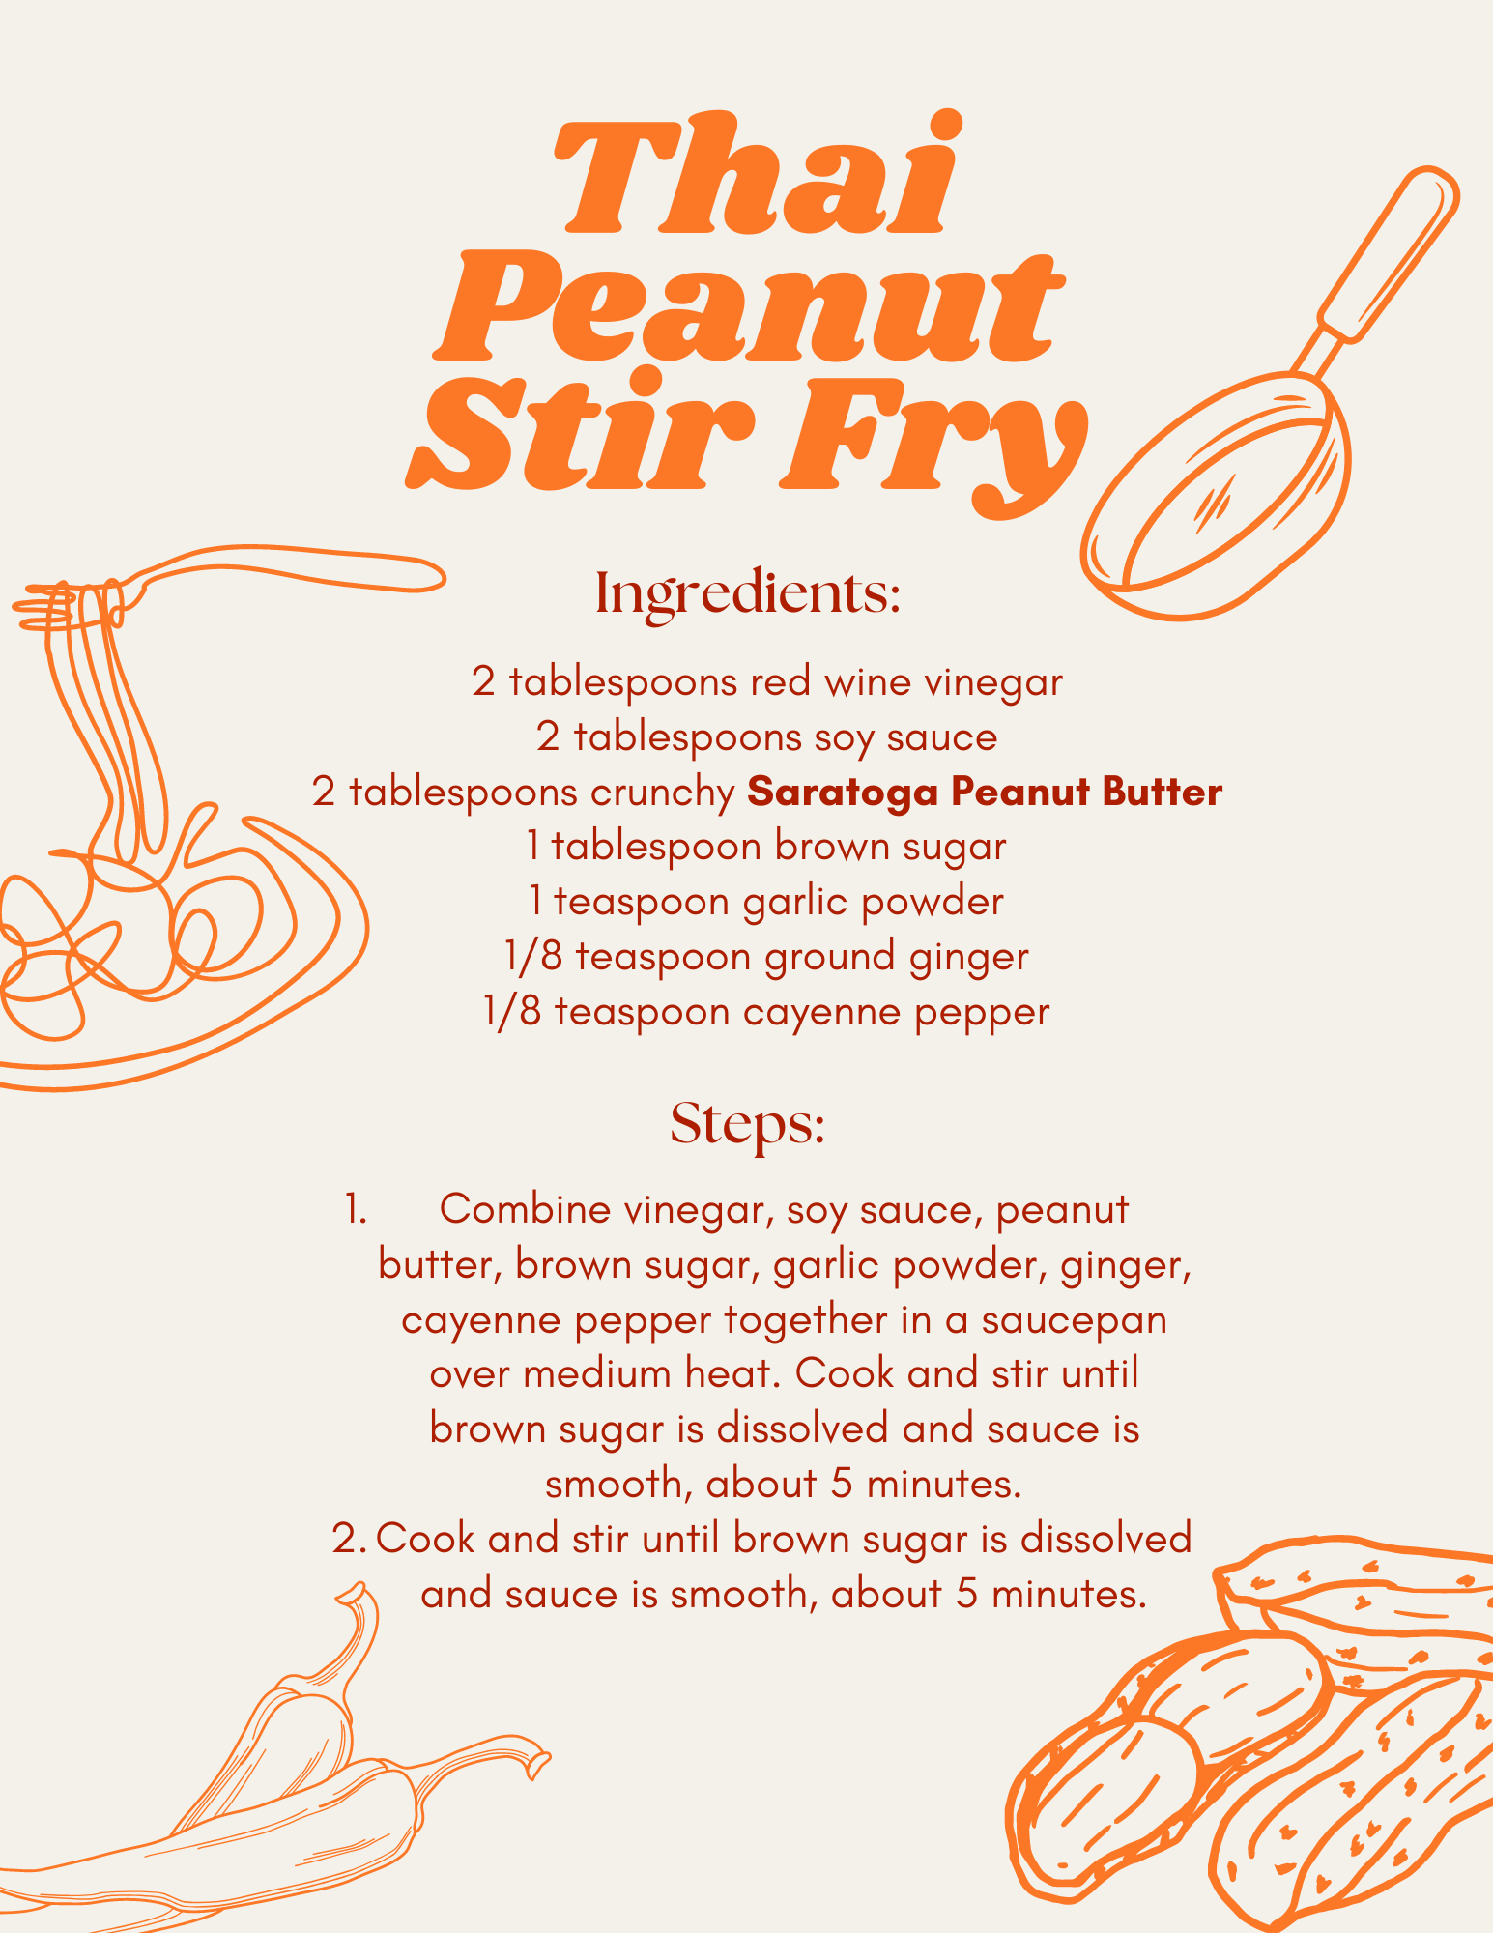
Recipe Contest
Example Recipe Post:
https://yopeanut.com/recipe/thai-peanut-stir-fry-sauce/
Notes:
Get rid of

Slide 44
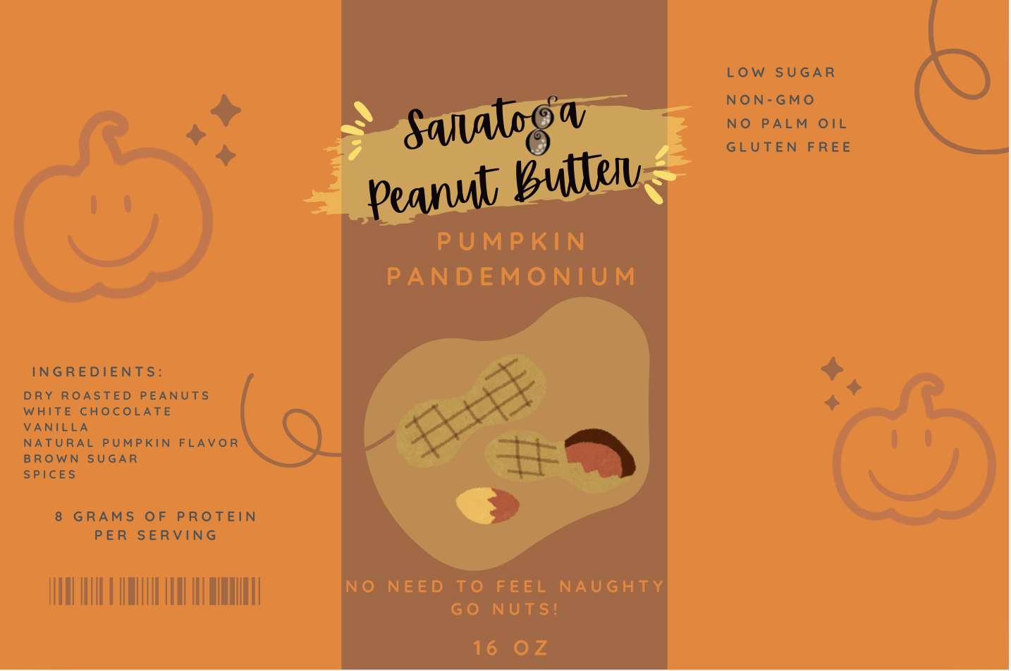
Label Design:
Elaborate on what you want to discuss.
Elaborate on what you want to discuss.

Slide 45

Conclusion
Problem: How to position Saratoga Peanut Butter to attract a healthy and mindful audience
Competition: Peanut Butter Industry - Competing on health, taste, and uniqueness
Positioning:
Homemade - Saratoga Peanut Butter creates a product which uses only the best ingredients with each customer in mind
Health - Our peanut butter is good for you while still prioritizing taste and fun
Tying it all Together: Saratoga Peanut Butter is the only peanut butter that prioritizes our consumers health and wellness in a way that is caring, fun, and indulgent

Slide 46
Thank you
Any Questions?

Slide 47
Sources
https://nationalpeanutboard.org/news/consumer-research-highlights-americas-love-peanuts-and-peanut-butter/​
https://www.statista.com/statistics/281221/us-households-consumption-of-peanut-butter/ ​
https://www.attentive.com/blog/millennial-gen-z-shopping-habits#:~:text=Both%20Gen%20Z%20and%20millennials,when%20shopping%20on%20their%20phones.
https://nutrionexfoods.com/pages/profitability-of-selling-private-label-peanut-butter#:~:text=Peanut%20Butter%20Demand,enough%20of%20this%20pantry%20essential.​
https://pubmed.ncbi.nlm.nih.gov/36342169/ ​
https://www.statista.com/statistics/586957/market-share-peanut-butter-brands-in-the-united-states/#:~:text=Peanut%20butter%20market%20landscape&text=In%202017%2C%20the%20industry%20had,butter%20brands%20under%20their%20control.
https://www.statista.com/statistics/281227/us-households-brands-of-peanut-butter-consumed/
https://ific.org/media-information/press-releases/strong-interest-in-knowing-about-food-ingredients/
https://foodinstitute.com/consumerinsights/poll-most-americans-have-trust-gap-over-food-source-information/
​
https://www.hormelfoods.com/inspired/story/the-spread-of-nut-butters/
​

