Slide 1
Sundaes Best
By: Olivia , Ayla , William , Kyle

Slide 2
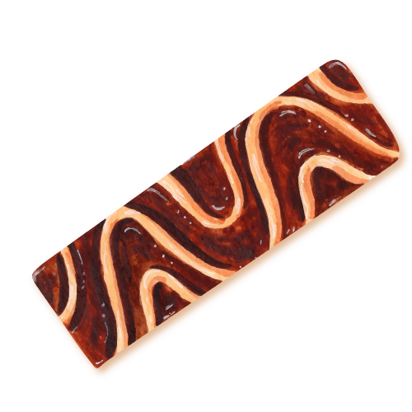
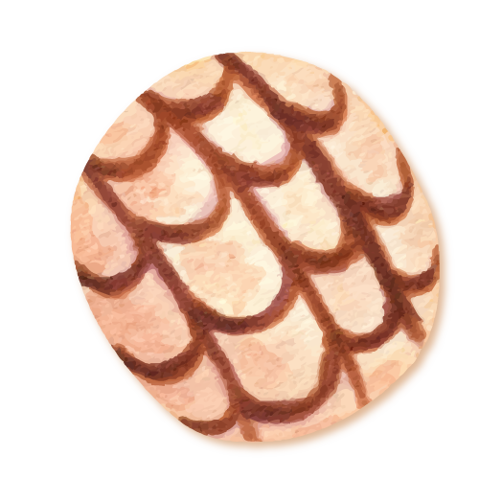
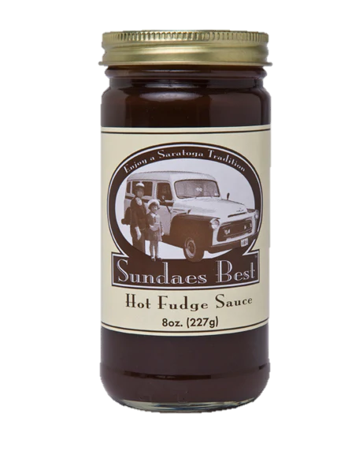

Agenda
01
02
Discovery
Strategies & Creatives
Industry Insights, Broad Cultural Context, and Company Insights
The Challenge, Target Audience, Key Competitors, Brand Positioning, Tagline, Visual Concepts
03
Conclusion

Slide 3
01.
Discovery

Slide 4
Industry Insights

Slide 5
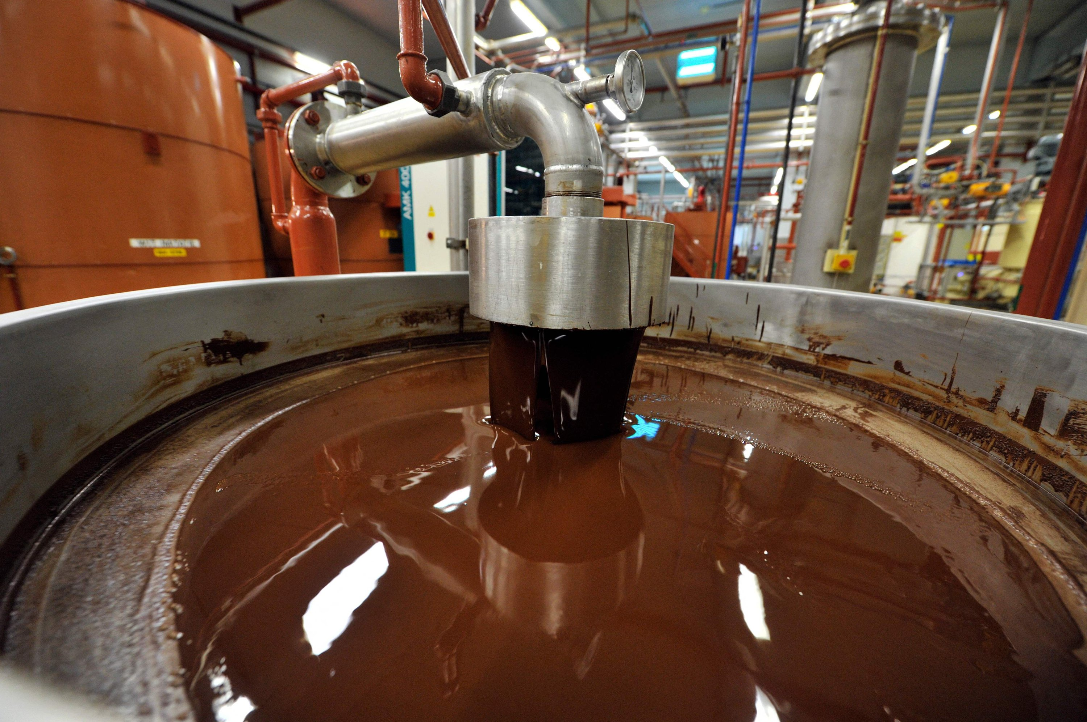
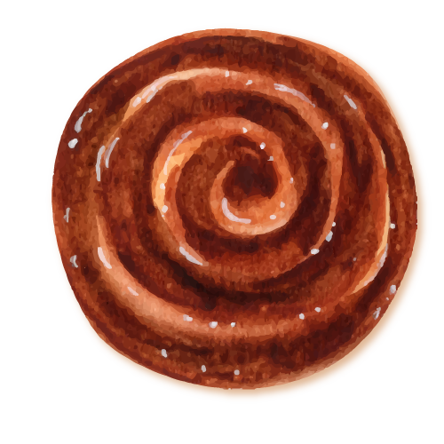
US Confectionery Market
    2022: $38.17 billion
    2030: $55.35 billion
    Compounded Annual Growth Rate: 4.8%
    North America leads with 38% of global market
      Source: https://www.grandviewresearch.com/industry-analysis/us-confectionery-market

Slide 6
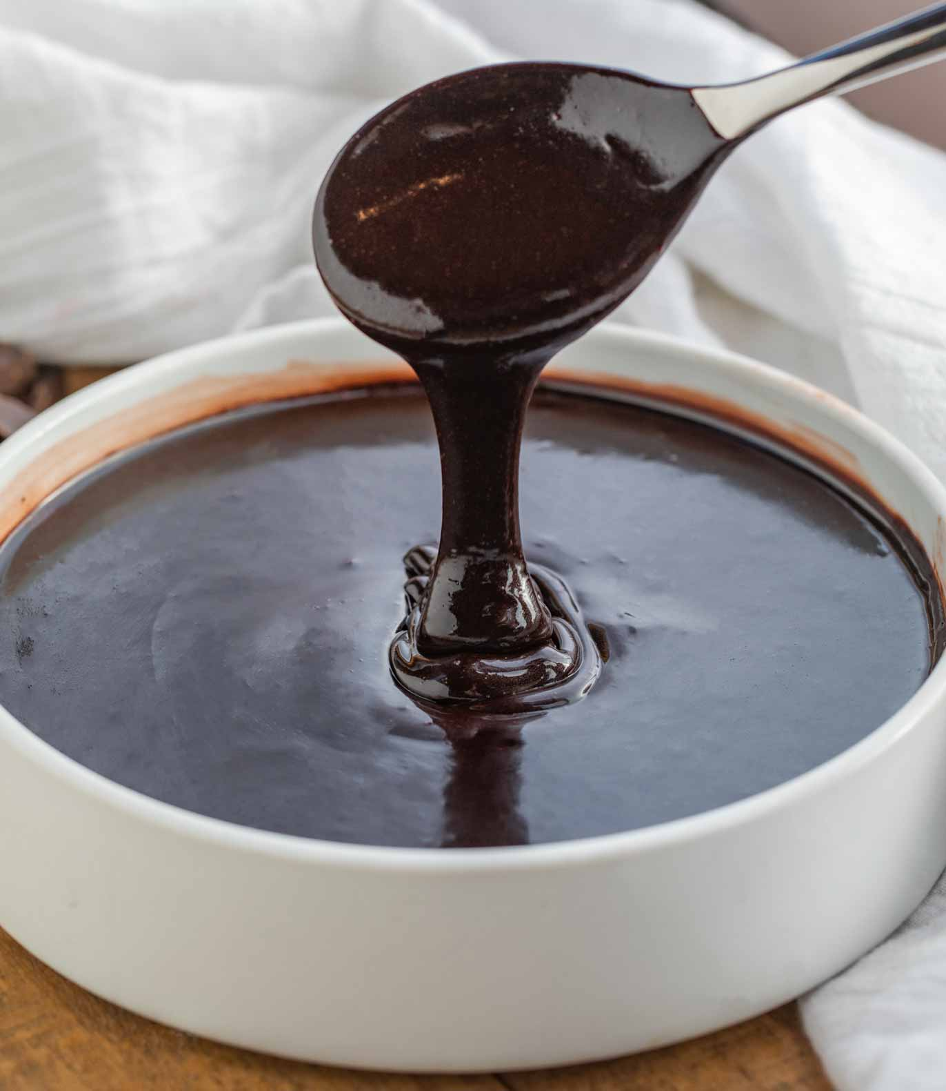
US Fillings and Toppings Market
    2024: $3.64 billion
    2029: $4.97 billion
    Compounded Annual Growth Rate: 6.42%
    In actuality – 2024: $1.1 billion
    Source:
    https://www.marketdataforecast.com/market-reports/north-america-fillings-and-toppings-market

Slide 7
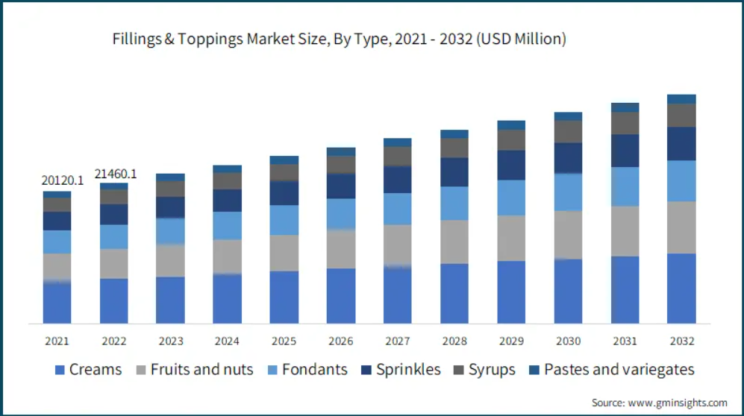

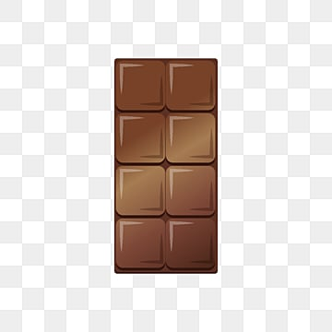
Fillings & Toppings Market Makeup
Fillings & Toppings Market Size, By Type, 2021 – 2032 (USD Million)
30%

Slide 8
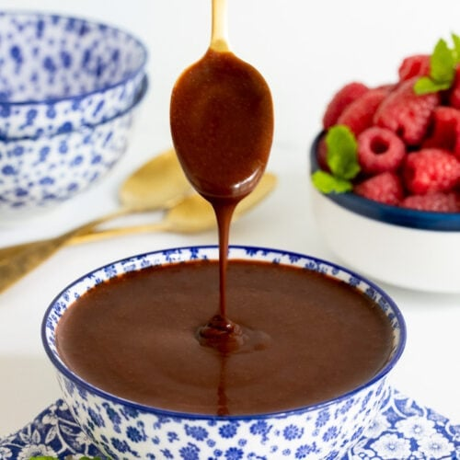
Trends
Consumers are increasingly seeking high-quality, fudge products
Health-conscious alternatives
Seasonal and limited-edition products
Consumer preference for elevated classics
Ice cream topping: hot fudge 35%, whipped cream 29%, caramel 24%, chocolate sauce 21%
Sources:
https://www.grandviewresearch.com/industry-analysis/us-confectionery-market
https://www.gminsights.com/industry-analysis/fillings-and-toppingmarket#:~:text=Fillings%20And% 20Toppings%20Market%20was,in%20today's%20dynamic%20food%20market.&text=Growth%20Drivers:,Expanding%20food%20and%20beverage%20industry
https://www.idfa.org/ice-cream-sales-trends

Slide 9
Broad Cultural Context

Slide 10
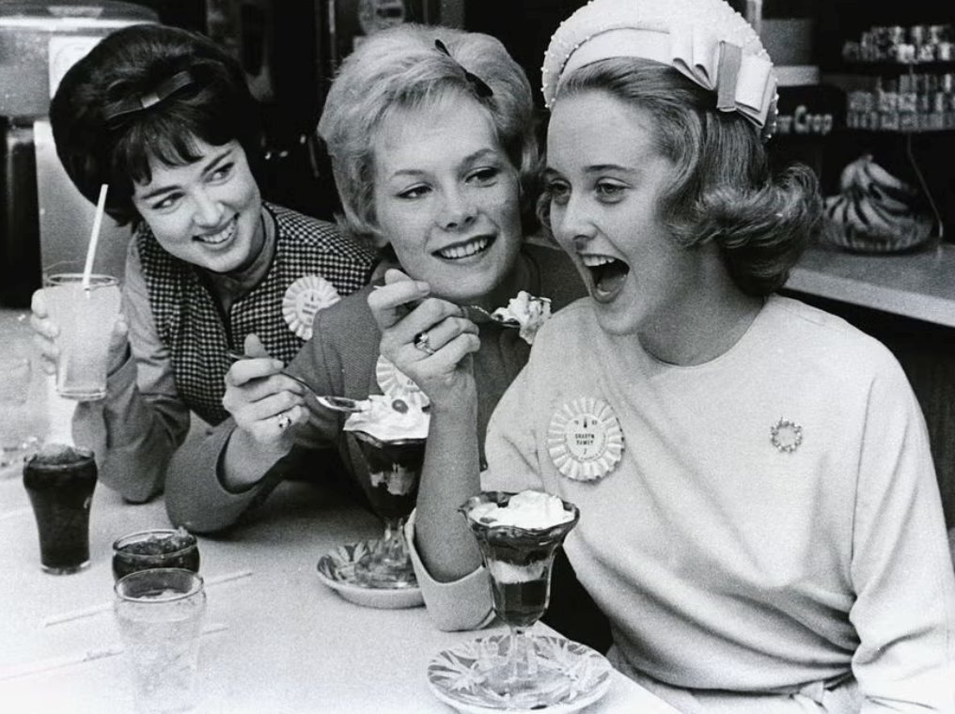
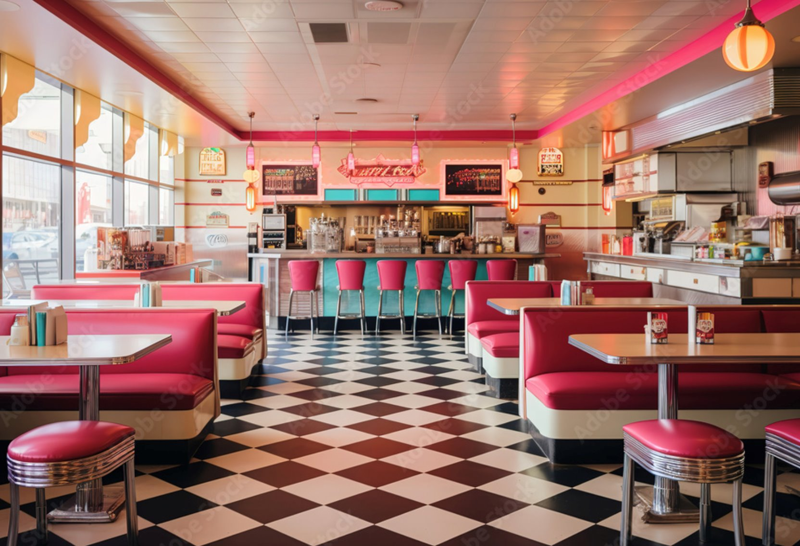
The History of the Ice Cream Sundae
Hot Fudge is an American Staple
First ice cream sundae made in the late 1800's
Post prohibition and the popularity of diners
Ice cream was a staple menu item
Chocolate syrup or hot fudge was a key dessert ingredient in the 50s-60s
Diners remained popular especially with families and young adults.
Sources: https://www.nationalgeographic.com/history/article/ice-cream-prohibition-era-craze
-https://www.delish.com/restaurants/g19577116/what-eating-at-restaurants-was-like-50-years-ago/
https://www.icecreamhistory.net/frozen-dessert-history/ice-cream-timeline/#google_vignette
https://www.usfoods.com/great-food/food-trends/tell-me-a-story-a-brief-history-of-the-humble-ice-cream-sundae.html

Slide 11
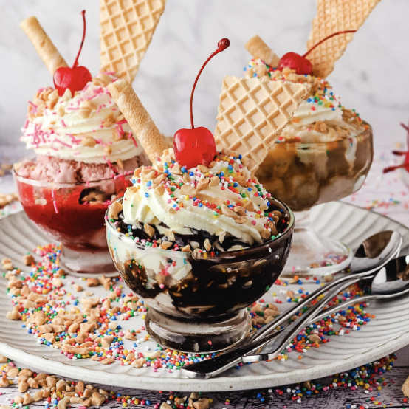
Cultural Context for Hot Fudge in 2024
Hot Fudge is Nostalgic at its Core
Hot fudge has remained a timeless dessert still enjoyed by people of all ages.
Hot fudge evokes feelings of nostalgia
Nostalgic food consumption is associated with positive emotions leading individuals to seek out foods linked to their past
Source: Vignolles, A. and Pichon, P.-E. (2014), "A taste of nostalgia: Links between nostalgia and food consumption", Qualitative Market Research, Vol. 17 No. 3, pp. 225-238. https://doi.org/10.1108/QMR-06-2012-0027

Slide 12
Company Insights

Slide 13
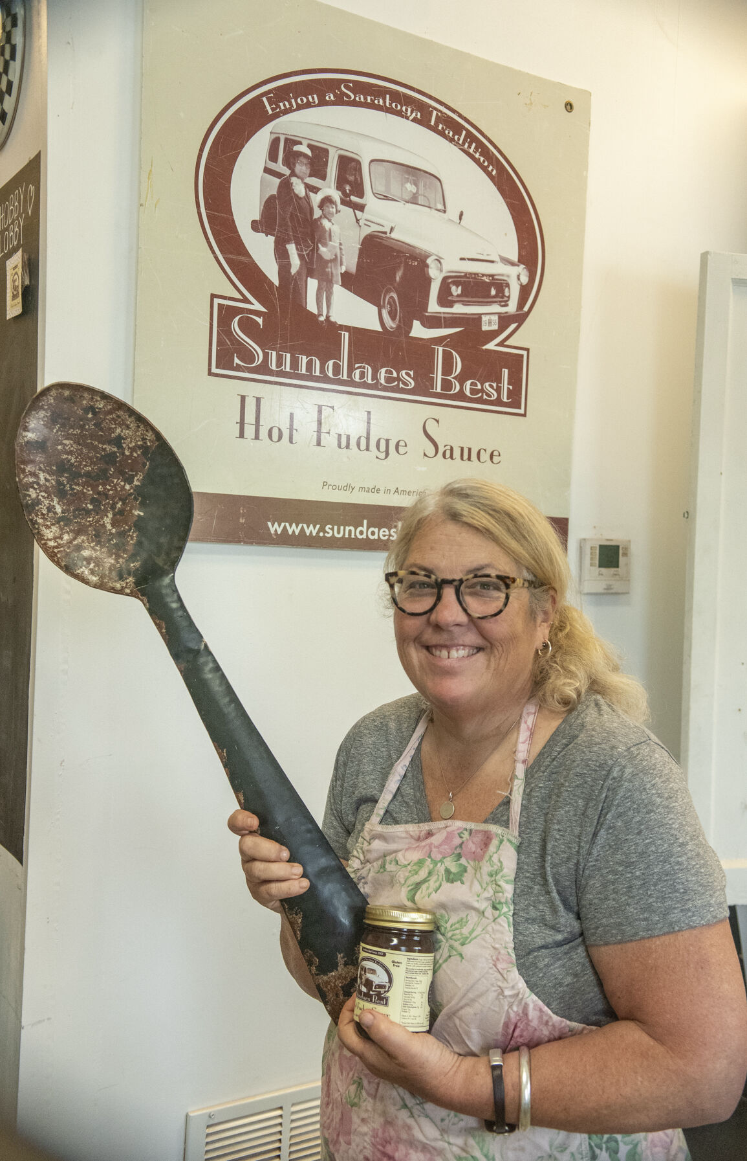
Company Story
Family recipe from Jeff's mom
Katie learned how to make the fudge over the phone
Considered selling the fudge for two years
Sold the first jar to Jeff’s mom in 2001
Featured on Good Morning America in 2020
Pivot to selling online

Slide 14
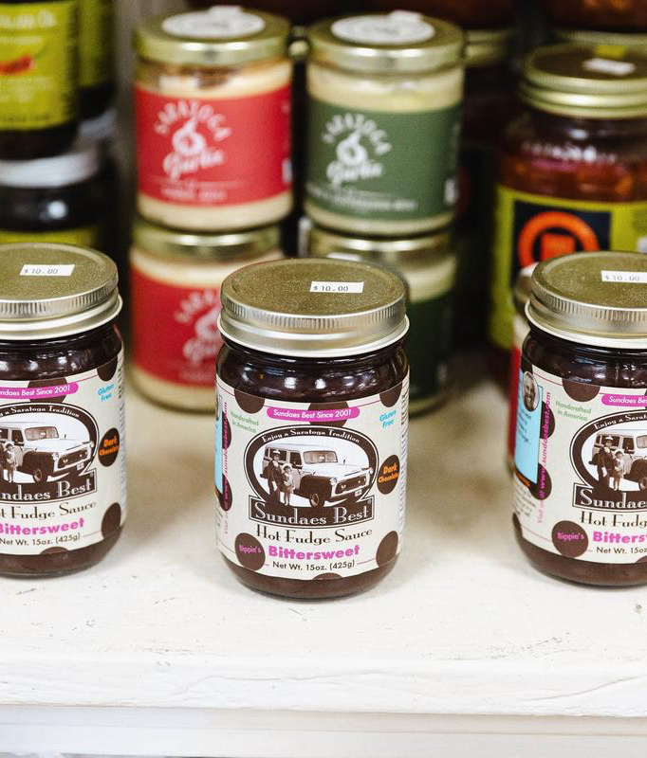
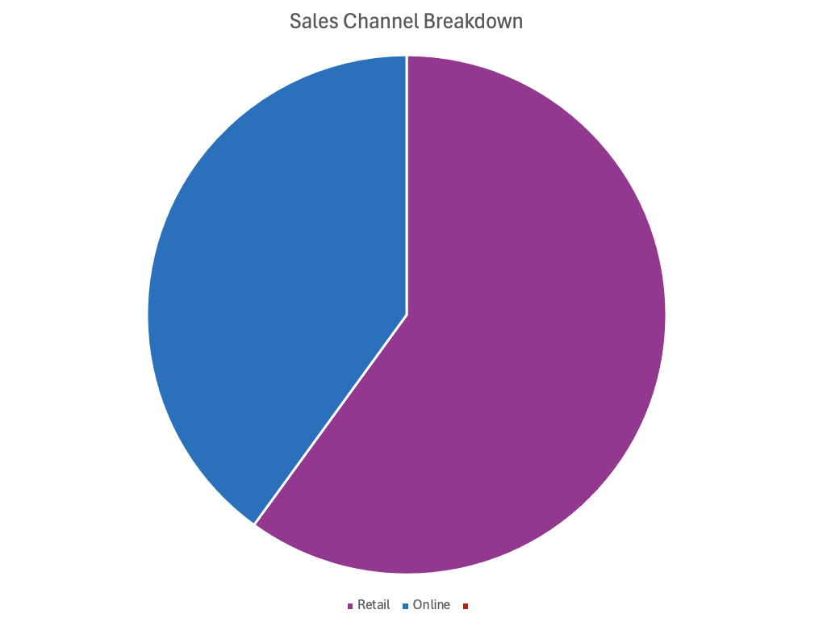
Sales Channels Breakdown
40% retail
5% in-person
55% Retail

Slide 15
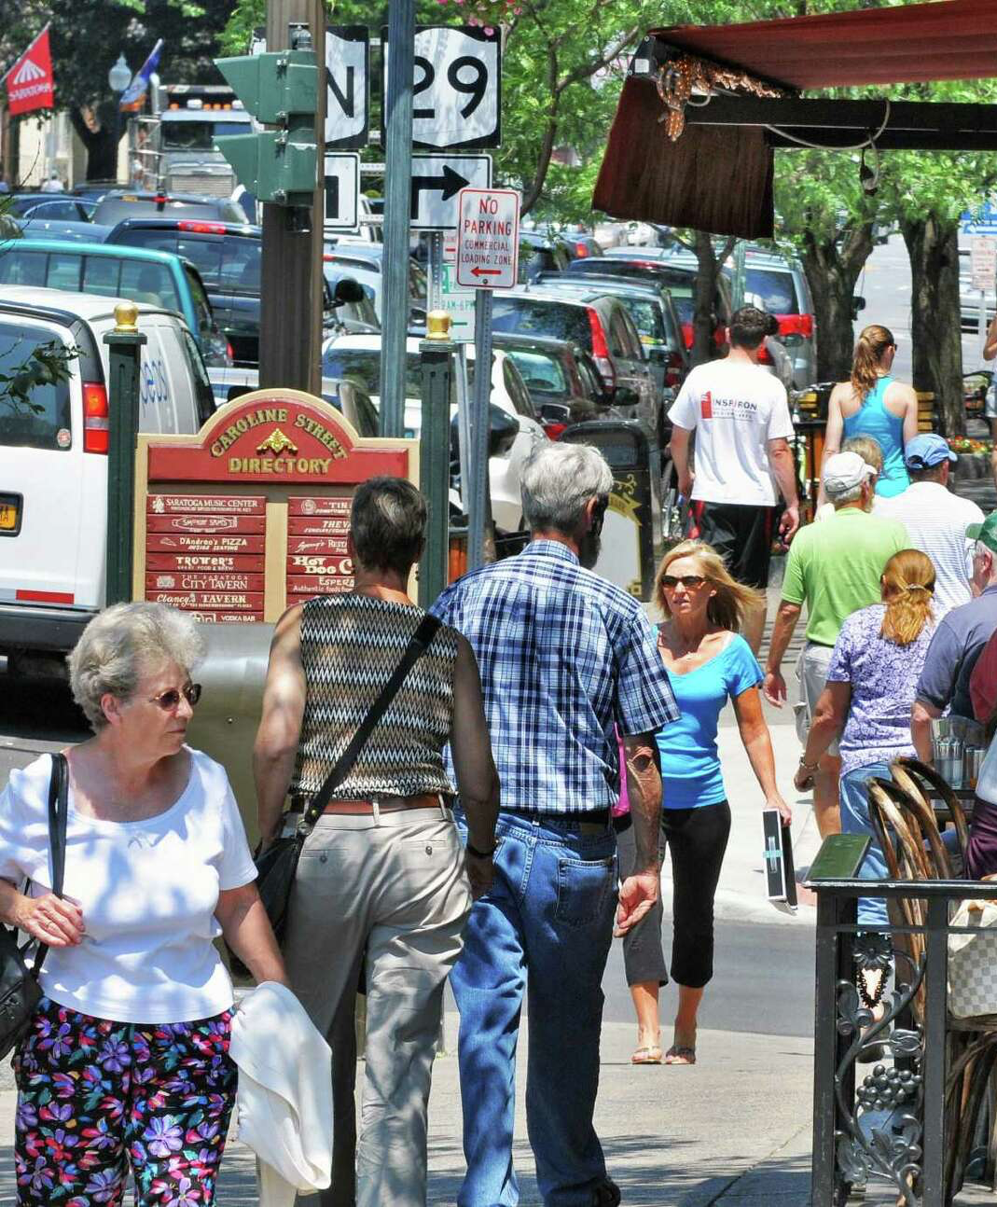
Consumer Insights Survey
Demographics
Location: Downtown Saratoga Springs, NY
N = 50
Median age: 44
29 women
21 men

Slide 16
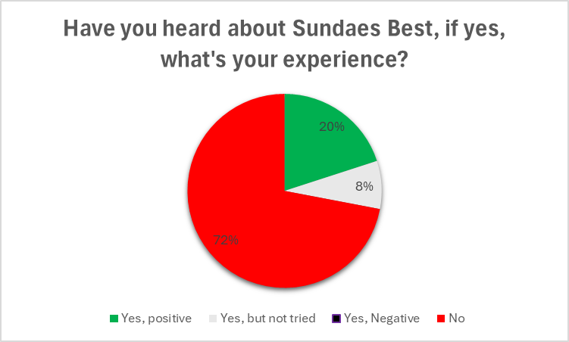
Sundaes Best Brand Awareness
Low Brand Awareness
36 people - Not heard about Sundaes Best
10 people who had tried it answered "Yes, positive"
4 people had heard about Sundaes Best but never tried any products.

Slide 17
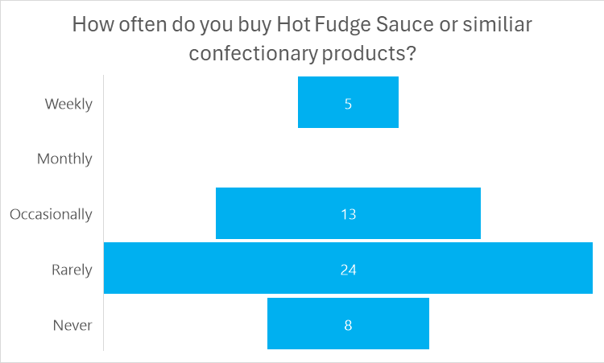
The Frequency of Hot Fudge Purchases
Hot Fudge Purchases Skew Toward Infrequent and Seasonal Use
Only elderly people who purchased it weekly
People in 30s & 40s were more prone to answer "rarely"
People who answered "occasionally" were typically parents with kids
Made comments such as "Great gifting product" or "Great seasonal product for Christmas for example"

Slide 18
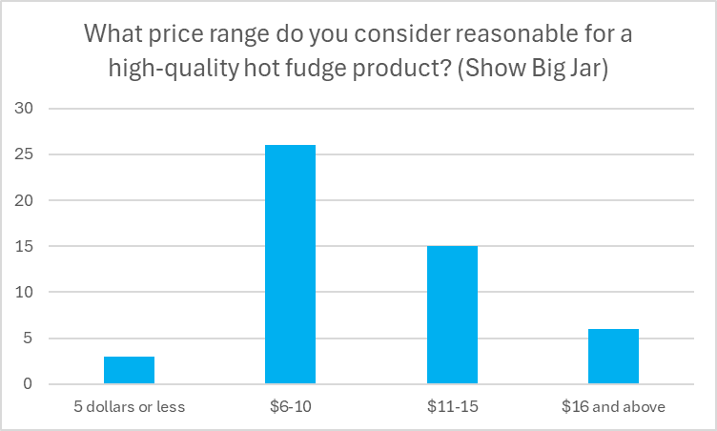
Consumers Willingness to Pay
Willingness to Pay Increases with Age
People who said $5 or less – also answered "never"
$6-10 typically the ones who answered "occasionally & rarely"
People who answered: $11-15 majority had tried the product
Only retirees / elderly willing to pay $15+
Women average price: $9.4
Men average price: $7.8

Slide 19
02.
Strategies & Creatives

Slide 20
The Challenge

Slide 21
The Challenge
Sundaes Best needs to create more brand awareness by differentiating themselves through a clear brand position
Craft a brand position that emphasizes Sundaes Best’s quality ingredients and its unique recipe creating an amazing taste

Slide 22
Target Audience

Slide 23
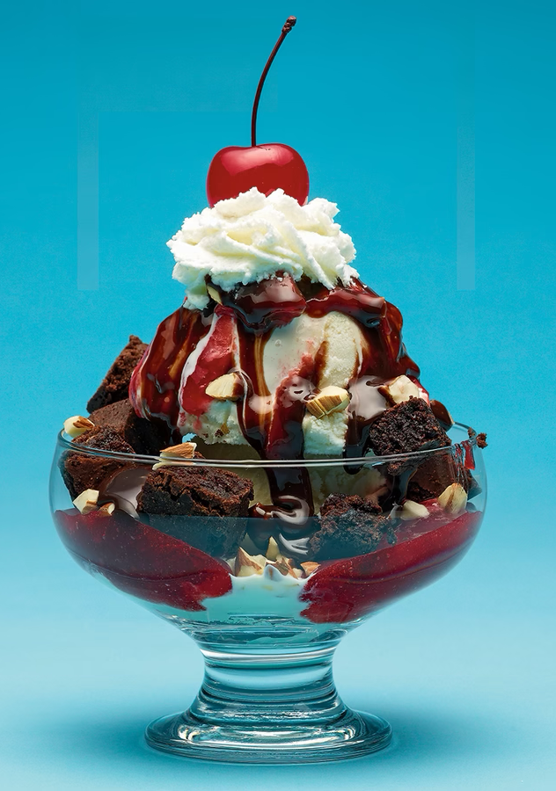
Target Audience Observations from Study
Seasonal Buyers and Age Skewing older
Retirees more willing to pay $15+ per jar
"Great Gift for Christmas!”
"Best Hot Fudge ever!”
"Great gifting product”
"Just sits in the fridge, because you don't eat it regularly"

Slide 24
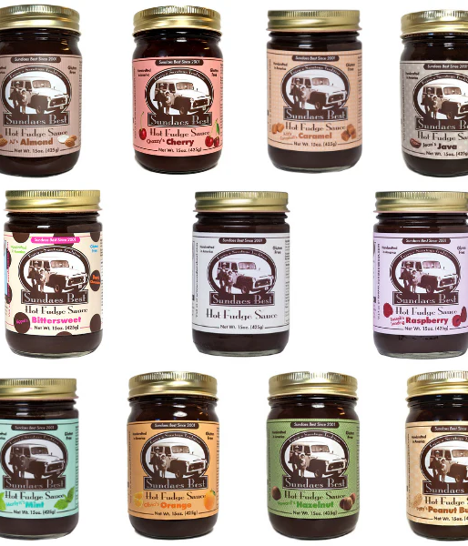

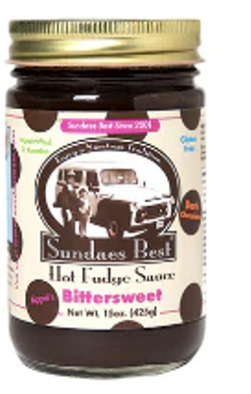
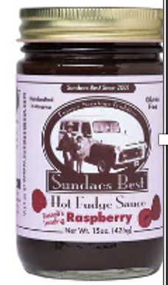
Target Audience for Sundaes Best
35-65+ years old
Upper middle class and upper class
Locals and northeast
Prioritize natural ingredients
Artisanal food buyers

Slide 25
Key Competitors

Slide 26
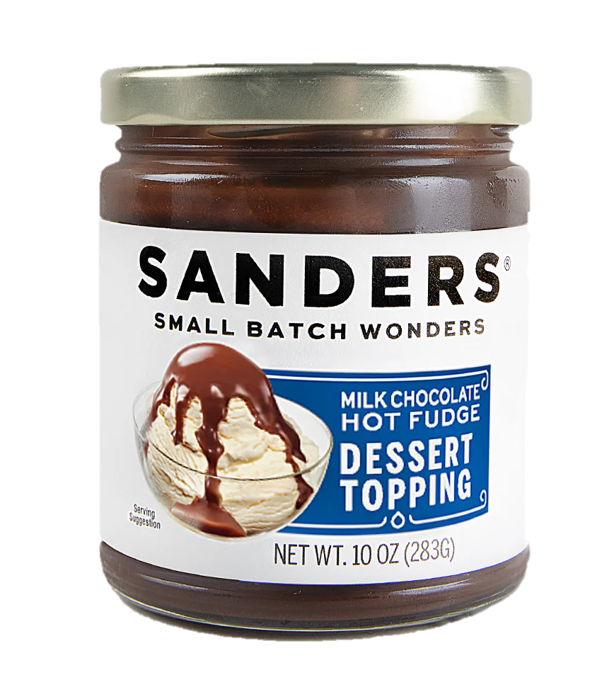
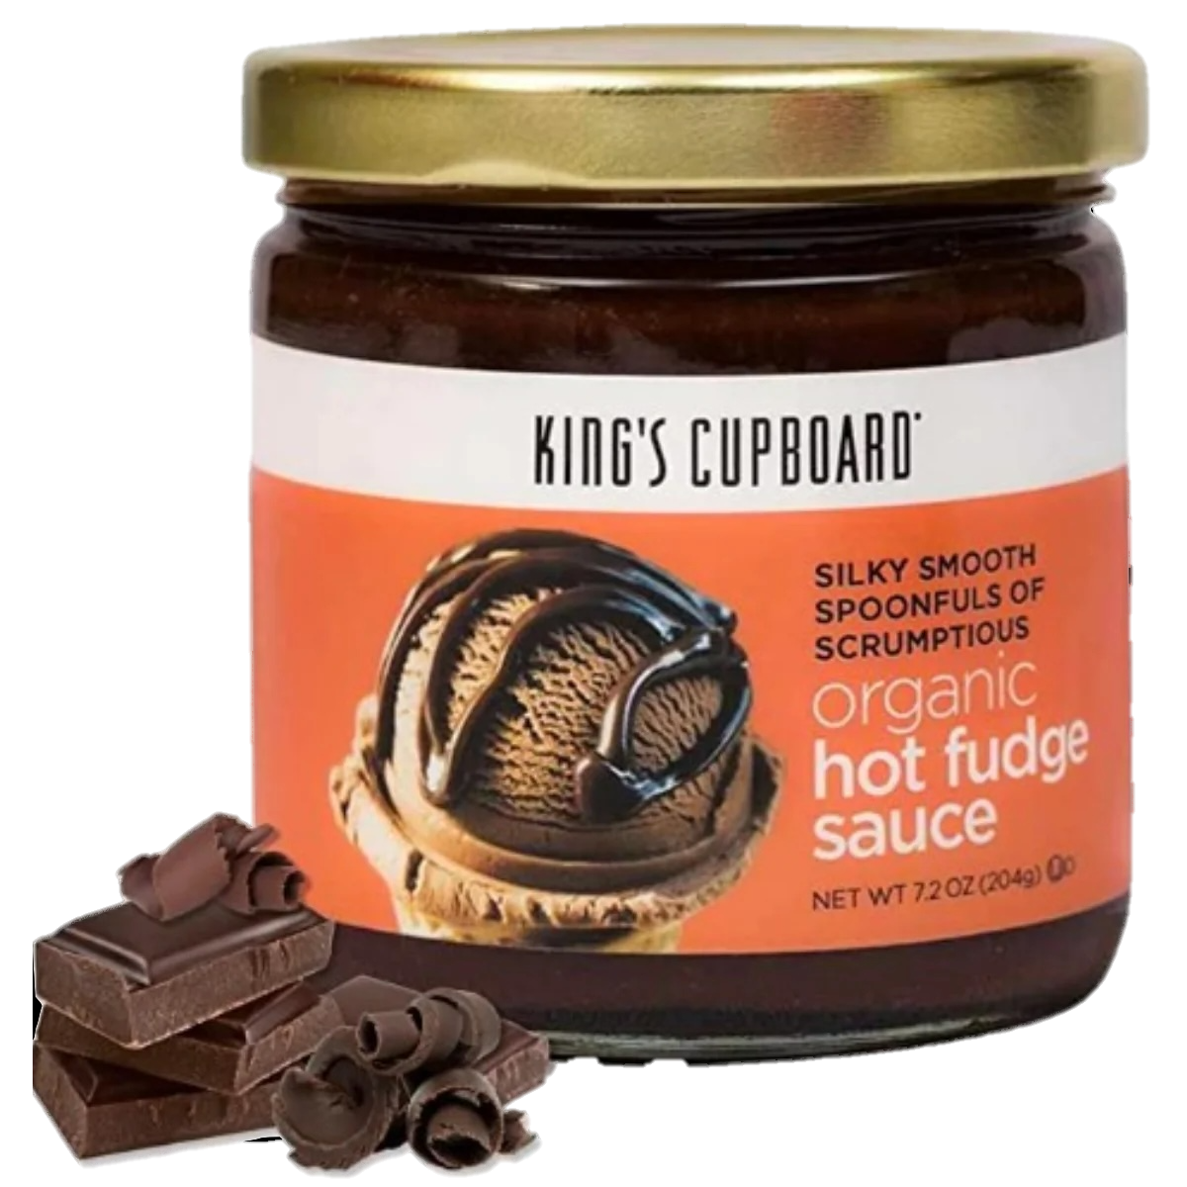
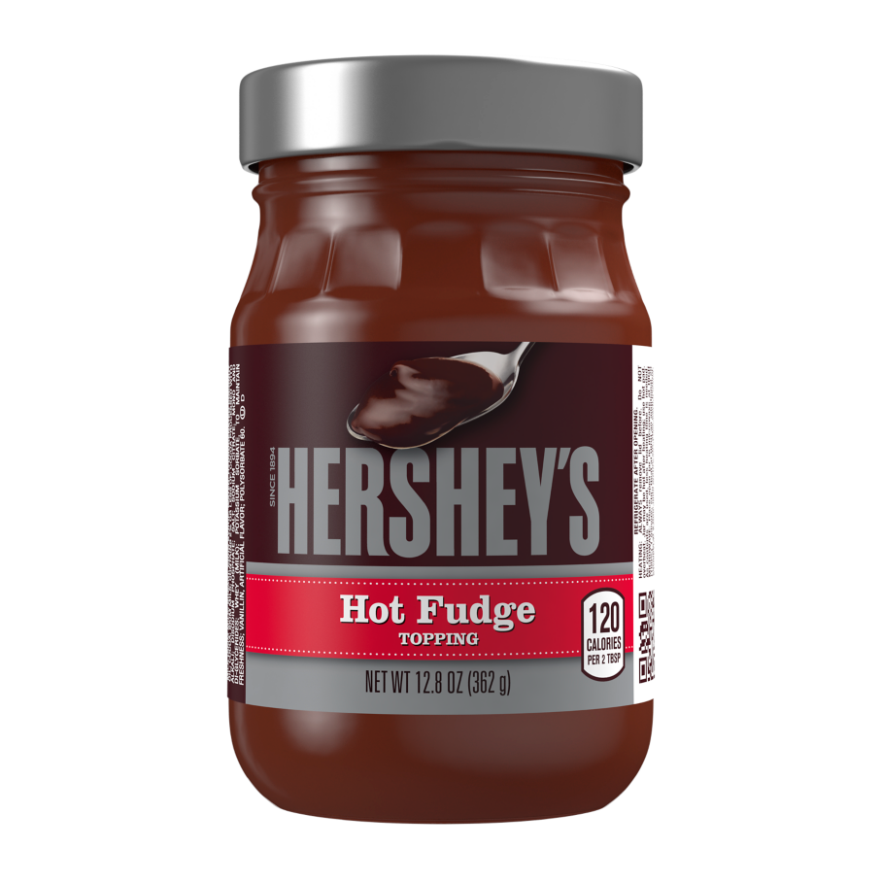
Main Competitors
Sanders
King’s Cupboard
Hershey’s

Slide 27
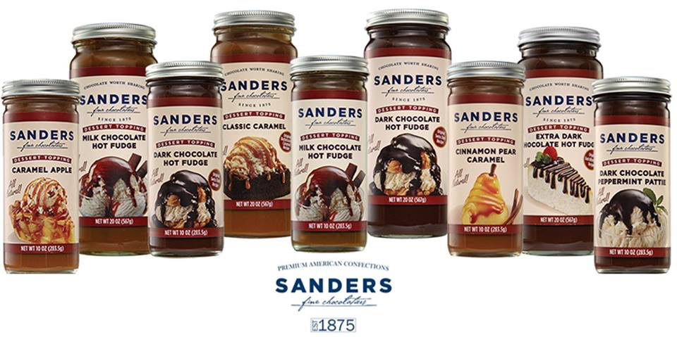
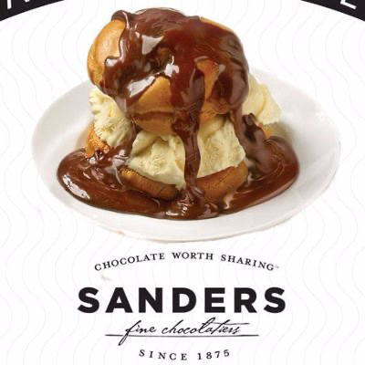
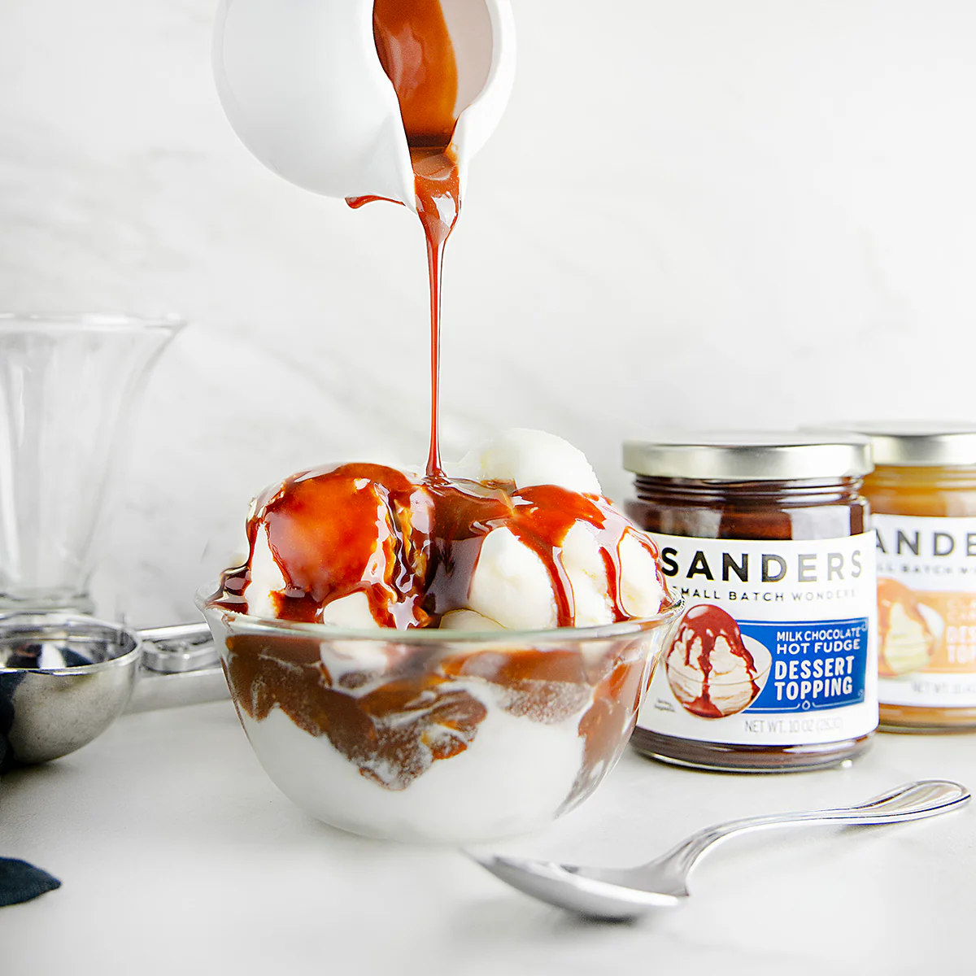
Sanders Overview
Archetype: Caregiver
Core Desire: Service to others
Characterized mainly as comfort, nurturing, and trustworthy
Variety of flavors
Heritage, legacy, and nostalgia
“Prescription: A warm serving of premium small batch Milk Chocolate Hot Fudge toppings for the end of a long day”

Slide 28
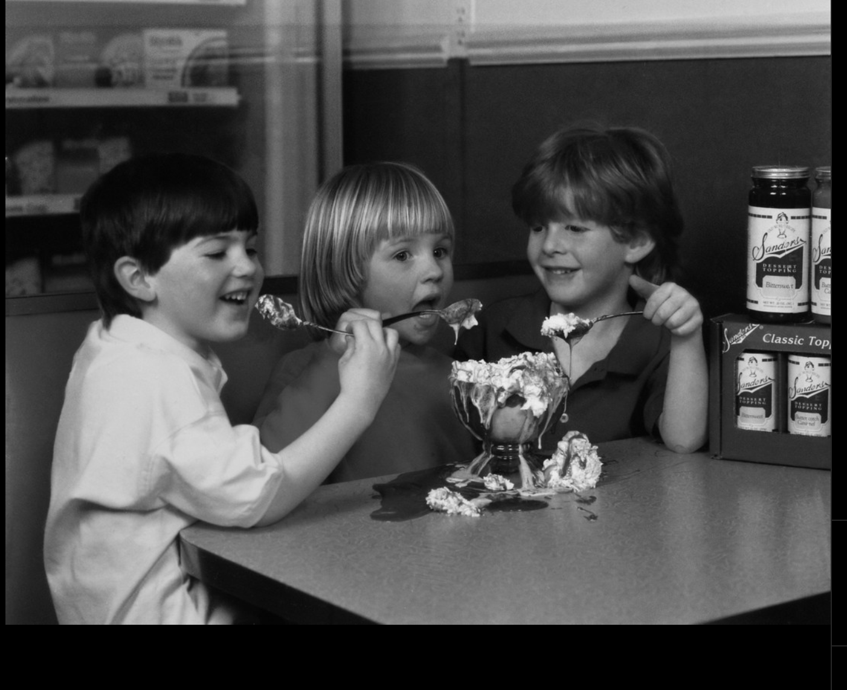
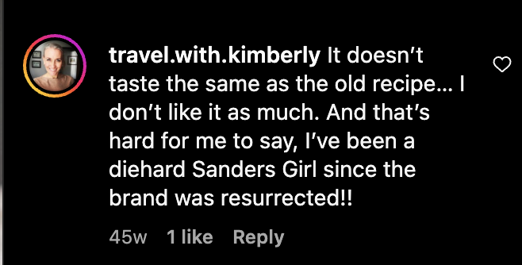
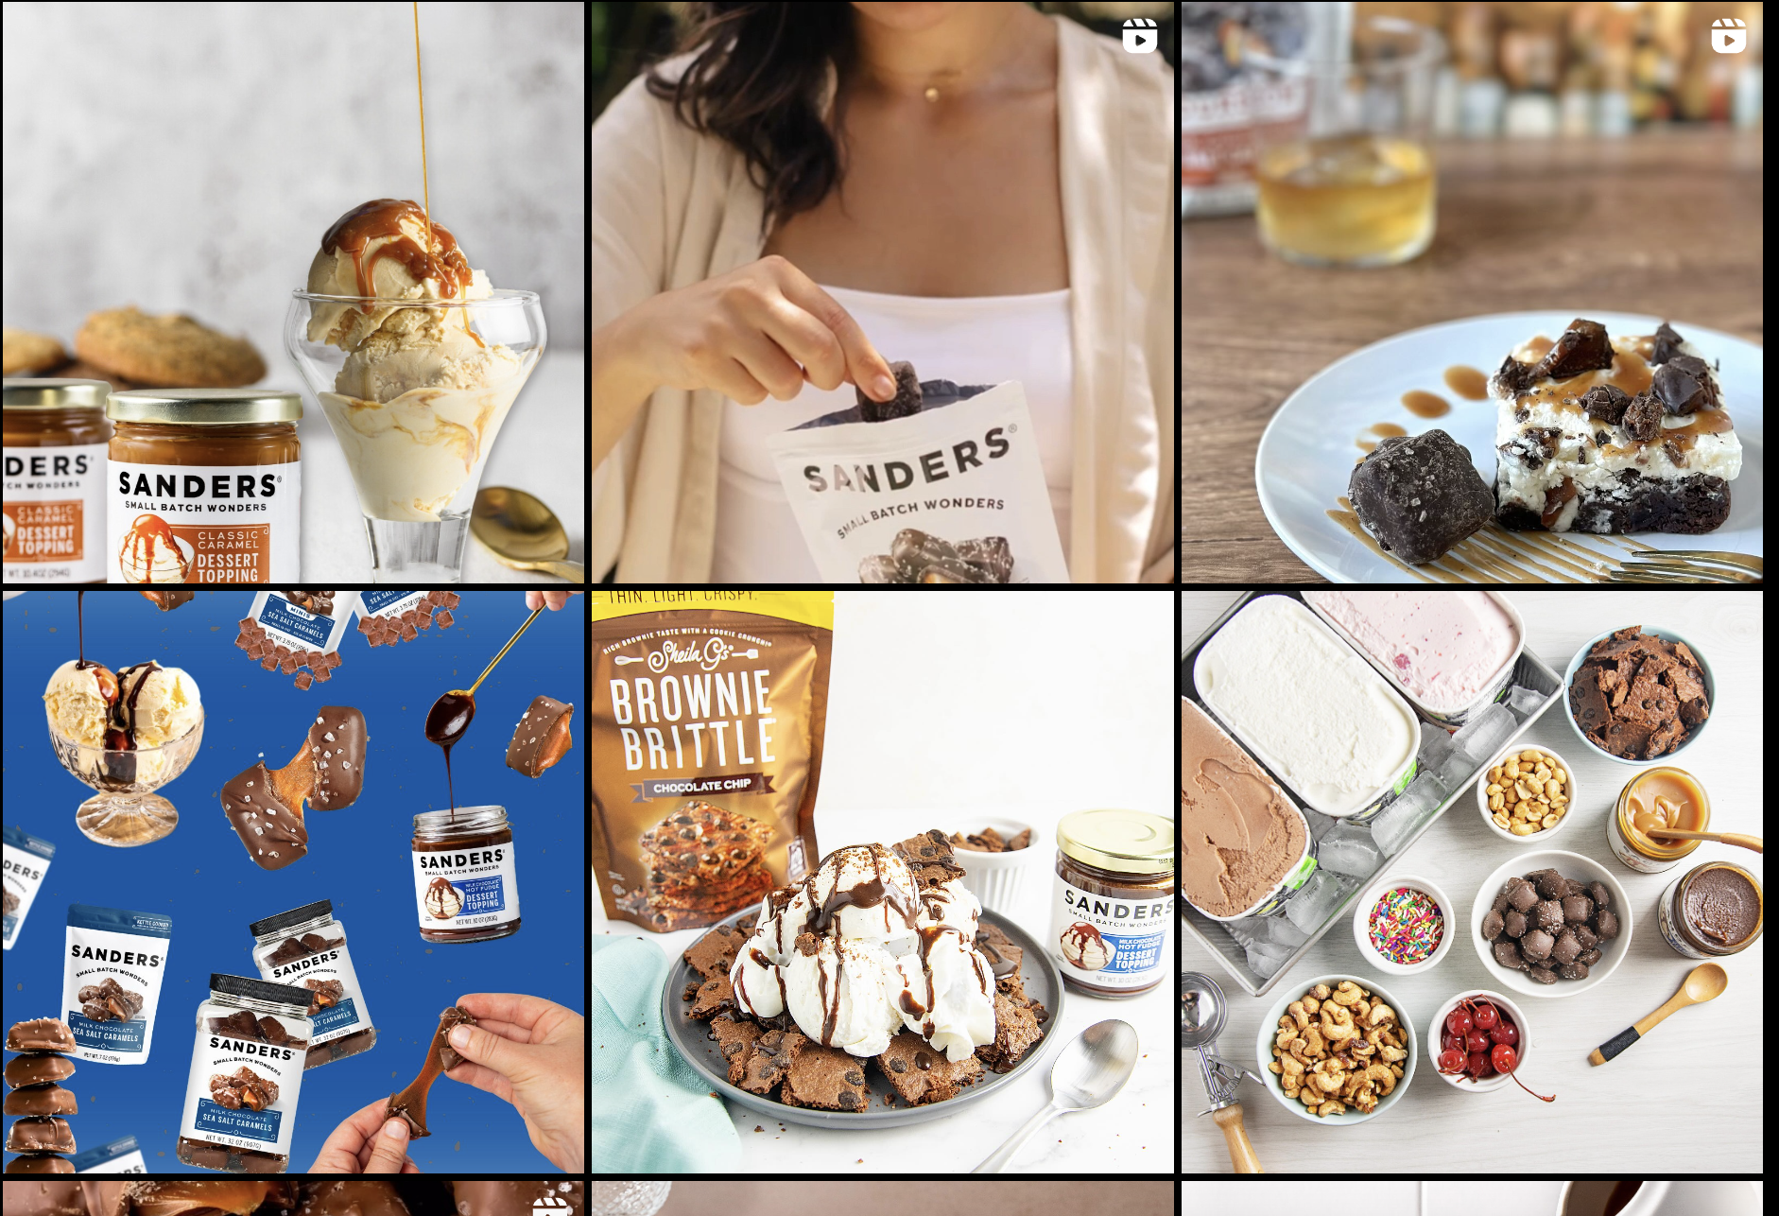
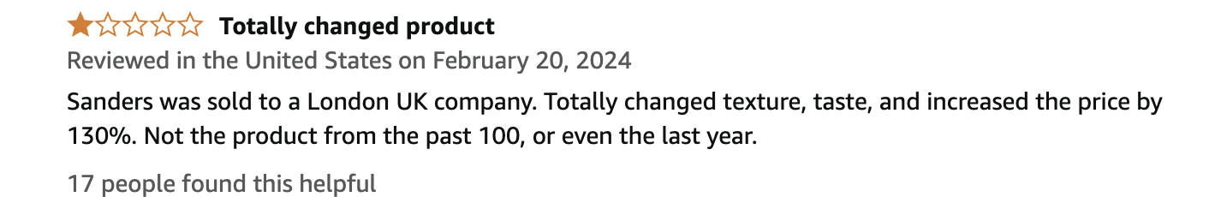

A Closer Look at Sanders
What Happened to Sanders?
Acquired in 2022 by CapVest Limited
In 2022, Sanders paused production of its dessert
Sanders moves to focus on other chocolate goods
In August 2023 Sanders resumes production of its best-selling flavors fudge

Slide 29
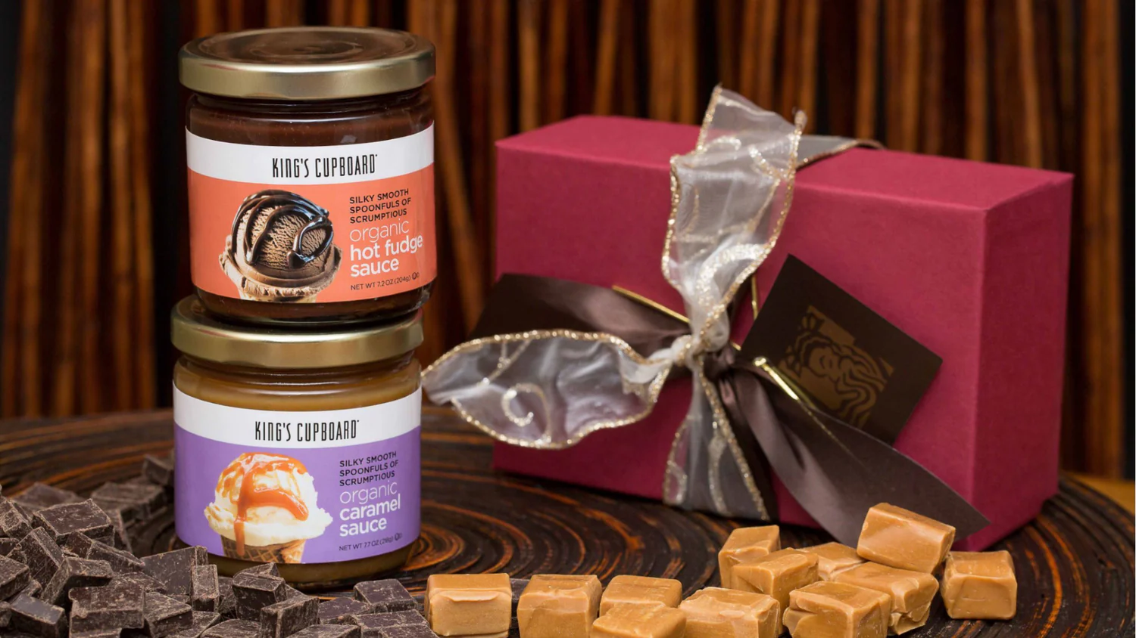
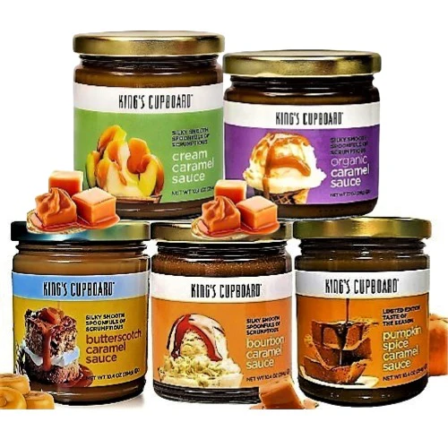
King’s Cupboard Overview
Archetype: Lover
Core Desire: Intimacy
Characterized mainly by Indulgence, elegance, and passion
Organic and natural ingredients
Sensory-driven experience
“Fall in love with the rich and indulgent flavors of our sea salt hot fudge sauce”

Slide 30
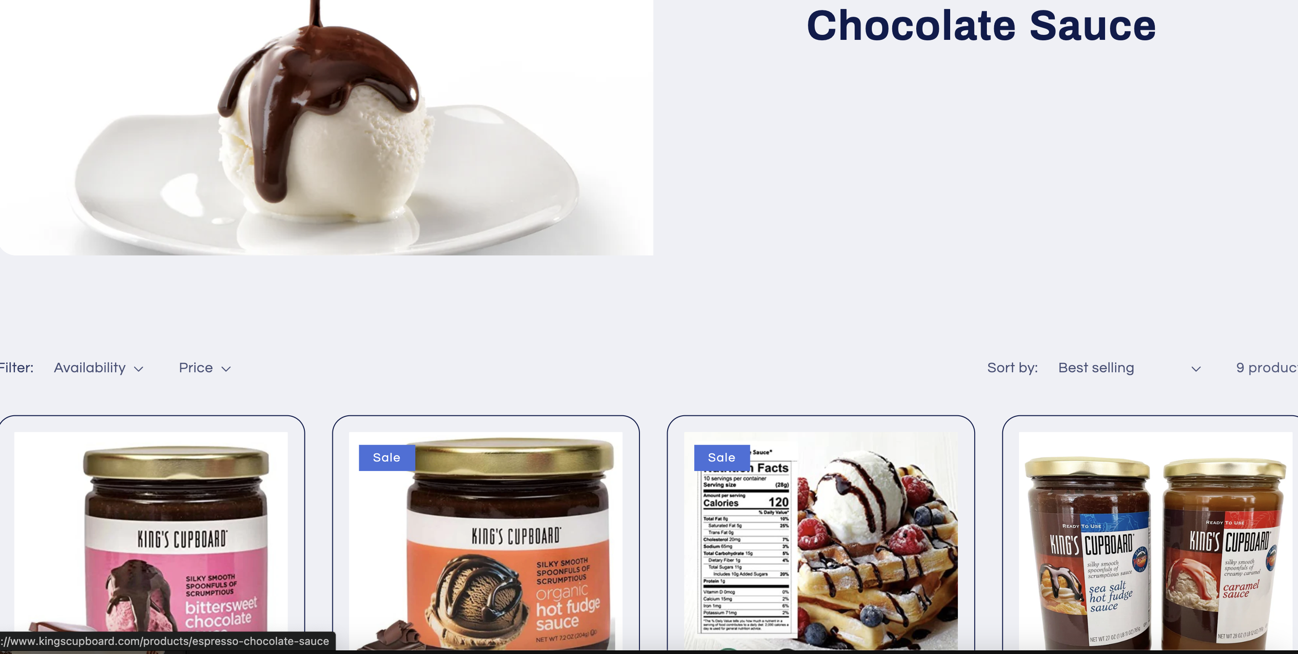
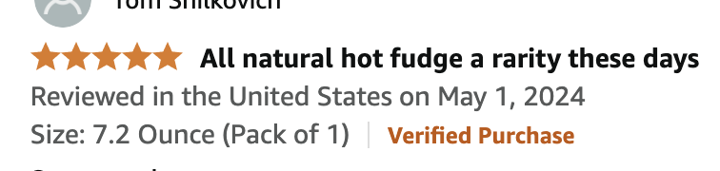
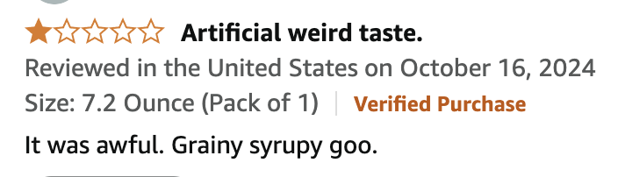
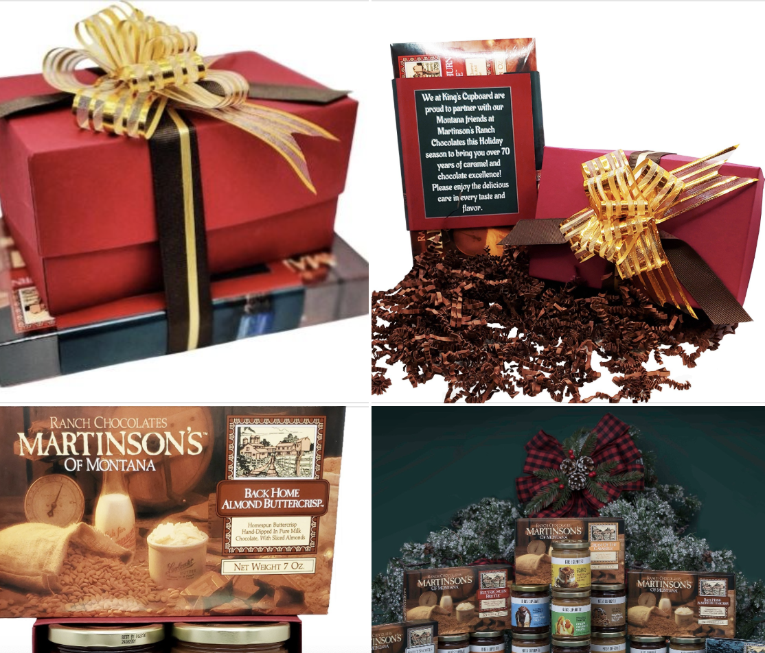
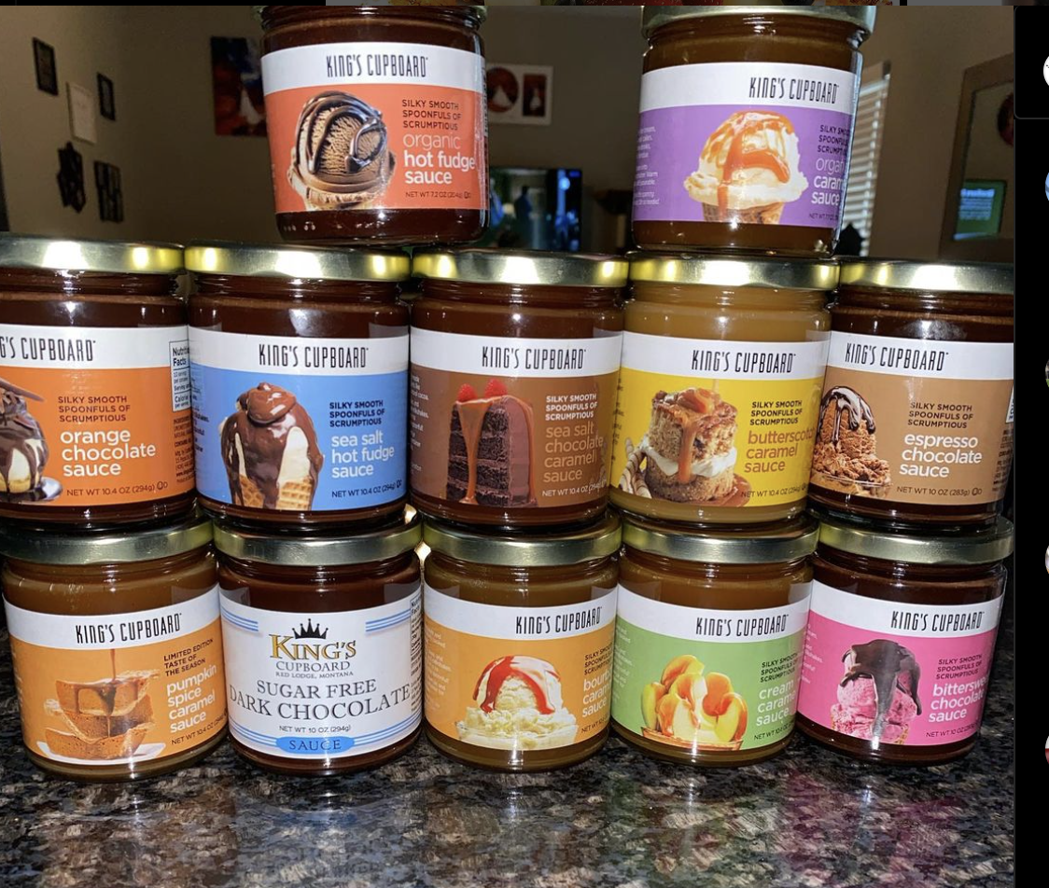
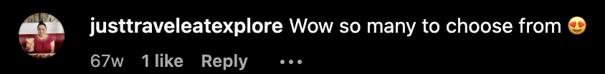
A Closer Look at King’s Cupboard
Gift-Ready, Seasonal Appeal with Varied Customer Feedback
Mixed opinions on flavor and quality
Lots of flavor options
Gift giving and the art of the seasonal
Located in bigger chain stores
Website is focused on business-to-business sales
No strong brand personality or story

Slide 31
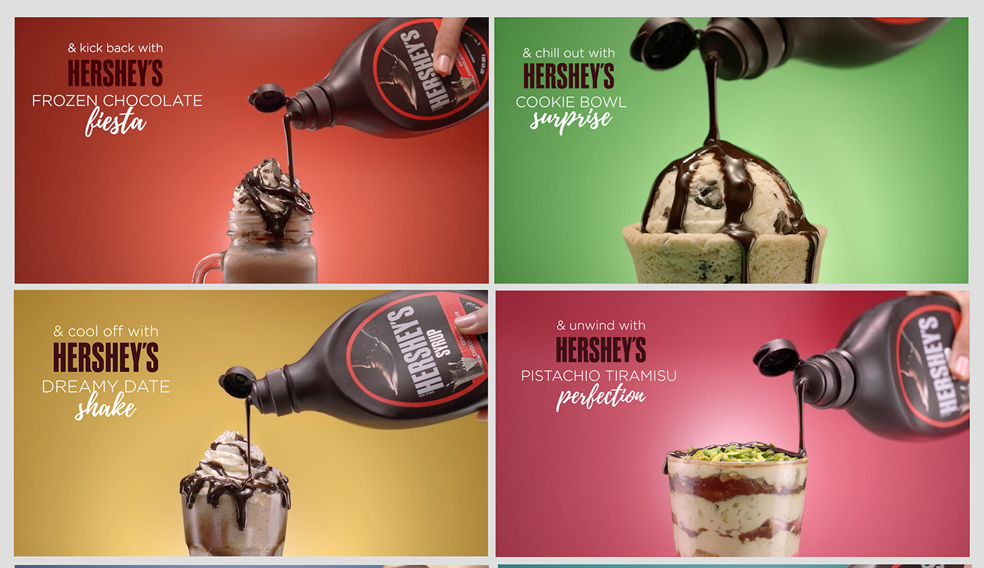
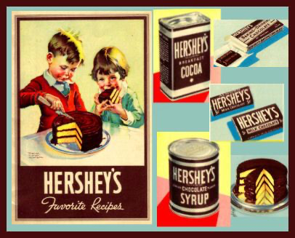
Hershey’s Overview
Archetype: Everyman
Core Desire: Belonging
Characterized mainly by its dependability, friendliness, and inclusivity
History and household name
Broad appeal, easily accessible, and versatile
“Puts a smile on any face” and “everyone is excited when they're reaching for HERSHEY'S milk chocolate”

Slide 32
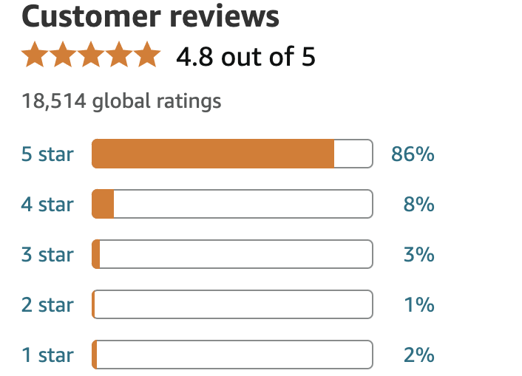
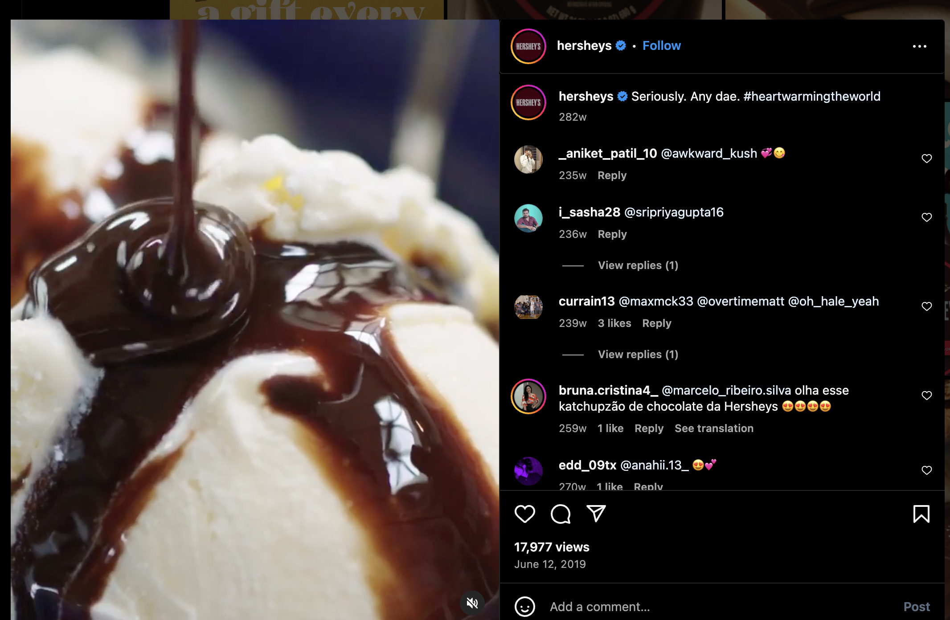
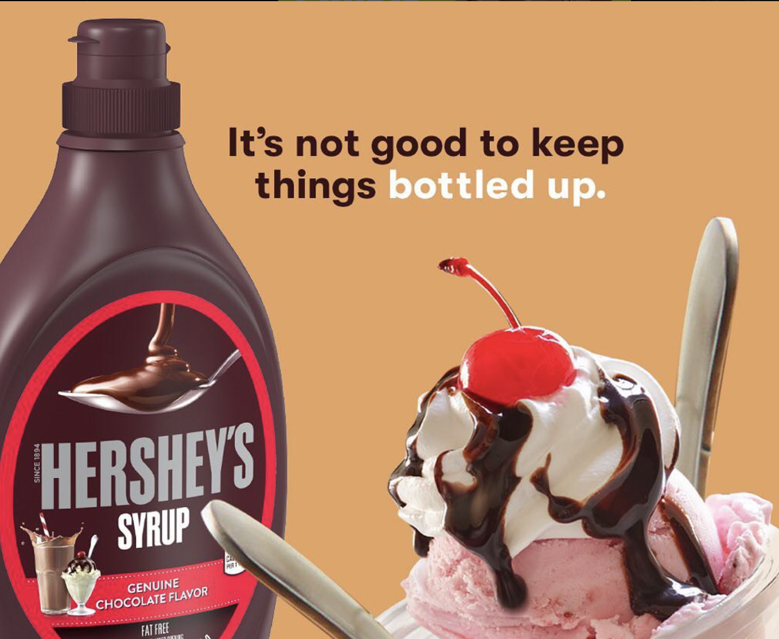
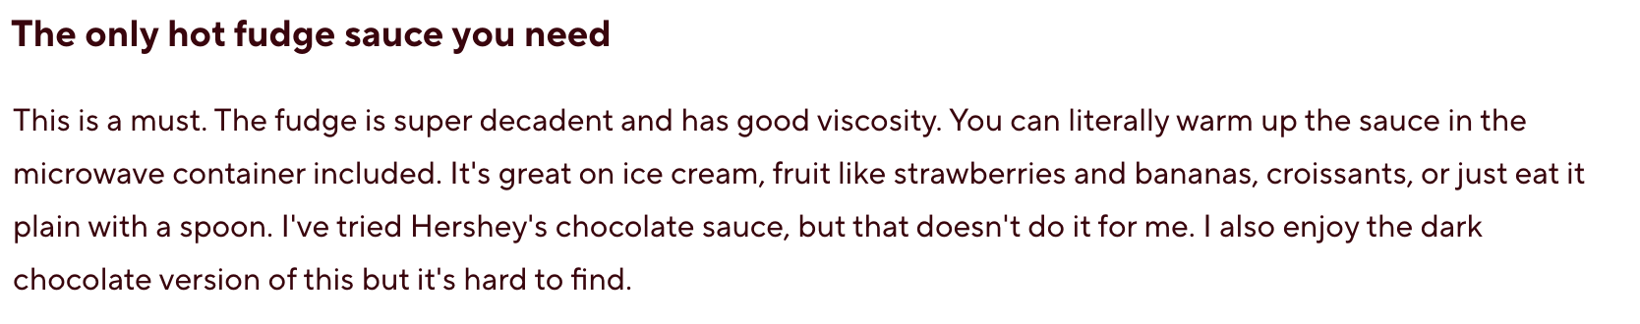
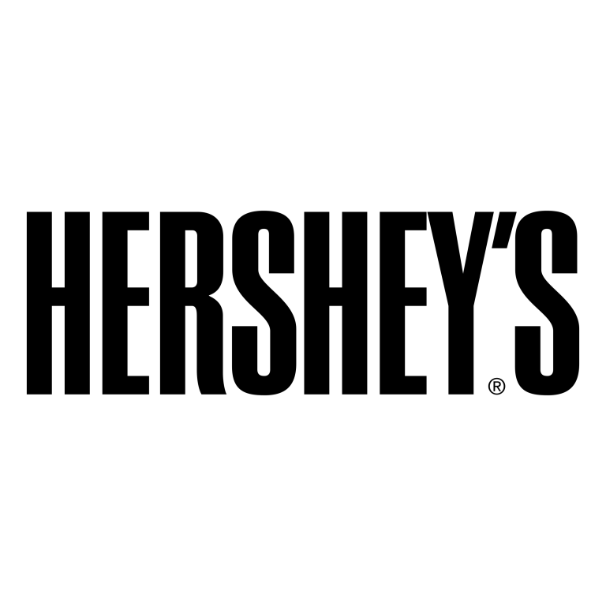
A Closer Look at Hershey’s
Hershey’s Dominance Through Brand Loyalty and Accessibility
56 % of chocolate and candy bar eaters in the United States eat Hershey’s
Brand awareness of Hershey's is at 94 %in the United States
Well liked and loyal customer base
Easily accessible
Source: https://www.statista.com/f orecasts/1352565/hershey-s-chocolate-brand-profile-in-the-united-states

Slide 33
Recap
Caregiver
Nostalgic
Classic
Attitude shift
Lover
Indulgence
Organic
Weak brand story
Everyman
Accessible
Reliable
Low quality

Slide 34
Strategies

Slide 35
Positioning 1:
Nostalgia

Slide 36
Key Message
Caregiver: Sundaes Best brings back the simple joy of a classic treat, crafted the way you remember. In every jar, you’re invited to relive the sweet moments of childhood with quality ingredients and a recipe made with care.

Slide 37
Rationale for Key Message
Sundaes Best is the only Hot fudge that offers its consumers high quality ingredients, sourced locally and mixed together by hand to create a nostalgic and classic dessert

Slide 38
Tagline
"Sundaes Best: Because Some Treats Are Timeless"

Slide 39
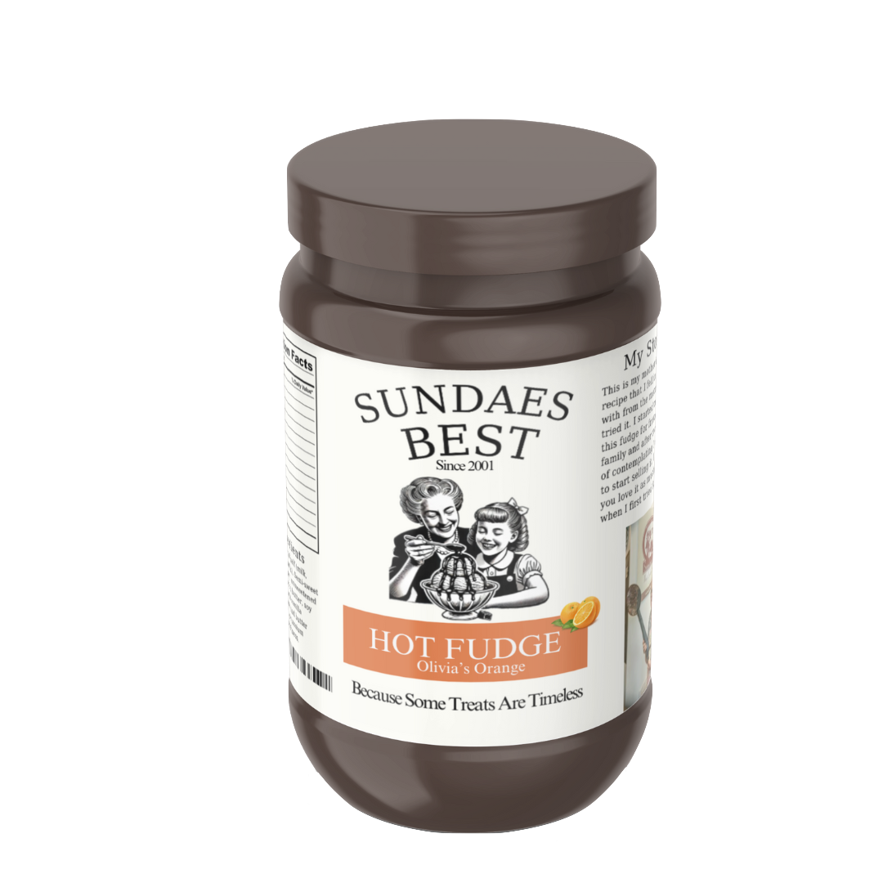
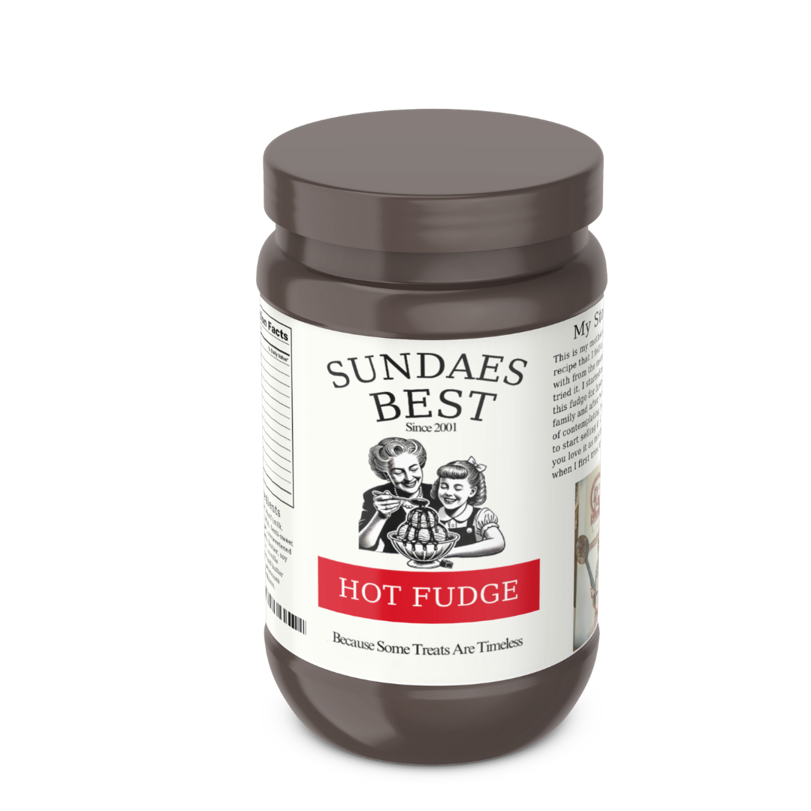

Creative

Slide 40




Creative
Fudge Throughout the Years
Scrolling post
Eating hot fudge in the past and eating it today
Sundaesbest_hotfudge
Sundaesbest_hotfudge
Sundaes Best: Because Some Treats Are Timeless
Sundaes Best: Because Some Treats Are Timeless

Slide 41



Creative
Hot Fudge Memory Campaign
Instagram story reposts
User generated content
People share their favorite hot fudge memories
Connecting fudge and nostalgia

Slide 42
Positioning 2:
Indulgence

Slide 43
Key Message
Lover: Sundaes Best is crafted for those who believe every dessert should be special. Indulge in a flavor-filled family recipe with a rich and creamy taste in every jar.

Slide 44
Rationale for Key Message
Sundaes Best is a luxurious and indulgent hot fudge made from a family recipe using high quality ingredients, making it the best-tasting hot fudge
Source: https://pubmed.ncbi.nlm.nih.gov/30599974/

Slide 45
Tagline
“Taste the Difference, Savor the Best”

Slide 46



Creative

Slide 47

Creative
Sundaesbest_hotfudge
Sundaes Best: Indulge in Sundaes Best rich and delicious hot fudge!

Slide 48

Creative
Sundaesbest_hotfudge
Sundaes Best: Taste the Difference, Savor the Best!

Slide 49
03.
Conclusion

Slide 50
Conclusion
Challenge: Craft a brand position that emphasizes Sundaes Best’s quality ingredients and its unique recipe creating an amazing taste
Competition: Sundaes Best’s main competitors have strong positionings as products with fun or unique flavors and products with organic ingredients
Sundae's Best Company Positioning:
  Nostalgia: Sundaes Best rekindles the joy of a classic treat, inviting you to relive sweet childhood moments with quality ingredients and care
  Indulgence: Sundaes Best is for those who want to indulge, offering a rich, creamy family recipe in every jar
Tying It All Together: Sundaes Best is best tasting hot fudge that provides high quality ingredients and a unique recipe creating a homemade nostalgic feel

Slide 51
Thank You

Slide 52



Operation - Logo Survey
#1
#3
#2

Slide 53

Operation - Logo Survey
#1
#3
#2
Not able to see more than 25 responses with free version of SurveyMonkey

Slide 54


Slide 55





Slide 56





